Slide 1
Vision Zero 2021: The Path Forward to Safe Streets
DDOT Vision Zero Team: Linda Bailey Charlie Willson Christine Mayeur

Slide 2
AGENDA
DM Remarks
Overview
Areas Fatalities Occurring
DDOT Approach to Vision Zero
DDOT Safety Work Budget
DDOT Work on High Injury Corridors – Highlights
Areas DDOT can Accelerate High Injury Corridor Work
How Residents See Safety Issues
Perceived Safety Issues/TSIs
TSI Resources Needed
Automated Traffic Enforcement Program
DDOT Safe Routes to School Program
Safety Communications Campaign

Slide 3
High Level Overview: DDOT has large safety program; progress will come from strong political support on High-Injury Corridors
Under Vision Zero, street design identified as key to improving traffic safety
DDOT safety program footprint over $20 million annually for past two years
DC is leader among peer cities in terms of improving safety and access, as standard practice
High-injury corridors are where we are focusing to stop the NEXT fatality and serious injury
Responding to resident concerns typically on neighborhood streets is critical to improving PERCEPTION of safety
Vision Zero Division leads post-fatal crash site visits showing responsiveness to public
Vision Zero initiative and all DDOT’s safety work recently reorganized to:
Focus all safety capital work under the Office of Chief Project Delivery Officer
Redirect additional staff to handle resident safety requests, aka Traffic Safety Investigations (TSIs)
Ensure safety is key part of every capital project in District
Crash rate for DC is below national average at 5 fatalities per 100,000 – compared to recent rates of 11-12 fatalities per 100,000 in U.S. overall….goal is 0 fatalities per 100,000
Other agencies participating in Vision Zero, generally through enforcement and education
Education efforts are significant and ongoing, including $2,000,000 per year between DDOT, MPD, and regional partners – messages focus on speed, pedestrian safety, driving under influence, child passenger seats
The Lab @ DC, DDOT, and DMV are working to identify and hone outreach tools to high-risk drivers, identified through ATE program

Slide 4
Areas Fatalities Occurring
High-Injury Corridors main area of concern
Over 50% of all traffic fatalities in last 3 years
Over 20% of all traffic injuries in last 3 years
How does DC stack up on our existing street safety?
DC has averaged 5 fatalities per 100,000 population over the last several years
US averaged 11 fatalities per 100,000 population in 2019
DDOT is leader on safety treatments compared to other cities (pedestrian safety at signals, bike lanes, etc)
Crash patterns for fatalities concentrated in Wards 5, 7, and 8, but somewhat randomly distributed. Data trends seen over multiple years on specific streets.
All DDOT work contributes to culture of traffic safety
Neighborhood traffic calming and TSIs contribute to perception of safety and DDOT responsiveness, but is not where data shows most fatalities and serious injuries occur
To have highest impact, focus on streets and neighborhoods continuously seeing highest fatal and serious injury crash rates

Slide 5
DDOT Approach on Vision Zero
CONTINUE GOOD WORK ON NHTSA CAMPAIGNS:
Design – High-visibility crosswalks, Leading Pedestrian Intervals, capital program, signals program, Traffic Safety Investigations
Education – DUI, Speed, Aggressive Driving, Car Seat program
Enforcement – DUI, Speed, Pedestrian safety
RAMP UP BETTER DESIGN:
Design for non-vehicle modes
Design assuming human error
EXPAND AUTOMATED ENFORCEMENT
New cameras in progress
WORK WITH COMMUNITY:
Equity component to prioritize safety
Effective safety interventions enhance sense of safety
Do advance work with community to ensure understanding and embracement of changes to streets
Limit ANC community engagement to ensure traffic safety improvements timely implemented

Slide 6
DDOT Safety Work Budget
Dedicated safety work encompasses
Safe Routes to School program
Support for TSI program
Support for high-injury intersections under FHWA’s Highway Safety Improvement Program
Major safety projects
Ongoing NHTSA behavioral work $3.8M
FY22 Budget Recommendations
DDOT developing quarterly Vision Zero Initiative, like Vision Zero Summer Initiative
Will address low hanging fruit requests (i.e., speed humps/bumps, signage, crosswalks, etc)
FY23 budget still in development

Slide 7
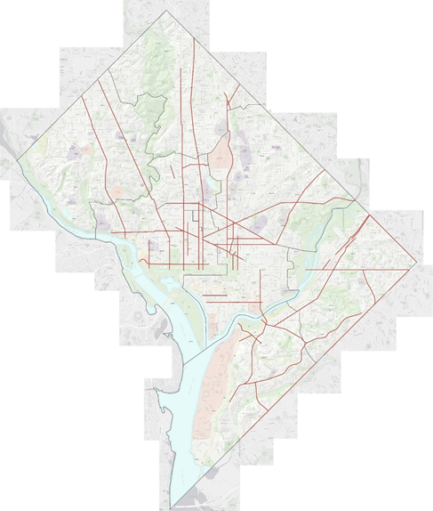
DDOT Work on High Injury Corridors - Highlights
Recent examples – High Injury Corridor Work
Martin Luther King, Jr Avenue SE – major corridor upgrade for safety
Florida Avenue NE
11th Street SE
14th St NW
Alabama Avenue SE
Connecticut Avenue NW
East Capitol Street Pedestrian Safety Project
Florida Ave/U St NW
K St NE Road Diet
Planned Projects
Connecticut Avenue
Wheeler Road
Southern Avenue
Alabama Avenue
Martin Luther King Jr Blvd (Transit priority)
M St SW/SE (Capitol Riverfront BID)

Slide 8
Areas DDOT is accelerating High Injury Corridor Work
Accelerating existing projects and focusing on high injury network
Prioritize projects in Ward 5, 7, and 8
Wheeler Road
Southern Avenue
Alabama Avenue
Martin Luther King Jr Ave SE
Prioritizing other corridors for design and actions
Developing five-year prioritized list of HIN street projects
Where possible, moving up initiated projects in future fiscal years

Slide 9
How residents see safety issues
Traffic Safety Investigations (TSIs) are main mechanism through which DDOT takes safety concerns
DDOT receives approximately 1,400 TSIs per year
Program community engagement being restructured to improve delivery times and safety interventions
1. Discontinue revisions to projects after completion of required community engagement processes in accordance with DC Law or Rulemaking;
2. Reduce comment period for safety related improvements;
3. Only issue NOIs as required by "Administrative Procedure Amendment Act of 2000" DC LAW 13-249 (48 DCR 3491 April 20, 2001) to modify traffic and/or parking requirements (e.g., new traffic control devices such as traffic signals/all-way stop control, changes to one-way restrictions, removal of parking spaces); and
4. Eliminate requirement of supporting documents from ANC and community for traffic safety investigation requests.

Slide 10
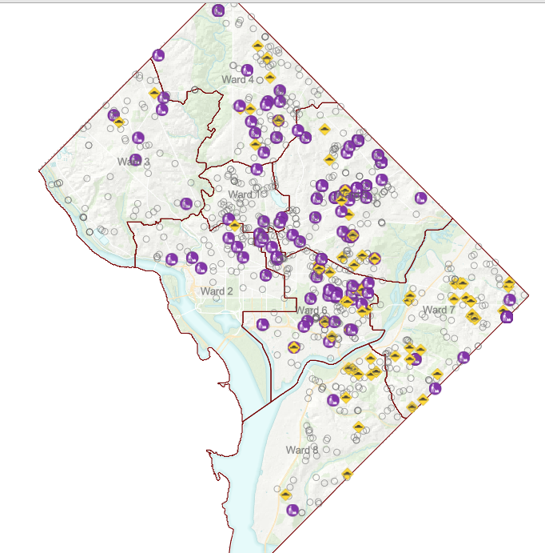
Perceived Safety Issues/TSIs– Great Progress in 2021
Traffic Safety Investigations (TSIs)
Backlog of 800 TSIs cleared through summer 2021 effort at DDOT
Ongoing work to address incoming TSI requests promptly and effectively
Local, neighborhood streets tend to be low-crash, so DDOT relies on neighborhood reporting to identify sites
Other ways safety issues on neighborhood streets come to DDOT attention:
Safe Routes to School program
Neighborhood planning studies
Councilmember requests
ANC requests
Closed TSI Requests as of 10/8/21

Slide 11
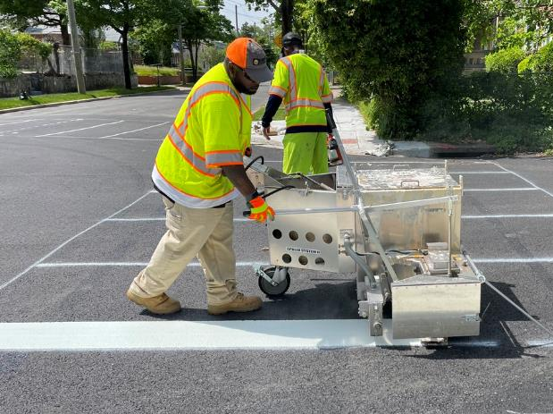
TSI Resources Needed
Additional support needed in near term for Traffic Safety Investigation program (TSIs)
FY22
TSI program needs dedicated funding to ensure other programs not affected or delayed
$3M specifically allocated to TSI program
FY23
Continue funding of dedicated TSI program budget
Request for $5M in TSI budget in FY23
Covers data collection, traffic studies, design, and construction of traffic safety improvements
Add three (3) FTEs to support program

Slide 12
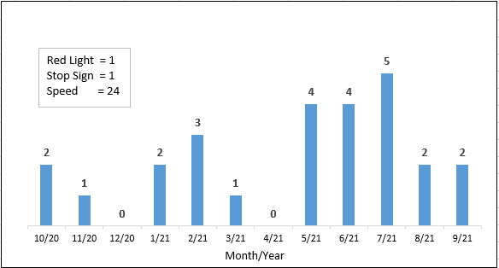
Automated Traffic Enforcement Program
Leading ATE program in country, issued record 1.47 million citations in FY21
MPD/DDOT research shows automated speed enforcement reduces injury crashes by 30 percent
RFP for updated equipment scheduled release in late Fall, award projected for March 2022
Move to DDOT supporting additional, data-driven sites
45 sites assessed
26 new speed enforcement sites deployed in FY21
Number of Cameras Rotated (26)

Slide 13
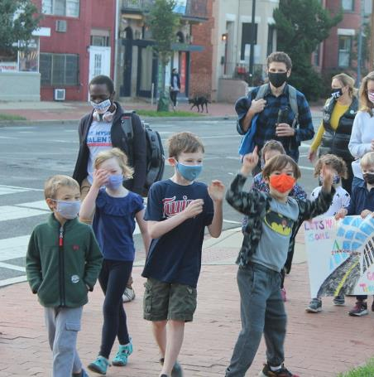
DDOT Safe Routes to School Program
Proactive, District-wide effort to plan for safe routes near schools
36 schools with safety plans in 2020-2021
Responsive school-based safety analysis and intervention
Based on school requests, Safe Routes program works with school on pick-up and drop-off and other safety issues near schools
Safe Routes program not held up by notice requirements
Notice requirements do not apply to Safe Routes to Schools program in same degree

Slide 14
Safety Communications Campaigns
DDOT and MPD manage $1 million, annual safety communications campaign supported by NHTSA
Focuses in 2022:
Driving Under the Influence (DUI)
Speeding
Aggressive Driving
Click it or Ticket
Child Passenger Seat safety
Distracted driving (texting)
DDOT has safety awareness campaign
20 is plenty/”Slow Down” yard signs – 1000s of signs distributed
Outreach at community events – dozens of events in summer 2021
Social media images, GIFs, and videos highlighting safety projects around District
The Lab @ DC testing outreach to high-risk drivers with DDOT and DMV in 2022 – first of its kind project in the US

Slide 15
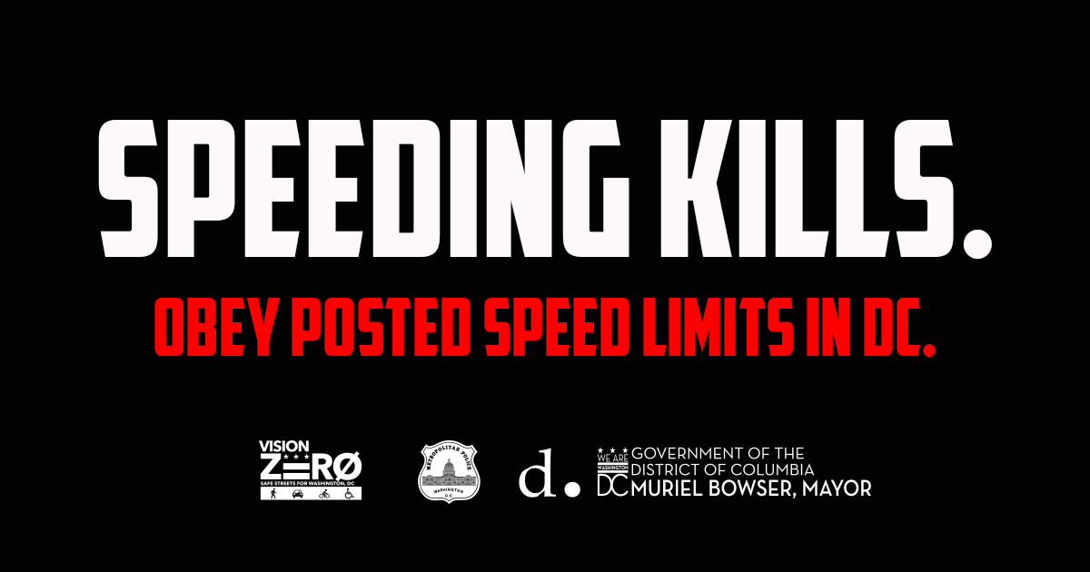
Speed Campaign

Slide 16
Impaired Driving Holiday Campaign

Slide 17
Click It or Ticket Campaign

Slide 18
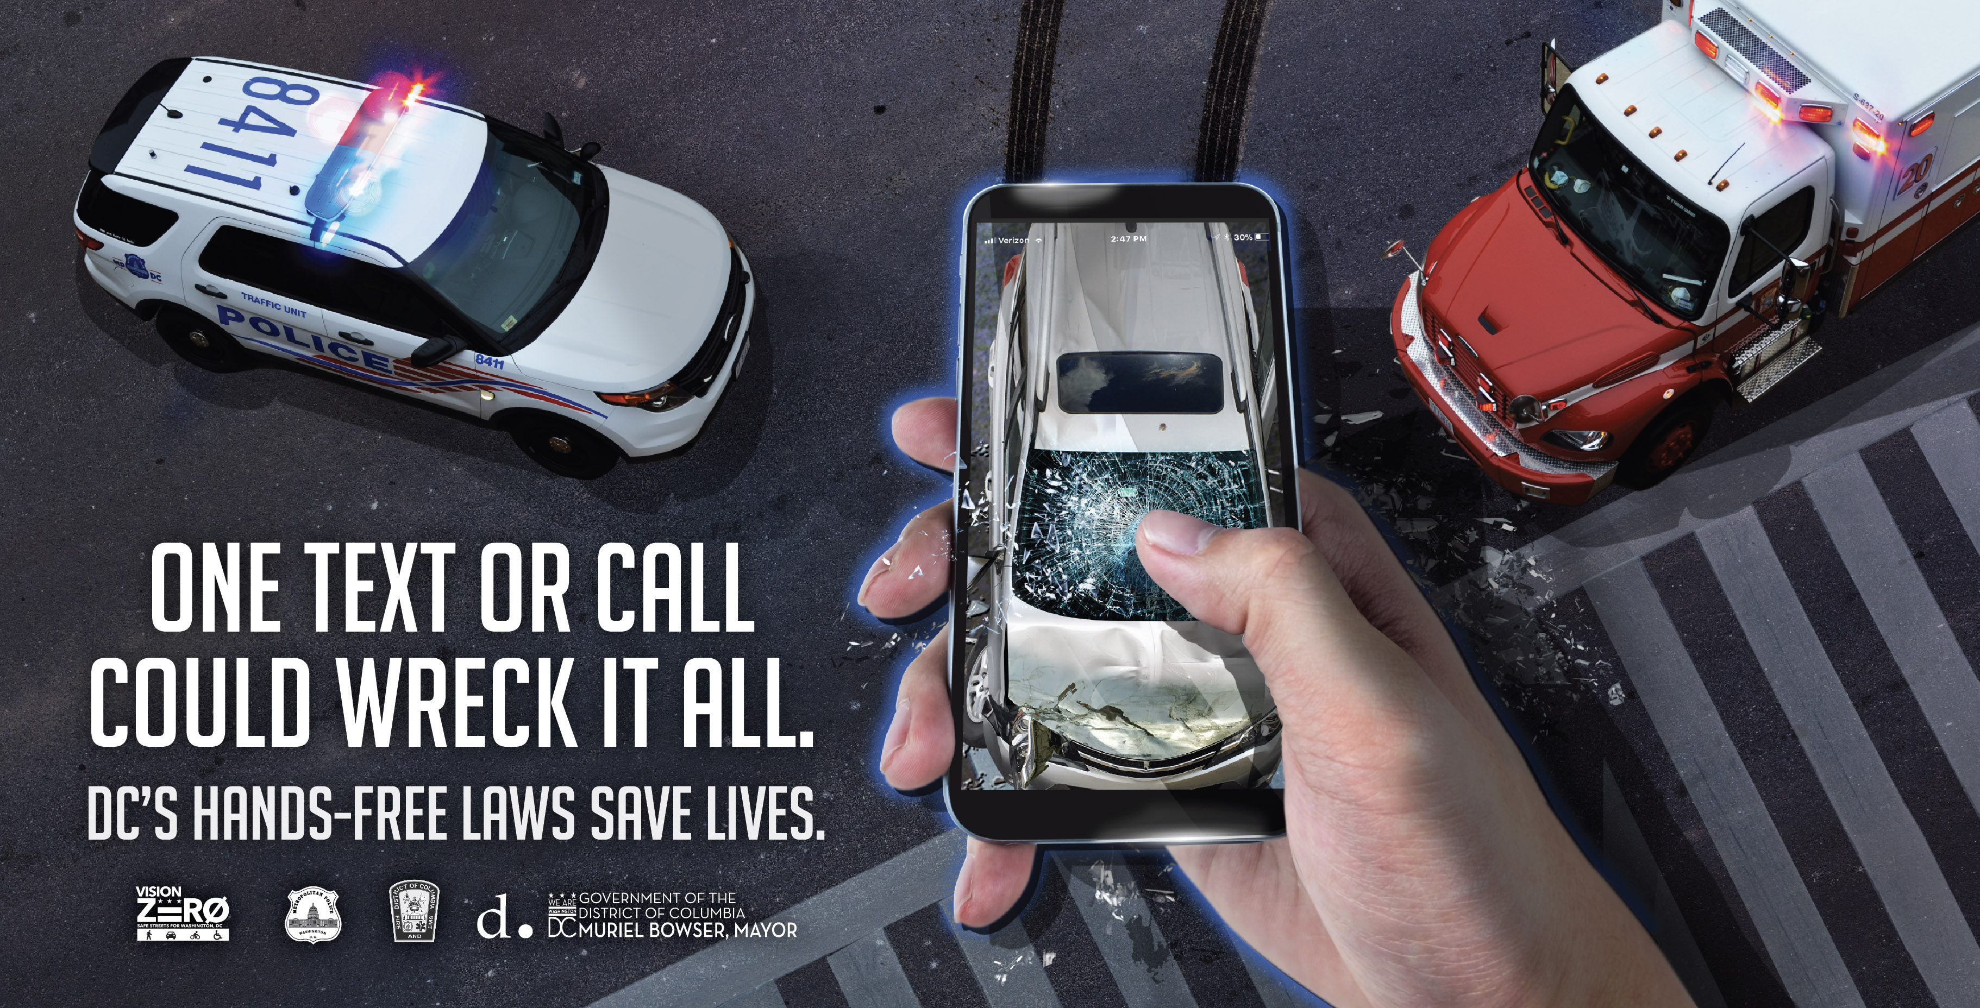
Distracted Driving Campaign

