Slide 1
Vision Zero 2021: Communicating Our Commitment
DDOT Vision Zero Team: Linda Bailey Charlie Willson Christine Mayeur

Slide 2
Changing the Narrative on Vision Zero
Talk about the awesome projects DDOT is already doing at high priority locations
Link the treatments back to how it improves safety
Reach out to staff if you want more specifics
Don’t tag Vision Zero on everything
Only high priority street and intersection projects, not neighborhood traffic calming (most TSIs)
Be responsive after injury and fatal crashes
Respond with empathy
Note where criminal investigations may be ongoing with MPD
Talk about the process DDOT uses to review crashes (especially fatal ones)
Ask the person to DM if they’d like to stay connected on improvements
Set the record straight where we can
Lots of content available on DDOT webpages on various topics, especially councilmember and the public’s FAQs
Respond with facts
Leave personal biases at the door

Slide 3
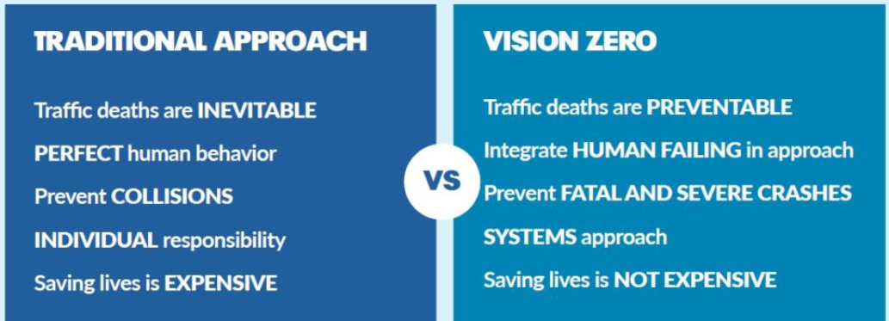
What is Vision Zero
Goal to eliminate traffic deaths and serious injuries on City Streets with urgency (by 2024)
Evaluation (Data), Engineering, Education, Equity, Encouragement (legislation) and Enforcement
Sweden in 1990’s was first, global movement now, nearly all major city has adopted Vision Zero Policy
No municipality has achieved it in the US.

Slide 4
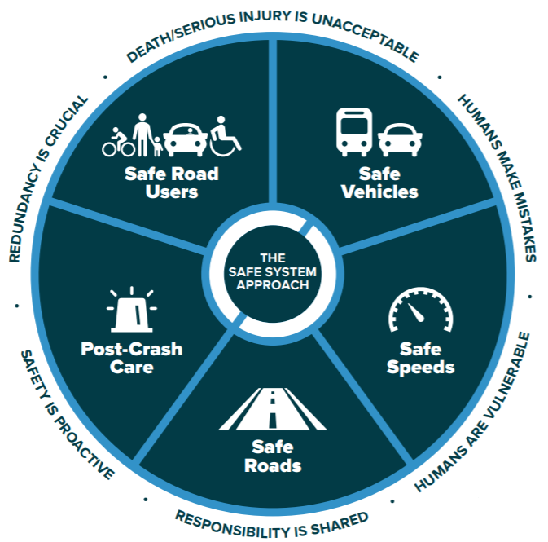
What does Vision Zero mean?
All efforts are put toward zero deaths every single year
We work toward zero aggressively, doing more than the US standard
We collect data, engineer our streets and intersections, set policies and laws, educate, and enforce based on the safe systems principles
We focus on areas that have seen historic disinvestment and continually see the highest rates of injury and fatality crashes
We use a Safe Systems approach
USDOT announced refocusing on this approach last week

Slide 5
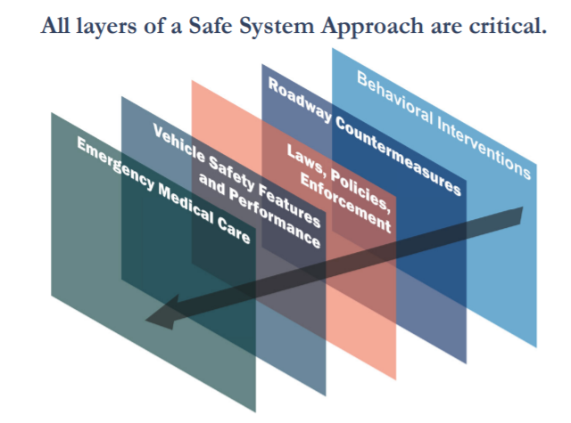
Safe Systems Core Principles
Death and Serious Injuries are Unacceptable.
No crashes are desirable
Prioritize the elimination of crashes that result in death and serious injuries
Humans Make Mistakes.
People make mistakes that can lead or contribute to crashes
System can be designed and operated to accommodate human mistakes to avoid death and serious injuries
Humans Are Vulnerable.
People have physical limits for tolerating crash forces before death or serious injury occurs; therefore, it is
Design and operate a transportation system that is human-centric and accommodates physical human vulnerabilities.

Slide 6
Safe Systems Core Principles
Responsibility is Shared.
All stakeholders – including government at all levels, […]– are vital to preventing fatalities and serious injuries.
Safety is Proactive.
Use proactive tools to identify and address safety issues
Rather than reacting after a crash
Redundancy is Crucial.
All parts of the transportation system should be strengthened (education, engineering, etc.)
If one part fails, the other parts still protect people.

Slide 7
Other Key Vision Zero Messaging
Speed is recognized to be one of the most fundamental factors in crash severity
The faster someone is traveling at the time of a crash, the more severe the outcomes
Streets should be self-enforcing
Re-engineering roads to slow down vehicles rather than relying on enforcement
Utilize speed safety cameras as a proven safety countermeasure.
Saving lives is not expensive
Saving lives costs money and staff time but does not have to wait for concrete and steel.
Striping, signal changes, and temporary vertical elements can produce the same or similar safety outcomes sooner than longer-term projects

Slide 8
What about bad behavior?
Yes, because crashes involve humans and humans make mistakes, behavior is a factor in every crash BUT
Rarely is behavior THE ONLY reason a crash occurred
There are other underlying, systemic forces at play behind individual behavior
Some things DDOT does not control – (ex: homelessness, drug use, police chases, poverty, etc.)
The laws of physics (street design) are more powerful than laws of humans (regulations, signs, ordinances)
DDOT has the power to create an environment that makes people slow down, reduces conflicts and exposure, as well as separates and protects vulnerable users
Behavior change takes generations and is a coordinated effort by multidisciplinary players (anti-smoking)
Behavior change is only slightly modified by PSAs and educational campaigns (this is your brain…this is your brain on drugs)
People overestimate their own habits and abilities therefore, most don’t think messaging applies to them (e.g., thinking they are a better driver than they are)
Behavior is more highly influenced by laws (no smoking in bars, on airplanes), incentives (health insurance benefits), disincentives (higher taxes on cigarettes), the environment (smoking sections, smoking/non-smoking hotel rooms), and social networks (people around you smoking and sustaining a habit or discouraging you and worrying about your health).
Bad behavior needs to result in immediate or as close as possible to the time of the behavior (e.g., scratching up your car if you go through a curb extension)

Slide 9
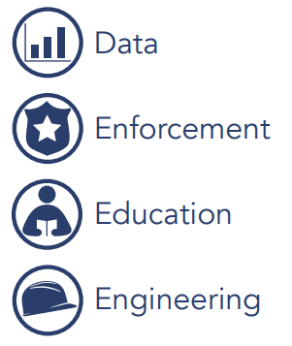
What are we doing about fatalities?
Building Vision Zero principles into everything DDOT and DC government does
Using data to identify the streets and intersections with the most injuries and fatalities and prioritizing these locations for safety treatments
Planning, designing, and building projects on the highest priority intersections and streets (short-, mid-, and long-term)
Working locally and regionally to promote safe travel behaviors through educational campaigns
Evaluating and further prioritizing our efforts based on correcting historic and continued disinvestment and ending systemic racism
Equity

Slide 10
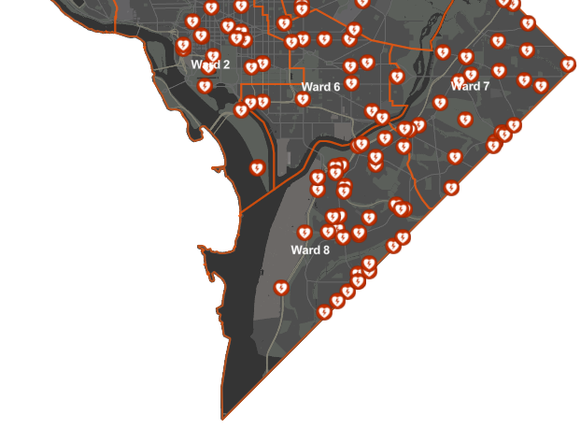
Facts about Fatalities
In any given year, fatalities are somewhat random. We analyze multiple years of data to see trends
Citywide and on specific streets
Common crash types
Common contributing factors
High-Injury Corridors main area of concern
Most are arterials
Over 50% of all traffic fatalities in last 3 years
Crash patterns for fatalities show concentrations in Wards 5, 7, and 8, but somewhat randomly distributed.
2018-2021 Fatalities by Ward: Ward 1- 4, Ward 2- 20, Ward 3- 1, Ward 4- 11, Ward 5- 23, Ward 6-13, Ward 7- 29, Ward 8- 38
How does DC stack up on our existing street safety?
DC has averaged less than 5 fatalities per 100,000 population over the last several years
US averaged 11 fatalities per 100,000 population in 2019
DDOT is leader on safety treatments compared to other cities (pedestrian safety at signals, bike lanes, etc.)

Slide 11
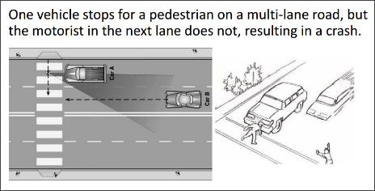
Facts About Safety Priorities
Fatal & Injury Crashes by Street Type
The risk of death and injury is HIGHEST on arterial streets
66% of all traffic related deaths and injuries occur on arterial streets
Arterial streets make up only 26% of the centerline miles of our street network
The risk of death and injury is LOWER on local streets
16% of all traffic related injuries and deaths occur on local streets
Local streets make up nearly 61% of the centerline miles of our street network
Most crashes occur at intersections
The deadliest crashes for pedestrians and cyclists are failures to yield by a driver, left turn, right turn, and dooring for cyclists.
Multi-lane streets and crosswalks are most dangerous.
Multiple lanes that are underutilized at any hour of the day encourages speeding
Multilane crosswalks result in a multiple threat crash (bottom left image)
All DDOT projects should:
Reduce exposure to crashes for all modes
Reduce and Manage vehicle speeds
Mitigate and reduce conflict points
Separate users, especially vulnerable street users
To reduce fatality numbers, DDOT needs to do better than US standards for street design

Slide 12
What happens after a crash?
CRASH
OCCURS
Fatality or Injury
Fatality
Other injury
MPD Major Crash Investigative Unit responds and reconstructs the crash. DDOT deploys rapid repair services for damaged signs, signals, etc.
Within 24 hrs, if fatal, DDOT staff visits the site and are briefed by MPD. DDOT staff update Crash Dashboard.
Within 1 week, a multidisciplinary DDOT team reviews the site and details for safety improvements and set those into motion.
Within 1-month, short-term actions should be installed or in design. If fatal, post crash information memo is posted online.
Within 6 months to 2 years typically, the criminal investigation and prosecution phase is closed.
MPD issues a crash report. Data dashboard is updated weekly, DDOT may deploy repair staff, if repairs are needed.
Property Damage only (no injury)
MPD may take a report under some circumstances. The Traffic Management Center or DDOT Call Center will take a report via phone for all other fender benders.
Critical Injury
MPD Major Crash Investigative Unit responds and reconstructs. DDOT deploys rapid repair services for damaged signs, signals, etc.
DDOT utilizes injury crash data (~7,000/year) to prioritize safety improvements at high-injury locations.
MPD issues a crash report. DDOT includes data in reports and summaries to be used in future planning

