Slide 1
FY 2022 Priority Initiative Progress Update
Transportation Equity, Mobility, and Safety

Slide 2
Problem Statement & Goals
WHAT IS THE PROBLEM?
HOW DO WE ADDRESS IT?
Deep-rooted structural injustices and inequities
Disparate access to safe, affordable, and efficient transportation
Ensure transportation investments benefit all residents, visitors, and commuters
EQUITY
Over-reliance on single occupancy vehicle travel
Impacts on safety, travel times, access to jobs and education, and the environment
Expand mobility options to provide safe and affordable travel choices for all users and trips
MOBILITY
Traffic deaths and injuries continue to occur in our city
Fatal crashes have increased significantly during COVID-19
Design and manage a transportation network that offers safe and secure travel choices for all users
SAFETY

Slide 3
Our Strategy
The District will invest nearly $408 million in FY 2022 to improve transportation equity, safety, and mobility
Equity
Mobility
Safety
Lead & Supporting Agencies
Lead: DDOT, DFHV Support: WMATA, DMOI | Lead: DDOT | Lead: DDOT Support: MPD, DMOI
Wards 1, 4, 5, and 8. Low-income residents who may need free or reduced travel to get to vital community resources (DC Neighborhood Connect) | All transit riders (Bus Priority) Capital Bikeshare location within 1/4-mile of each DC resident All residents and visitors | All residents and visitors
Anacostia Metro Ped Bridge ($20.5M) DC Streetcar ($136.0M) Restore DC Neighborhood Connect ($917K) Expand DC Neighborhood Connect ($747K) | Bus Priority ($63.6M) Trails ($113.1M) Bicycle Lanes ($23.6M) Capital Bikeshare ($19.4M) | Safe Routes to School ($2.9M) Livability ($3.5M) Fall Safety Campaign ($17.4M)
Population Impacted
New FY22 Investments

Slide 4
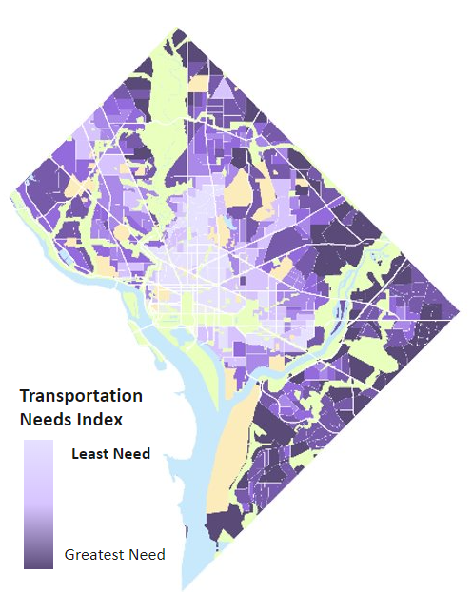
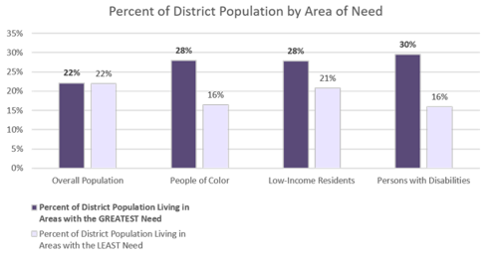
Our Equity Challenge
Where you live in the District impacts your access to high-frequency transit and other mobility options. Low-income residents, people of color, and persons with disabilities disproportionately live in parts of our city with the greatest need for transportation investments.
Areas shaded dark purple have the least access to high-frequency transit and other mobility options.

Slide 5
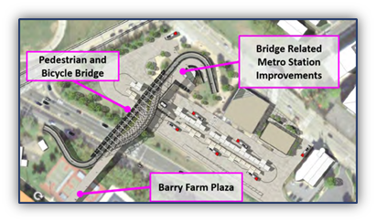
Equity: Anacostia Metro Pedestrian Bridge
The District is investing $20.5 million to build the Anacostia Metro Pedestrian Bridge
Key pedestrian and bicycle connection
Connects neighborhoods south of Suitland Parkway to the Anacostia Metro Station
Provides safe passage to a regional transit hub (Green Line Metro & 15 bus routes)

Slide 6
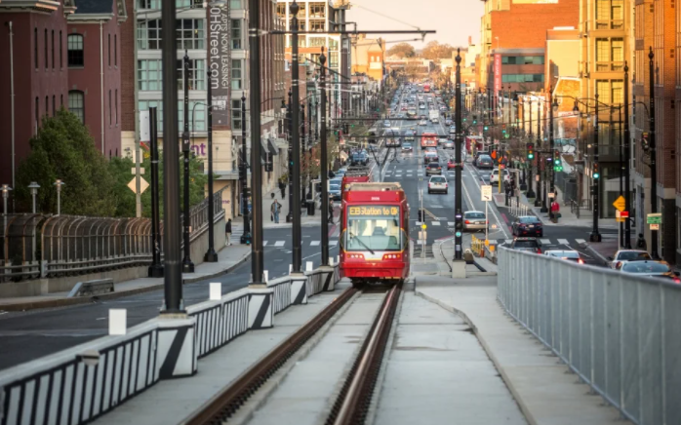
Equity: DC Streetcar Expansion
The District is investing $136 million to extend DC Streetcar to Wards 5 & 7
Key transit link to residents and businesses in Wards 5 and 7
Free transit option in areas of greater transit inequity
Improves safety for people walking and biking on Benning Road, replaces aging Whitlock Bridge, and improves safety and access for vehicles using 295

Slide 7
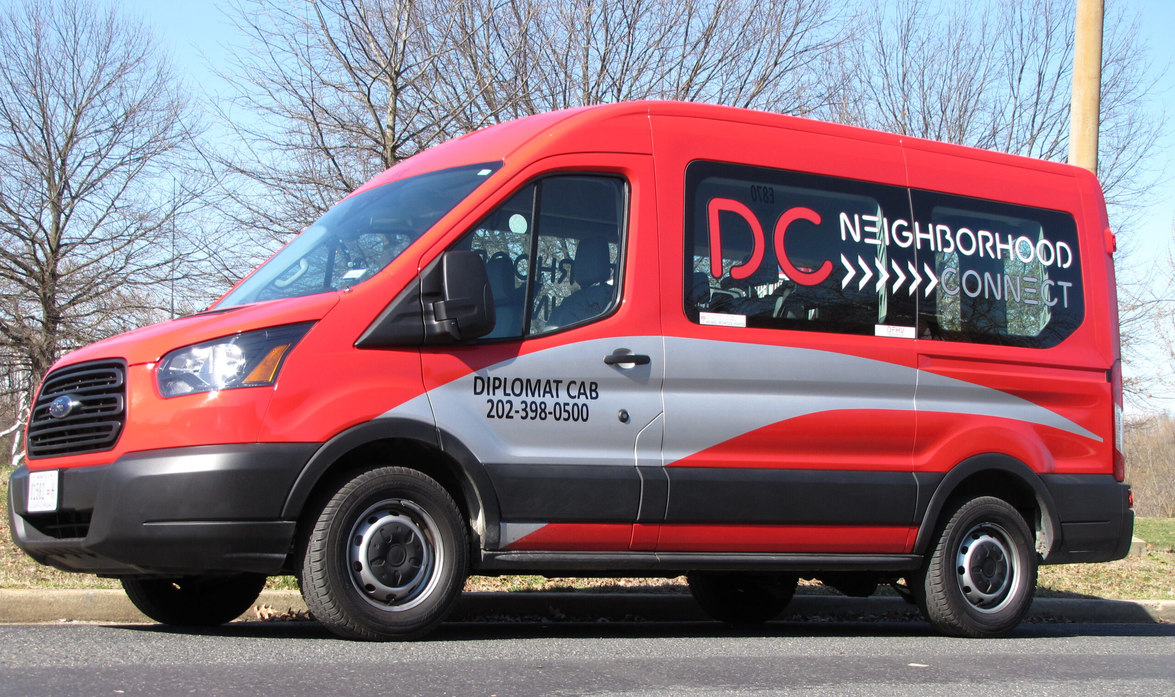
Equity: DC Neighborhood Connect
The District is investing $1.7 million to restore and expand DC Neighborhood Connect
Shared, on-demand shuttle service for areas with fewer transit options
Service restored in Wards 1, 4, 5, and 8 after being suspended during COVID-19
New service coming March 2022 connecting NoMa, Fort Lincoln, Ivy City, and Trinidad
10K+ trips since service restored in Jun/July 2021, with 4.8 out of 5 satisfaction rating

Slide 8
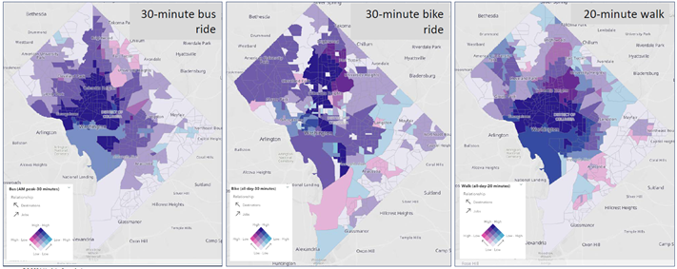
Our Mobility Challenge
Only in certain parts of our city are people able to easily travel by bus, bike, or walking to get to and from jobs and economic opportunities.
Areas shaded dark purple have the greatest ability to easily travel by bus, bike, or walking.

Slide 9
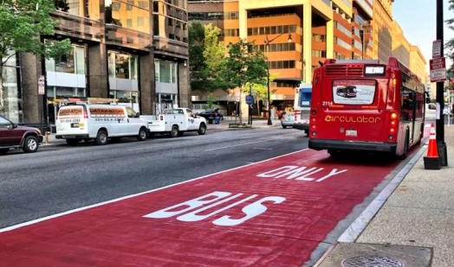
Mobility: Bus Priority
The District is investing $63.6 million over 6 years to install Bus Priority on 50+ bus corridors
Makes bus travel faster and more reliable with bus-only lanes, transit signal priority, queue jumps, and more
Helps residents more easily reach jobs and other economic opportunities
Planned FY22/FY23 Construction
H & I Streets NW (14th to N. Cap.)
Minnesota Avenue SE (Penn. To E. Cap.)
Columbia Road NW (16th to California)
Pennsylvania Avenue SE (2nd to 13th)

Slide 10
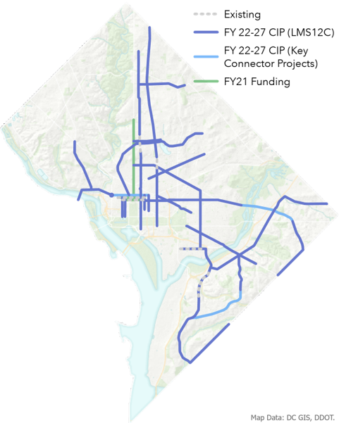
Mobility: Bus Priority
OUR BUS PRIORITY VISION
A 70-mile Bus Priority Network
Serves 122 Metrobus and 5 Circulator routes
63% of District residents live within 1/4-mile of the network
Corridors across all Wards identified by DDOT and WMATA
Better Access to Jobs and Opportunity
Serves approximately 60% of bus riders and 79% of jobs
Approximately 67% of low-income households, 65% of persons with disabilities, and 64% of People of Color live within 1/4-mile
A Network Worth Investing In
Almost half of District Metrobus riders make less than $30,000/year, and 2 in 3 live in zero-car households
During COVID-19, Metrobus ridership was consistently 2-3 times higher than Metrorail ridership

Slide 11
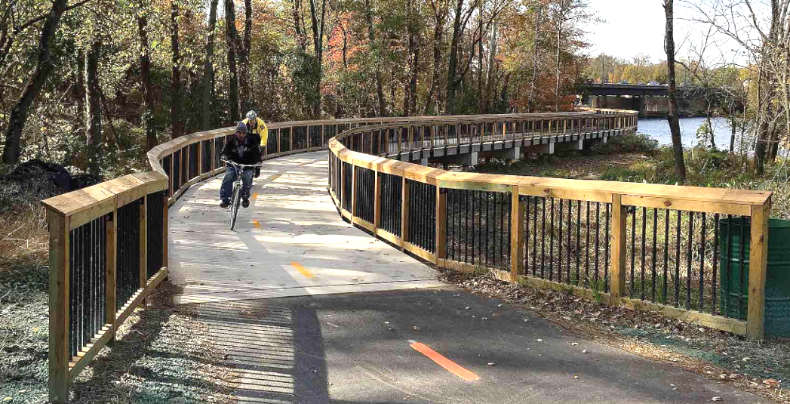
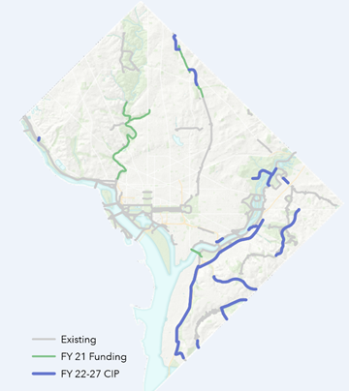
Mobility: Trails Network
The District is investing a record $113 million over 6 years to add 17+ miles to the city’s Trails Network
New South Capitol Street, Shepherd Branch, Fort Davis, and Oxon Run trails in Wards 7 & 8
Completion of the Metropolitan Branch Trail north through Fort Totten and Takoma
New trail connections to the Anacostia Riverwalk and National Arboretum
Funds for additional trail maintenance and expanded Trail Rangers program
PLANNED TRAILS INVESTMENTS
Blue lines indicate trails funded for construction by FY 2027. Most trails are in Wards 7 and 8.

Slide 12
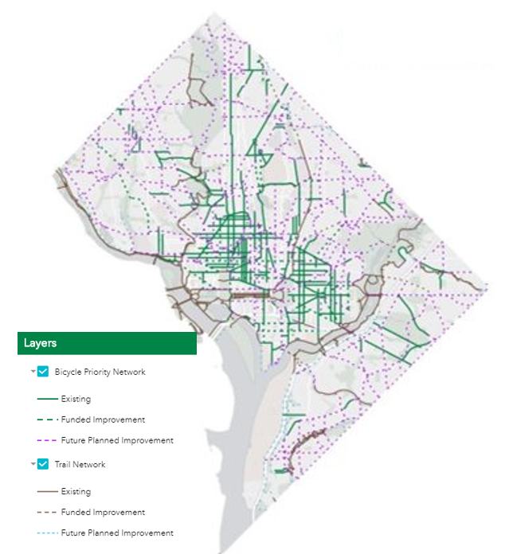
Mobility: Protected Bike Lanes
PLANNED BIKE LANE INVESTMENTS
Solid green lines are existing lanes.
Dotted green lines are lanes funded for construction.
The District is investing $21 million over 6 years to add 10 miles of Protected Bike Lanes per year
Meets our “20x22” goal of adding 20 miles of new lanes by 2022
Keeps that progress going, with another 20 miles of new lanes by 2024
9th Street Bike Lane
This investment funds the design and construction of the 9th Street protected bike lane from Florida Ave to Pennsylvania Ave NW

Slide 13
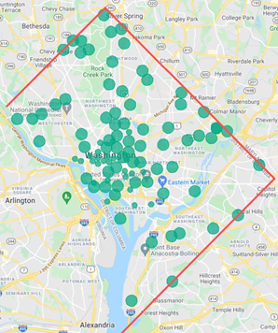
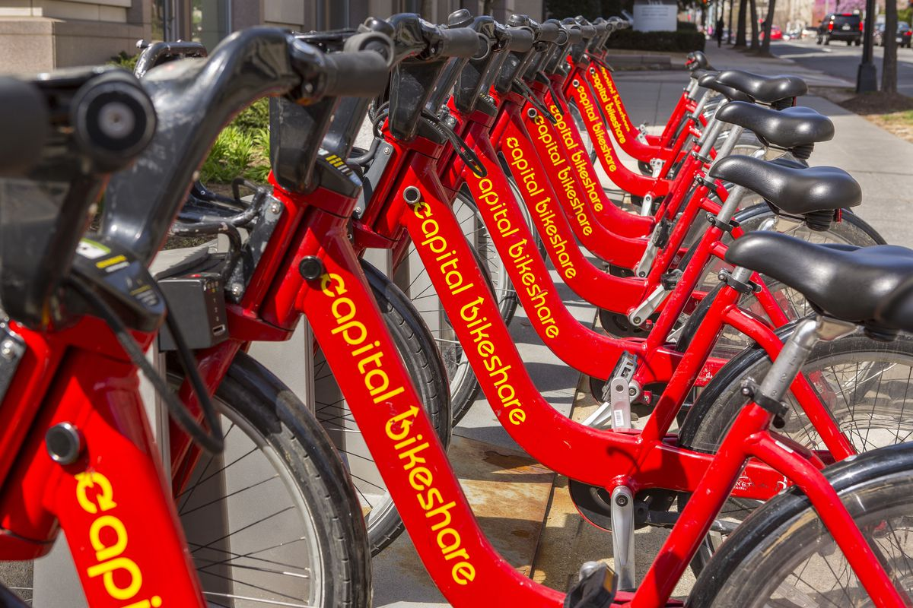
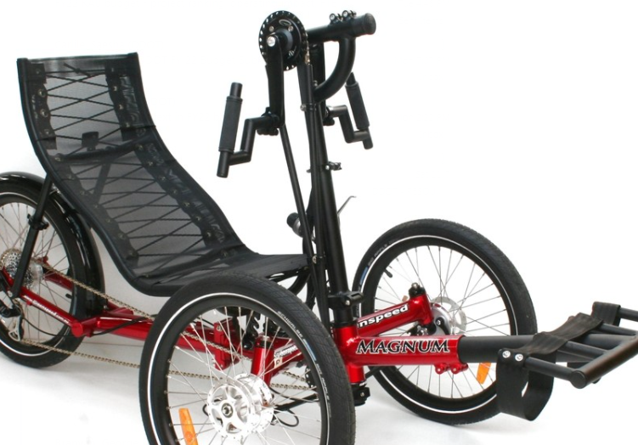
Mobility: Capital Bikeshare
The District is investing $19.4 million over 6 years to make Capital Bikeshare available to more people
80 new docking stations, so every District residents has a station within 1/4-mile of home
800 new bicycles and 2,500 new e-bikes
Adaptive Bikeshare Pilot
This investment funds a pilot of a new adaptive bikeshare program for users unable to ride a traditional, upright two-wheeled bike.

Slide 14
Our Safety Challenge
Traffic deaths and serious injuries continue to occur in our city, and crashes are concentrated in Wards 5, 7, and 8.
2020 fatalities
2021 fatalities (as of 10/19)

Slide 15
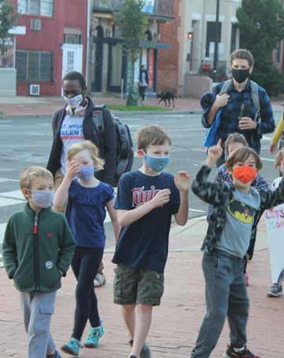
Safety: Safe Routes to School
The District is investing $2.9 million in sidewalks and other Safe Routes to School safety improvements in FY 2022
District-wide effort to plan for safe routes near 36 schools with safety plans in 2020-2021
Responsive school-based safety analysis and intervention
DDOT works closely with schools on pick-up/drop-off and other safety issues near schools
Eligible for expedited implementation

Slide 16
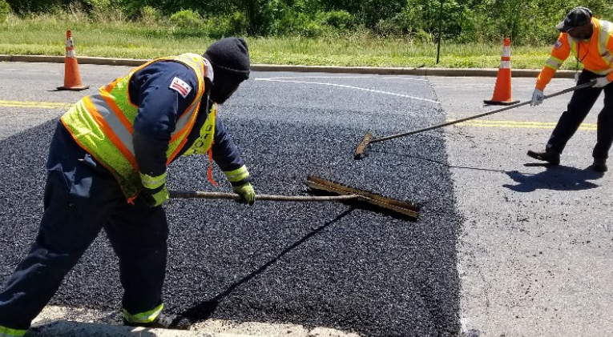
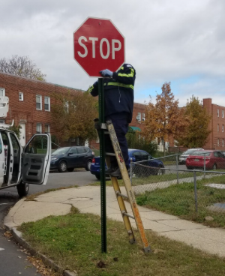
Safety: Vision Zero & Fall Safety Campaign
The District is investing $17.4 million in traffic safety improvements over the next 6 years
Manage speed and focus driver attention
Includes implementation of Traffic Safety Investigation (TSI) recommendations
Fall 2021 Safety Campaign
100+ speed hump installations or repairs
40+ stop sign repairs or replacements
Stop signs at dozens of new locations
Flexi-post installations at 4 intersections to improve driver line-of-sight and slow turning

Slide 17
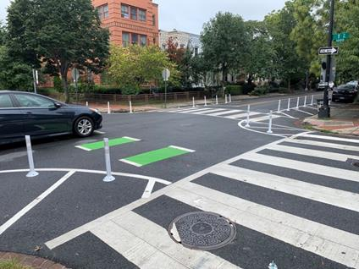
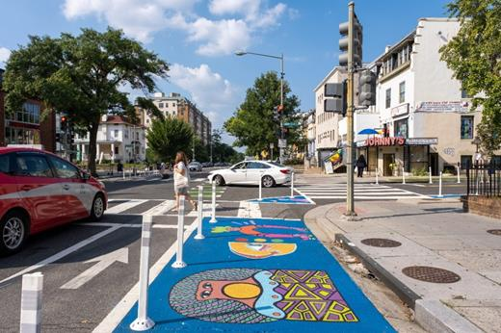
Safety: Livability Study Recommendations
The District is investing $3.5 million in FY 2022 to deliver neighborhood-specific Livability Study Recommendations
14 Livability projects and 15 intersection safety improvements
Improvements include:
Safer pedestrian crossings
Improved access to bus stops
Traffic signal modification
Enhanced green spaces
Signage for better driver information
Speed control in sensitive areas
Improvements identified through Livability Studies conducted with neighborhood engagement and input

Slide 18
Safety: Streetscapes
The District is investing $144.4 million over 6 years to study, design, and/or construct 17 Streetscape projects that will improve safety for people biking and walking.

Slide 19
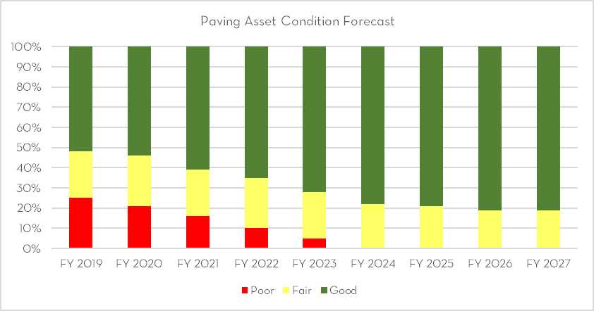
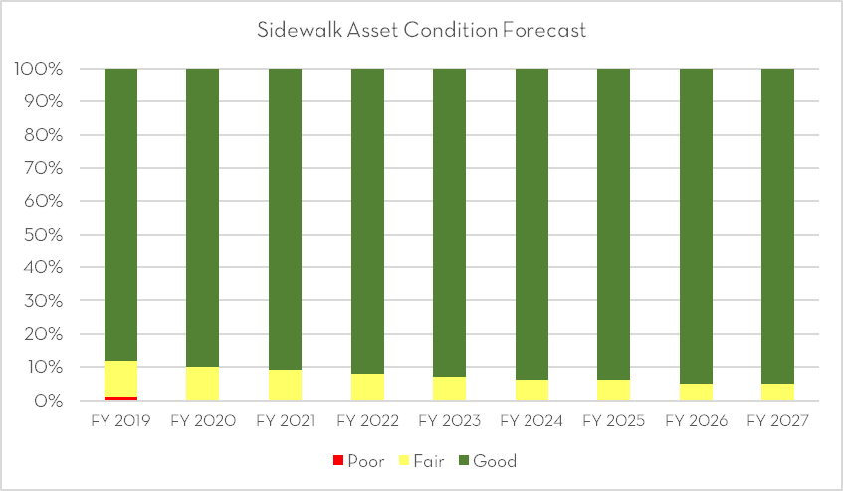
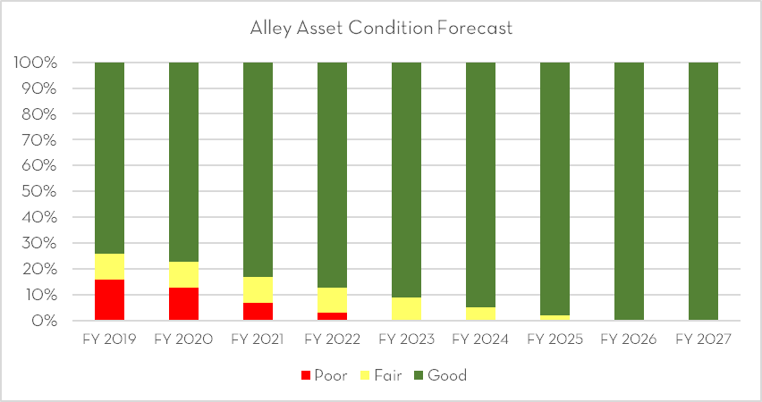
Safety: State of Good Repair
STREETS
SIDEWALKS
ALLEYS
$218.4 million over 6 years
Eliminate roads in poor condition by 2025
Taper to maintenance level in out-years
$111.4 million over 6 years
Maintain sidewalk network with no sidewalks in poor condition
$106.4 million over 6 years
Eliminate alleys in poor condition by 2023 and eventually bring nearly all alleys into good condition
Spent $81.8M in FY 2020 – 33% increase over FY 2019, and 13X more than historical average
Paved 132 miles of local roads – compared to 84 in FY 2019 and 21 in FY 2018
Spent $20.2M in FY 2020 – 32% increase over FY 2019, and 6X more than historical average
Completed 347 blocks – up from 257 in FY 2019 and 198 in FY 2018
Spent $23.3M in FY 2020 – 5% increase over FY 2019, and 3X more than historical average
Completed 150 alley blocks – up from 128 in FY 2019, and 109 in FY 2018

Slide 21
Equity: Investments

Slide 22
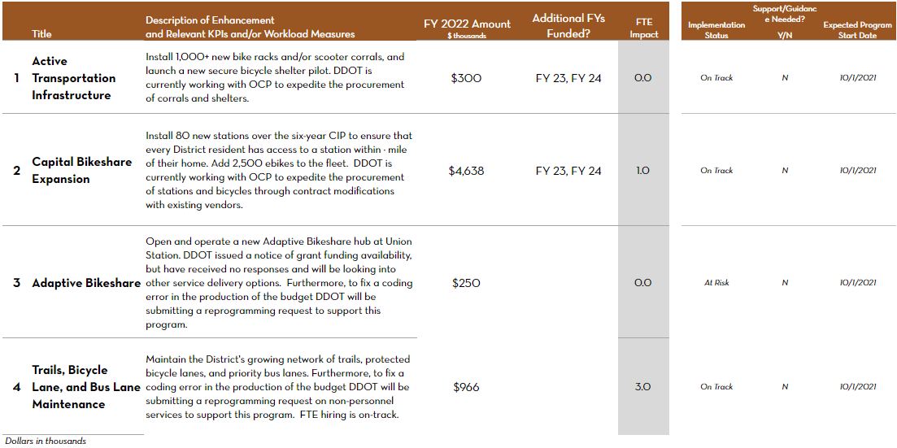
Mobility: Investments

Slide 23
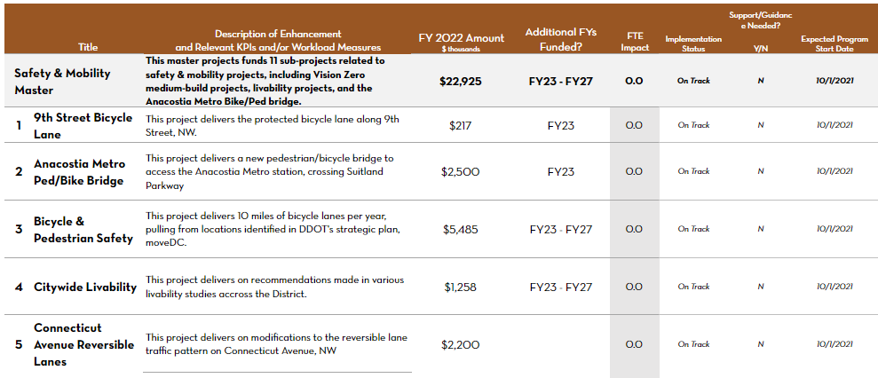
Safety: Investments

Slide 24
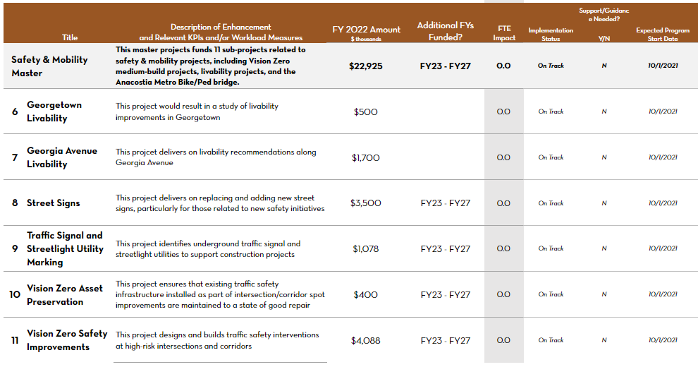
Safety: Investments (continued)

