Slide 1
Safety Stat
Bus Priority Update
November 12, 2021

Slide 2
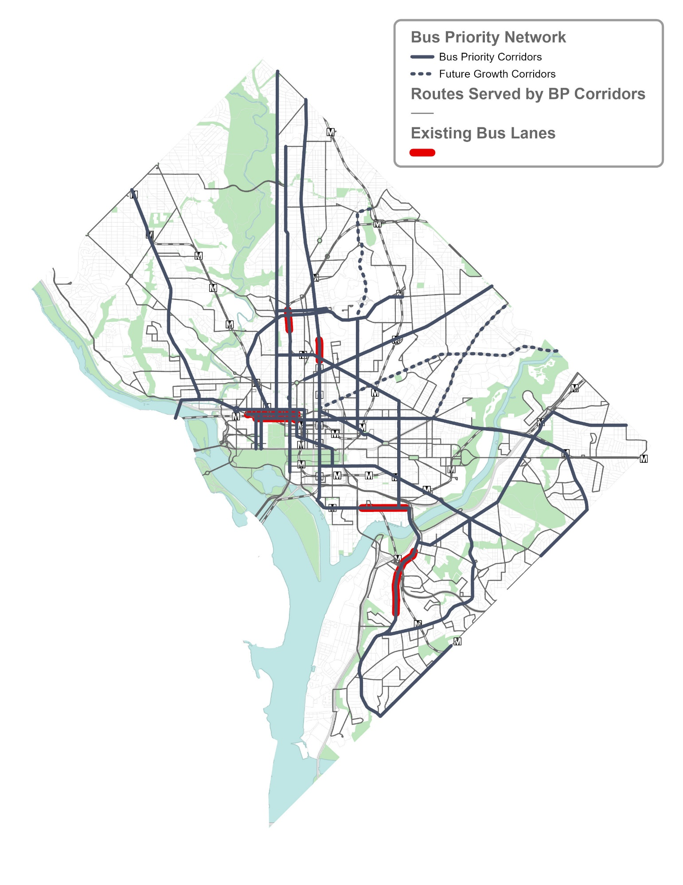
Bus Priority Program
Faster and more reliable transit provides better access to more jobs and opportunity
Address transportation needs identified in moveDC’s analysis and support an equitable recovery
Almost half of District Metrobus riders make under $30,000 per year and two thirds live in zero-car households
Improve the entire rider experience

Slide 3
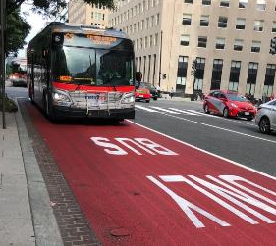
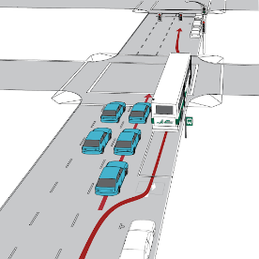
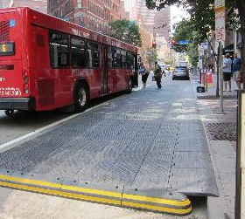
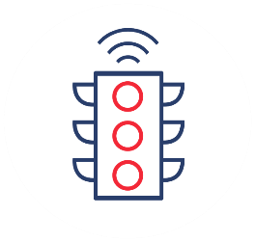
Flexible and Context-Sensitive Planning
DDOT will identify the tools to improve bus speeds and reliability within the neighborhood context and specific project needs
DDOT’s Bus Priority Program Toolbox includes over 20 treatments to improve bus operations including:
Bus lanes to reduce congestion delay
Queue jumps to allow buses to get to the front of the line
Bulb-outs to allow buses to board from the travel lane and provide more space for passengers to wait
Transit signal priority to give buses more green time
Notes:
Bus priority is not one-size-fits-all. For each project, DDOT will identify the tools to improve bus performance within the given neighborhood context and project needs.
DDOT developed a toolbox of over 20 bus priority improvements to target specific causes of delay, including:
Bus lanes
Queue jumps
Bulb-outs
Transit signal priority
Bus priority improvements yield travel time savings of 10-20% based on peer cities and DDOT experience. The pilot bus lanes on H and I Street NW improved travel times overall by 10% and further benefits are expected as DDOT upgrades the design this fiscal year.

Slide 4
FY 2022 EOM Budget Presentation to DC Council

Slide 5
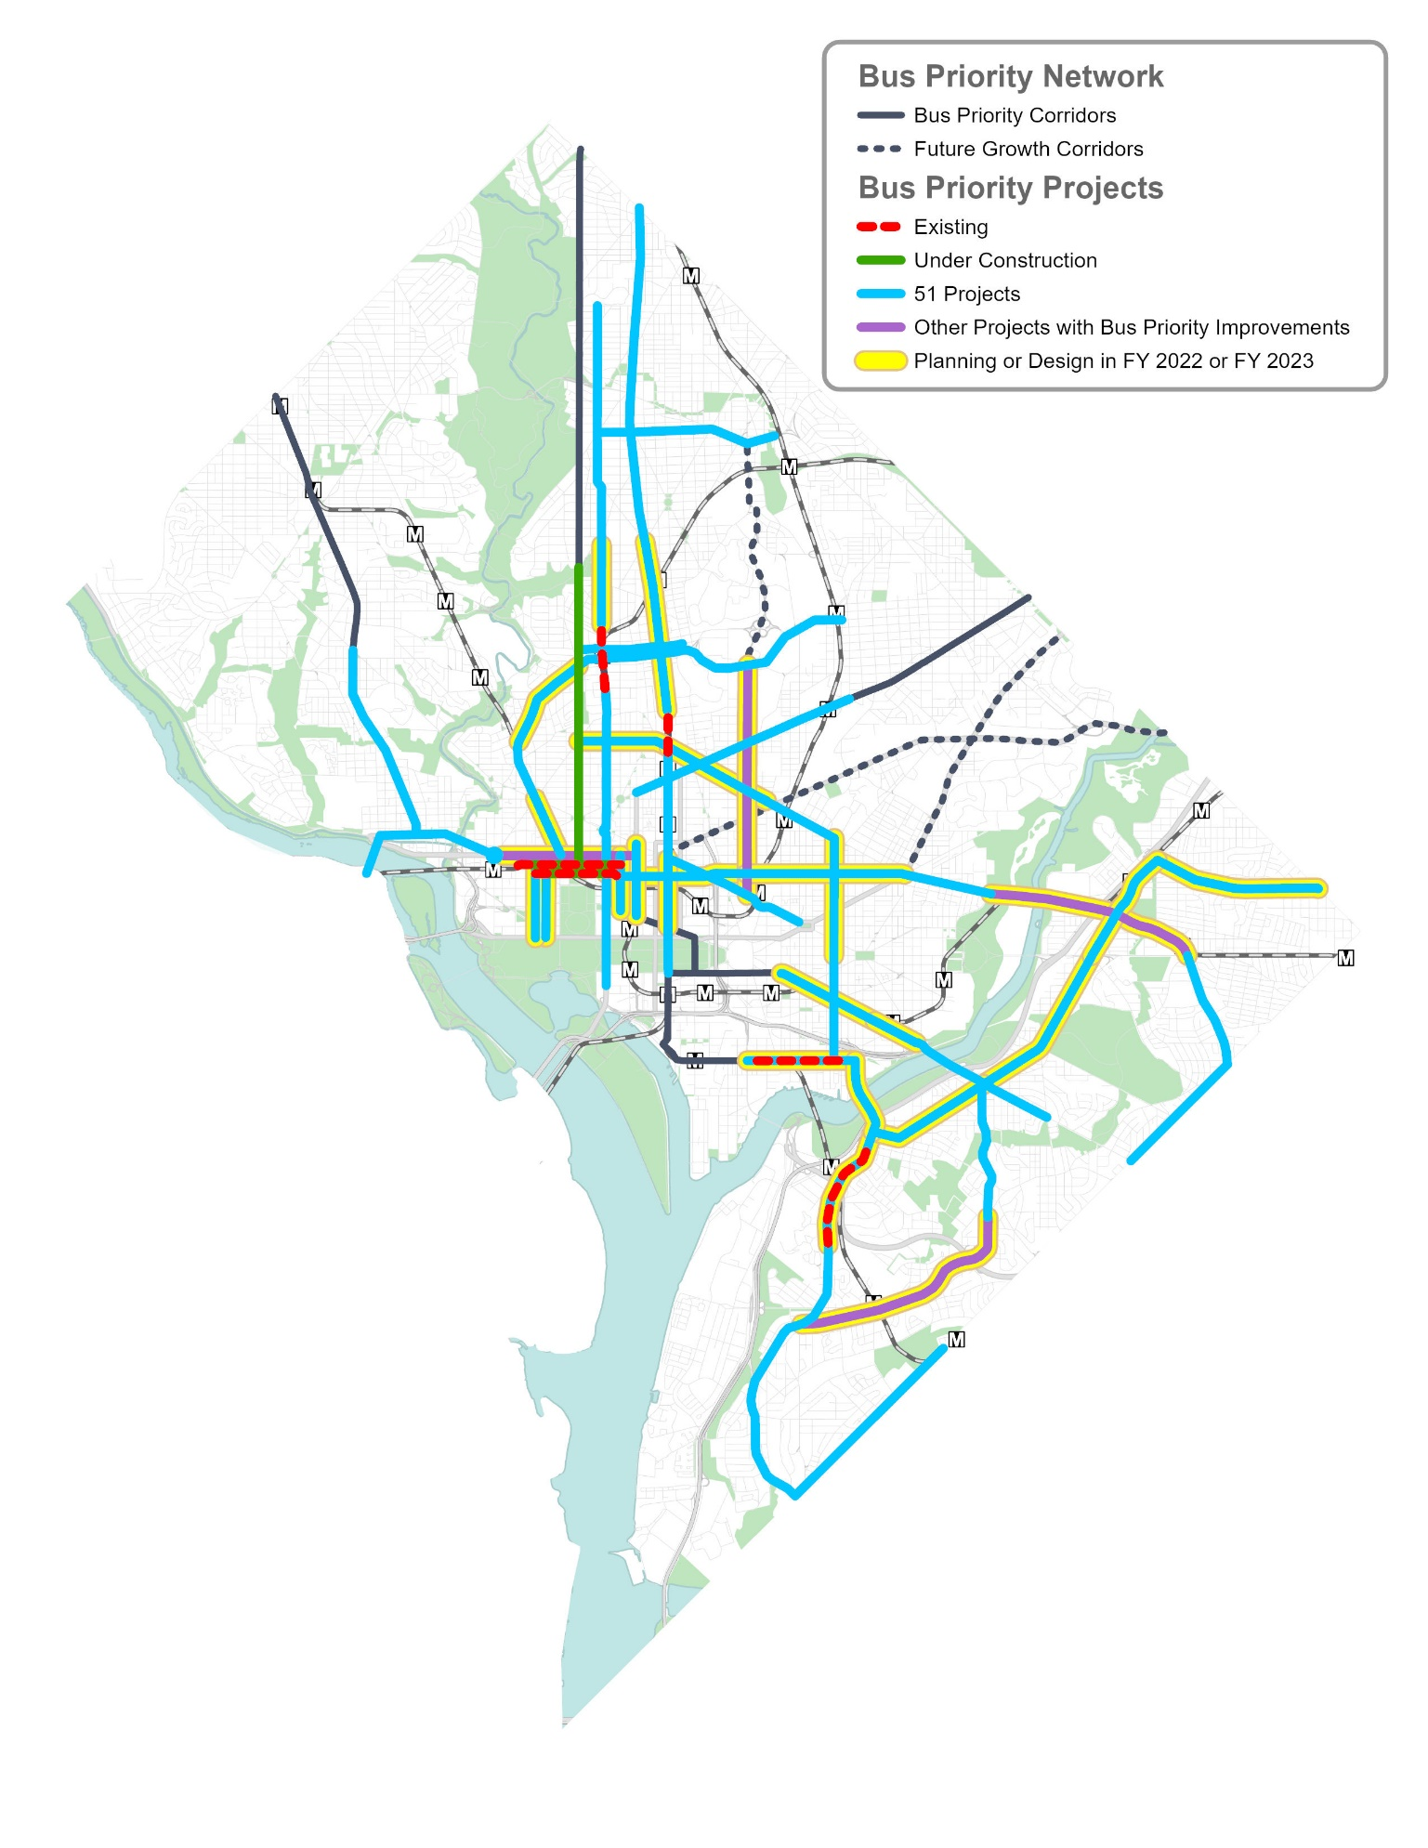
Project Pipeline
51 projects over the next 8 years (ramping up to 7-8 projects starting construction per year)
Team Effort
Planning led by TDD
Design and construction led by TESD
Involvement & coordination with teams across the agency
Several projects led by other teams with bus/transit priority improvements

Slide 6
Active Projects
FY22 Construction Start
H Street NW: 14th to North Capitol
Curbside AM/PM bus lanes
Minn Ave SE: Penn Ave to East Capitol
Safety focus with bus bulb-outs and bike lanes
Penn Ave SE: 2nd to 13th St
Peak hour/peak direction bus lanes and protected bike lanes
FY23 Construction Start
MLK 2.0: Good Hope to Redwood
Upgrades to existing pilot lanes
M St SE 2.0: South Capitol to 11th St
Upgrades to existing pilot lanes plus protected bike lanes
7th St NW: Mass to Penn Ave
Design completed 2020
8th St NE: FL to East Capitol
Bus bulb-outs and stop rebalancing

Slide 7
Active Projects
FY24 Construction Start
Columbia Rd NW: 16th to California
11th St NW: Mass to Penn
13th St NW: K to Penn
GA Ave NW: Kansas to Barry
Minn Ave SE: Good Hope to Penn Ave
H St NE: North Capitol to Benning
NHB Ave NE: Minn to Eastern

