Slide 1
PROJECT DELIVERY ADMINISTRATION
FY22 First Quarter
Capital Projects Update
January 2022

Slide 2
FY22 COMPLETED PROJECTS

Slide 3
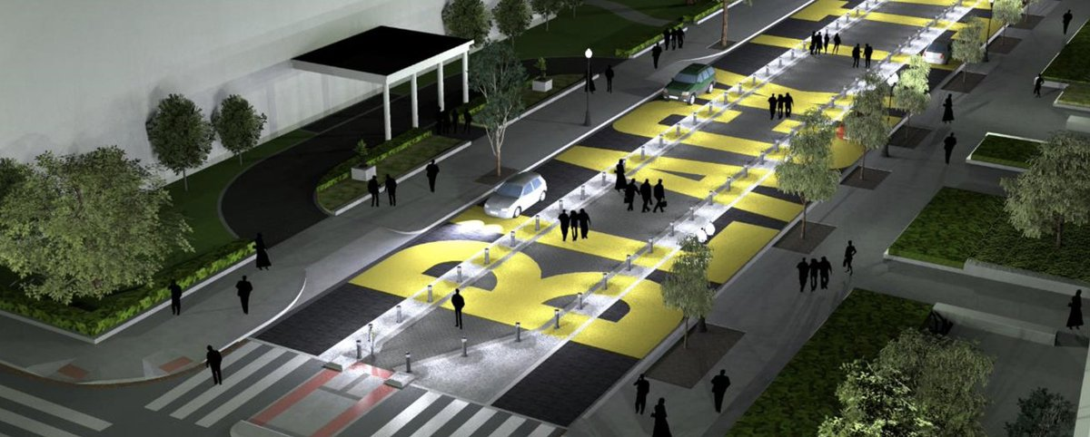
Black Lives Matter Plaza (Phase I)
Ward: 2
Performance Objective: Pedestrian Safety
Construction Start: FY21
Construction End: FY22
Budget Type: Local
Cost: $4M
Project Limits: 16th Street NW between H and K Streets NW
Project Description: Installation of roadway pavers, bollards, and the permanent Black Lives Matter mural. The permanent installation protects pedestrian safety while accommodating vehicles and keeping with the spirit of the original mural design.

Slide 4
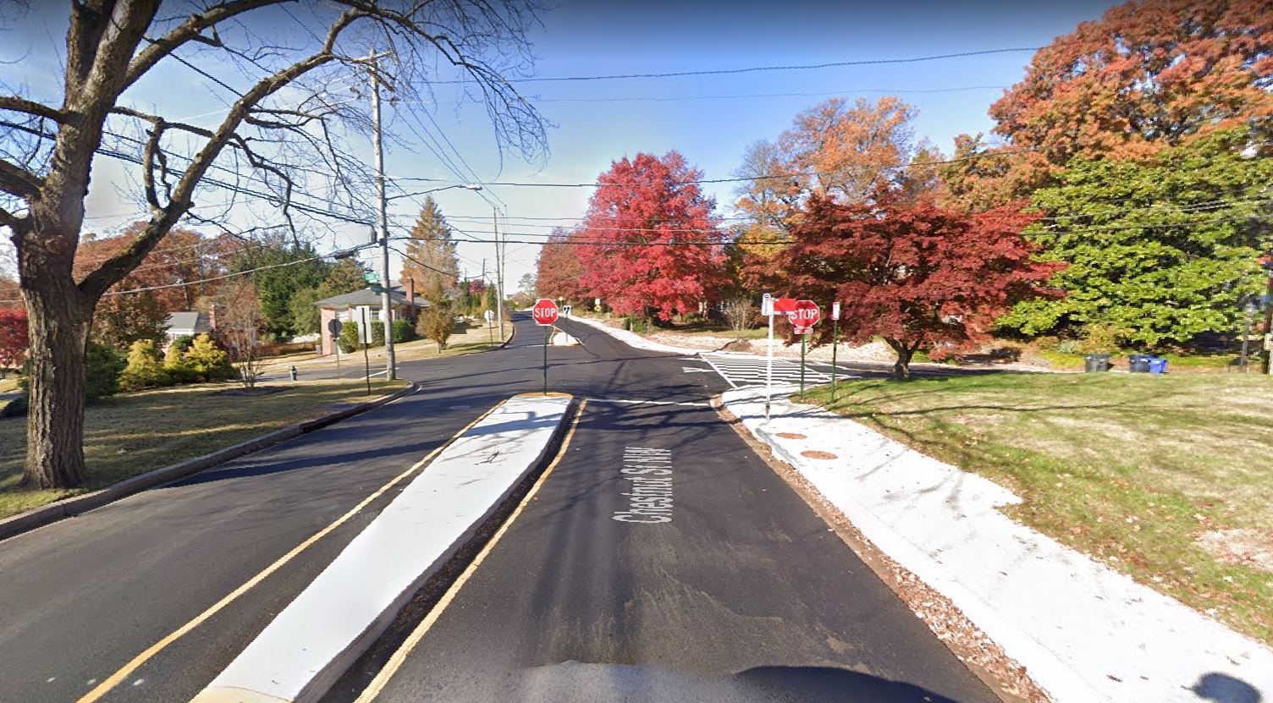
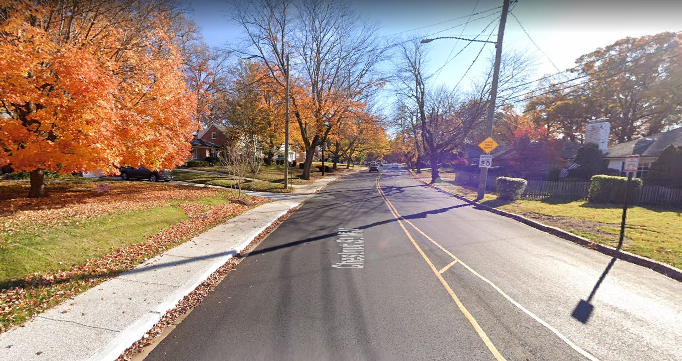
Chesnut Street Sidewalk
Ward: 4
Performance Objective: Pedestrian Safety, and Traffic Calming Measure
Construction Start: FY21
Construction End: FY22
Budget Type: Local
Cost: $1,014,353.50
Project Limits: From Oregon Avenue NW to Western Avenue NW
Project Description: The Chestnut Street Sidewalk Improvement Project added a new sidewalk on the north side of Chestnut Street. The installation of the sidewalk provides a reduction in roadway width and provides traffic-calming benefits. Additional improvements included pavement resurfacing, bus pads (north side), driveway entrances, ADA compliant curb ramps, crosswalks on the side streets, drainage improvements, and landscaping.

Slide 5
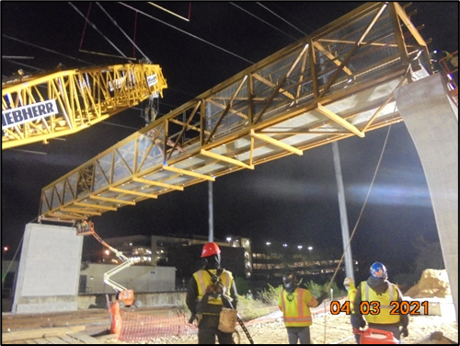
Parkside Pedestrian Bridge
Ward: 7
Performance Objective: Sustainability, Pedestrian Safety
Construction Start: FY20
Construction End: FY22
Budget Type: Local and Developer
Construction: $15M
Project Limits: From Minnesota Avenue Metro Station to Kenilworth Terrace NE
Project Description: The project improved connections for neighborhoods on each side of DC-295, providing new access to the Minnesota Avenue Metro Station that is safe, well-lit, accessible, and available 24/7.

Slide 6
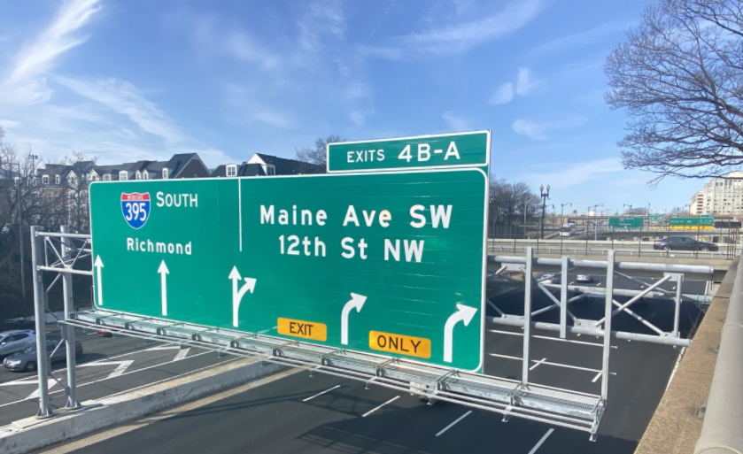
I-395 Sign Structure Improvements
Ward: 6
Performance Objective: Safety improvements
Construction Start: FY20
Estimated Construction End: FY22 (Jan. 31, 2022)
Budget Type: Federal
Cost: $5.6M
Project Limits: Ohio Dr. to D St., SW
Project Description: Replacement of 7 existing overhead sign structure and repair of 8 existing sign structure including replacement of existing sign panels; the work also includes replacement of one sign structure at NY Ave. Total of 16 sign structures.

Slide 7
PROJECTS UNDER CONSTRUCTION DELIVERING IN FY 22

Slide 8
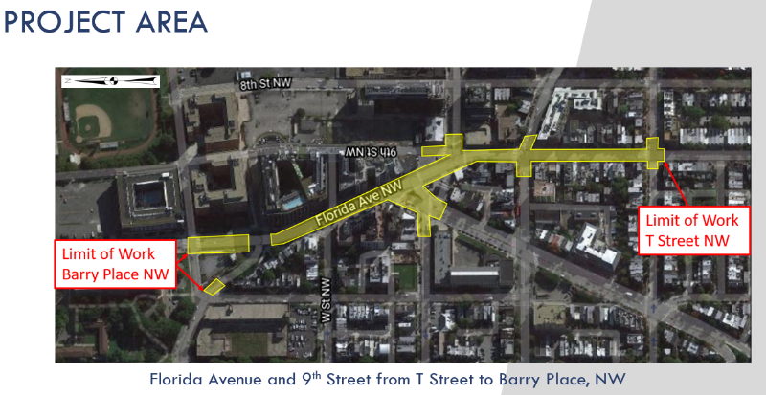
Reconstruction of Florida Avenue/9th St NW
Ward: 1
Performance Objective: Safety/Vision Zero
Construction Start: FY21
Estimated Construction End: FY22
Budget Type: Federal
Cost: $8.6M
Project Limits: 9th & T St NW to Florida Ave/Sherman Ave & Barry Place NW
Project Description: Safety improvement of 1,500 linear foot roadway section. Reconfiguration of the intersection at Florida Ave/Sherman Ave with pavement reconstruction. Improvements of streetscape elements including widened sidewalks, ADA ramps, curbs and gutters, pavement marking, landscape and streetlights as well as bicycle lanes and closing curb cuts.
Challenges and Barriers: Ongoing coordination with private development (Whole Foods).
Opportunities to Expedite: None at this time.

Slide 9
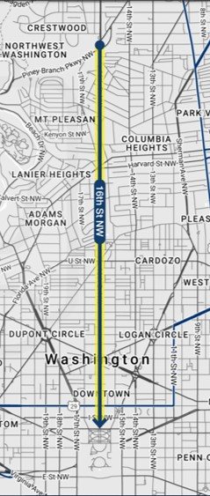
16th Street NW Transit Priority Project
Ward: 1, 2, and 4
Performance Objective: Bus Priority, Equity, Sustainability
Construction Start: FY21
Estimated Construction End: FY22
Budget Type: Federal and local
Cost: $12M
Project Limits: 16th Street from Arkansas Ave NW to H St NW
Project Description: ​This bus priority project will improve transit performance and reliability of a 2.7 mile segment of 16th St NW. Design includes peak period red bus lanes, bus stop enhancements, pedestrian improvements, transit signal priority, and queue jumps. Project will have automated traffic enforcement to ensure performance.
Challenges and Barriers: None at this time.
Opportunities to Expedite: None at this time.

Slide 10
Virginia Avenue NW Protected Bike Lanes
Ward: 2
Performance Objective: Bicycle Safety, Sustainability
Construction Start: FY21
Estimated Construction End: FY22
Budget Type: Federal and Local
Cost: $1.3M
Project Limits: Rock Creek Parkway NW to 18th/Constitution NW
Project Description: Adding protected bike lanes that connect Georgetown, Theodore Roosevelt Bridge path, G St protected bike lanes, Foggy Bottom, and the Mall.
Challenges and Barriers: Federal stakeholders with changing needs, residential stakeholders with differing views on goals.
Opportunities to Expedite: None at this time.

Slide 11
Oregon Avenue NW Reconstruction
Ward: 4
Performance Objective: Core Infrastructure
Construction Start: FY20
Estimated Construction End: FY22
Budget Type: Federal
Cost: $29.2M
Project Limits: From Military Road to Western Avenue NW.
Project Description: This project aims to improve the overall roadway and storm management infrastructure. The project, which went through an Environmental Assessment (EA) process, includes construction of new sidewalk, stormwater Low-Impact Development (LIDs), and streetlights, as well as replacement of a deteriorated large box culvert with a new bridge over Pinehurst Run.
Challenges and Barriers: NPS coordination.
Opportunities to Expedite: None at this time

Slide 12
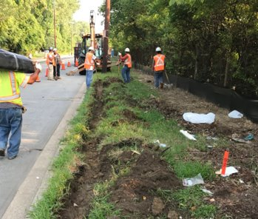
Metropolitan Branch Trail (MBT) Brookland to Fort Totten
Ward: 4 and 5
Performance Objective: Bicycle and Pedestrian Safety and Access; Sustainability
Construction Start: FY19
Estimated Construction End: FY22
Budget Type: Federal and Local
Cost: $8.5M
Project Limits: From John McCormack Drive to First Place NE
Project Description: Design-Build construction extending the MBT from Brookland to the Fort Totten Metro, along the Red Line tracks over the Green Line tunnel.
Challenges and Barriers: Ongoing coordination with WMATA, National Park Service (NPS), and District Department of Energy and Environment (DOEE) for construction activity along Red Line.
Opportunities to Expedite: None at this time.

Slide 13
Maryland Avenue NE Multi-Modal Improvements
Ward: 6
Performance Objective: Vision Zero, Multimobility
Construction Start: FY19
Estimated Construction End: FY22
Budget Type: Federal and Local
Cost: $22M
Project Limits: From 2nd Street, NE to 14th Street, NE
Project Description: The project provides multi-modal improvements to the Maryland Avenue NE corridor to improve pedestrian and overall corridor safety, add bicycle lanes, and incorporate a “road diet” to slow traffic by reducing lanes. The project aims to improve bus operations, traffic signal operations, lighting, and drainage.
Challenges and Barriers: Coordination with Washington Gas capital project working concurrently.
Opportunities to Expedite: None at this time.

Slide 14
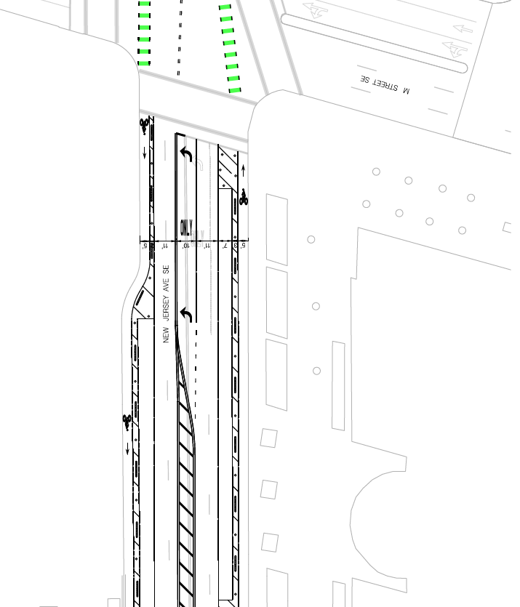
New Jersey Avenue SE Protected Bike Lanes
Ward: 6
Performance Objective: Bicycle Safety, Sustainability
Construction Start: FY22
Estimated Construction End: FY22
Budget Type: Local
Cost: $165,000
Project Limits: H Street SE to Tingey Square SE (Navy Yard)
Project Description: Extend existing protected bike lanes south to meet bike lanes at Tingey Square, crosses in front of USDOT Headquarters.
Challenges and Barriers: Stakeholder concern over relocation of loading / PUDO zones.
Opportunities: In discussion with US DOT to hold joint media event in winter/spring with the Secretary to focus on safety, cut the ribbon on the NJ Ave. PBL, and commemorate 100 miles of bike lanes being built in the District.

Slide 15
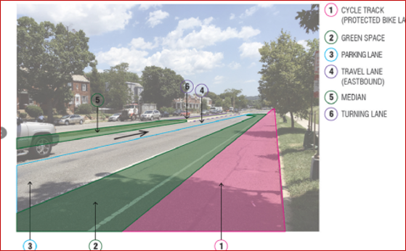
C Street NE Safety Improvements
Ward: 6
Performance Objective: Multimobility, Vision Zero
Construction Start: FY21
Estimated Construction End: FY22
Budget Type: Federal
Cost: $17M
Project Limits: C Street from 14th Street to 21st Street NE and North Carolina Avenue from 14th Street to 16th Street NE
Project Description: This project involves a road diet to reduce the number of vehicle travel lanes, as well as adding protected bicycle lanes and curb extensions to improve safety for pedestrians and bicyclists. The project will add green infrastructure and improve circulation by adding left turn lanes.
Challenges and Barriers: None at this time
Opportunities to Expedite: None at this time

Slide 16
New Frederick Douglass Memorial Bridge / South Capitol Street Corridor
Ward: 6 and 8
Performance Objective: Core Infrastructure
Construction Start: FY17
Est. Construction End: FY21 (Bridge), FY22 (Ovals, Interchange)
Budget Type: Federal
Cost: $500M
Project Limits: South Capitol Street from N St to Firth Sterling Ave; I-295 from Firth Sterling Ave to Howard Rd; Suitland Parkway from South Capitol St to Firth Sterling Ave.
Project Description: In FY21 a new 6-lane Frederick Douglass Memorial Bridge was opened to traffic to replace the existing structurally deficient bridge. The new bridge increases bicycle and pedestrian safe access and improves drainage and stormwater management across the bridge and at both FDMB abutments.
In FY22 the project will complete the construction of two new traffic ovals (one on each side of the Anacostia River) and the reconstruction of the Anacostia Freeway Bridges over Howard Road, Firth Sterling Avenue, and Suitland Parkway (structurally deficient bridges built in 1964).

Slide 17
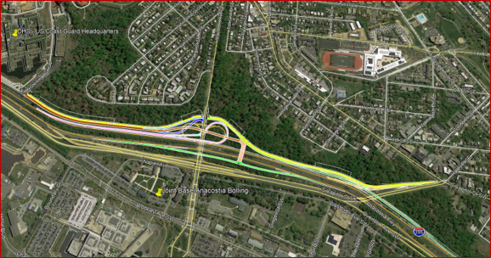
I-295/Malcolm X Avenue Interchange Improvement
Ward: 8
Performance Objective: Core infrastructure
Construction Start: FY18
Estimated Construction End: FY22
Budget Type: Federal
Cost: $ 105 M
Project Limits: From Firth Sterling Ave SE to MLK Jr. Ave SE.
Project Description: Project will build access roads from I-295 to St. Elizabeth’s West Campus, site of Department of Homeland Security. The construction project includes 3.45 lane miles of roadway, 6 new overpass bridges, one overpass bridge widening, 240,000 sf of walls with aesthetic finish, and improved streetlights, traffic signals, and landscaping. The project has a requirement for new hires and trainees to be at least 51% DC residents. The project also has a requirement of 29 trainees for On the Job Training (OJT). In addition, the Construction Management consultant team will train four local trainees to become inspectors. Trail: The project includes about 1.3 miles of shared use path starting from the South Capitol St. SE and MLK Ave. SE intersection to the gate 4 at the St. Elizabeth’s west campus. Bus Route: The project includes Coast Guard HQ & Bus Bay D at the existing access road, which will be transferred to DDOT, and two bus stops at the Malcolm X and I-295 intersection. GI Facilities: The project includes extensive amount of bioswales, bioretention planters, and detention basins which requires extensive maintenance program for the future.
Challenges and Barriers: Stakeholder management is also a challenge.
Opportunities to Expedite: None at this time.

Slide 18
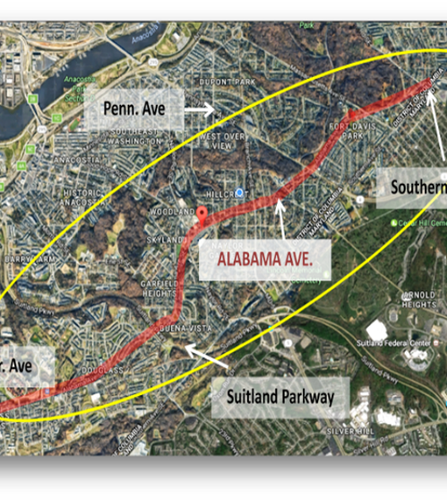
Alabama Avenue SE Corridor Safety Improvement Project
Ward: 8
Performance Objective: Vehicular and Pedestrian Safety
Construction Start: FY21
Estimated Construction End: FY22
Budget Type: Local
Cost: $600,000
Project Limits: 7th Street – 18th Street SE
Project Description: This Project is based on the findings of the 2017 Alabama Avenue SE Corridor Safety Study. To advance Vision Zero, the project will reduce travel lanes in some sections while maintaining parking along the corridor. Curb bump outs, refuge islands, and a HAWK signal at 15th Place SE improve pedestrian safety, a critical component of DDOT's Vision Zero program.
Challenges and Barriers: None at this time.
Opportunities to Expedite: None at this time.

Slide 19
CONSTRUCTION SCHEDULED TO BEGIN IN FY22
16th Street Bridge over Piney Branch Parkway Reconstruction (Wards 1 and 4)
H Street NW Bus Priority (13th Street to North Capitol) (Ward 2)
Cleveland Park NW Streetscape and Drainage Project (Phase 1) (Ward 3)
Florida Avenue (2nd Street to H Street) NE Multimodal Safety and Streetscape (Wards 5 and 6)
Florida Avenue-New York Avenue NE Intersection Project (Wards 5 and 6)
Pennsylvania Avenue SE Bus/Bike Priority (Ward 6)
Douglas Street NE Pedestrian Bridge (Ward 7)
Pennsylvania Avenue & Minnesota Avenue SE Intersection Safety Project (Ward 7)
Minnesota Avenue SE Bus/Bike Priority (Pennsylvania Avenue to East Capitol) (Ward 7)
Revitalization of Martin Luther King, Jr, Avenue SE Phase 2 (4th Street SE to South Capitol Street) (Ward 8)

Slide 20
PROJECTS UNDER CONSTRUCTION DELIVERING IN FY 23

Slide 21
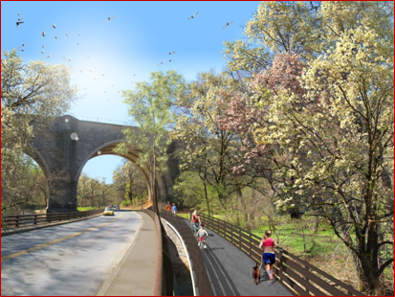
Rock Creek Park Multi-Use Trail and Pedestrian Bridge
Ward: 1, 2, 3, and 4
Performance Objective: Bicycle and Pedestrian Safety and Access, Sustainability
Construction Start: FY21
Estimated Construction End: FY23
Budget Type: Federal
Cost: $18.9 M
Project Limits: M Street to Broad Branch Road NW; Piney Branch Parkway; Beach Drive to Arkansas Avenue NW
Project Description: This project includes 3.7 miles of trail and the construction of a new pedestrian bridge entirely on National Park Service (NPS) land.
Challenges and Barriers: None at this time.
Opportunities to Expedite: None at this time.

Slide 22
Massachusetts Avenue NW Reconstruction
Ward: 2
Performance Objective: Core Infrastructure
Construction Start: FY21
Estimated Construction End: FY23
Budget Type: Federal
Cost: $25M
Project Limits: 20th Street to Waterside Drive NW
Project Description: Reconstruction of 0.86 mile roadway section in which the subgrade has deteriorated to poor condition. Improvement of streetscape elements to improve safety including sidewalks, ADA ramps, traffic signals, streetlight, and Low-Impact Development (LID).
Challenges and Barriers: Coordination with various stakeholders including 34 foreign embassies. Contractor overlap due to major Washington Gas upgrade within the same project footprint.
Opportunities to Expedite: None at this time.

Slide 23
Pennsylvania Avenue SE Streetlights (2nd – 14th Street SE)
Ward: 6
Performance Objective: Core infrastructure
Construction Start: FY21
Estimated Construction End: FY23
Budget Type: Federal
Cost: $15.3 M
Project Limits: Pennsylvania Ave SE from 2nd-14th Street SE
Project Description: This project will convert streetlights to LED luminaries, upgrade traffic signals at intersections, repair sidewalks and ADA ramps to improve pedestrian mobility, and repave the road.
Challenges and Barriers: None at this time
Opportunities to Expedite: None at this time

Slide 24
CONSTRUCTION SCHEDULED TO BEGIN IN FY23
K Street Transitway (Ward 2)
I-395 HOV Bridge over Potomac River (Ward 2)
Theodore Roosevelt Bridge Rehabilitation Project (Ward 2)
11th Street NW Bus/Bike Priority (Massachusetts to Pennsylvania Avenue) (Ward 2)
Aspen Street NW Rehabilitation (Ward 4)
Kennedy Street NW Reconstruction (Ward 4)
Metropolitan Branch Trail: Fort Totten to Takoma (Wards 4 and 5)
H Street Bridge Reconstruction (Ward 6)
8th Street NE Bus Priority (Ward 6)
Benning Road Reconstruction and Streetcar Project (Ward 7)
Lane Place Pedestrian Bridge (Ward 7)
Southern Avenue Phase 1 (South Capitol Street to Barnaby Road) (Ward 8)
MLK Jr. Avenue SE Bus Priority 2.0 (St. Elizabeths East Campus to Good Hope Road) (Ward 8)
M Street SE Bus/Bike Priority 2.0 (South Capitol to 11th Street) (Ward 8)

Slide 25
PROJECT PREVIEW

Slide 26
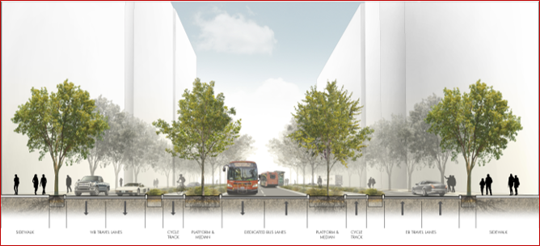
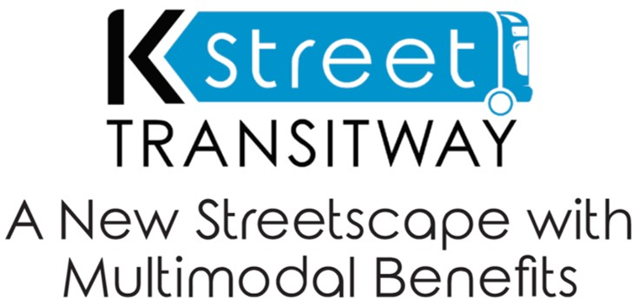
K Street Transitway
Ward: 2
Performance Objective: Bus Priority, Bicycle Safety and Access
Estimated Construction Start:FY23
Estimated Construction End: FY25
Budget Type: Local
Construction: $124.7M
Project Limits: K Street from 12th Street to 21st Street NW
Project Description: K Street Transitway will improve on-time bus performance and reliability of east-west bus routes across the District. It will feature a 2-way dedicated bus stops, lighting, landscaping, pedestrian amenities and protected bicycle lanes.
Challenges and Barriers: Utility relocation, curbside management (operations and policy to complement new street design), construction impacts to businesses and traffic.
Opportunities to Expedite: MOU with utilities

Slide 27
I-395 HOV Bridge over Potomac River
Ward: 2
Performance Objective: Core Infrastructure
Estimated Construction Start: FY23
Estimated Construction End: FY26
Budget Type: Federal
Budget Estimate: $26 M
Project Limit: Over Potomac River and immediate approaches
Project Description: Rehabilitation of existing bridge to upgrade and maintain current level of service for 40 years by performing structural repairs. Pier crack repairs, deck overlay, steel bridge coating restoration and bridge lighting upgrade.
Challenges and Barriers: Securing staging and laydown areas for construction. Coordination with other stakeholders including Commonwealth of Virginia, National Park Service (NPS), U.S. Coast Guard, and U.S. Army Corps of Engineers.
Opportunities to Expedite: None at this time

Slide 28
Metropolitan Branch Trail (MBT): Ft Totten to Takoma
Ward: 5 & 4
Performance Objective: Bicycle and Pedestrian Safety and Access, Sustainability
Estimated Construction Start: FY22
Estimated Construction End: FY24
Budget Type: Federal
Cost: $18.7M
Project Limits: From First Place NW to Sandy Spring Street NW.
Project Description: Metropolitan Branch Trail is a key transportation route facilitating access to many residential areas and business as well as convenient access to Metro stations. This project will provide a connection for bicyclists and pedestrians to the surrounding neighborhoods, Metrorail stations, and the regional trail network.
Challenges and Barriers: Stakeholders coordination.
Opportunities to Expedite: None at this time.

Slide 29
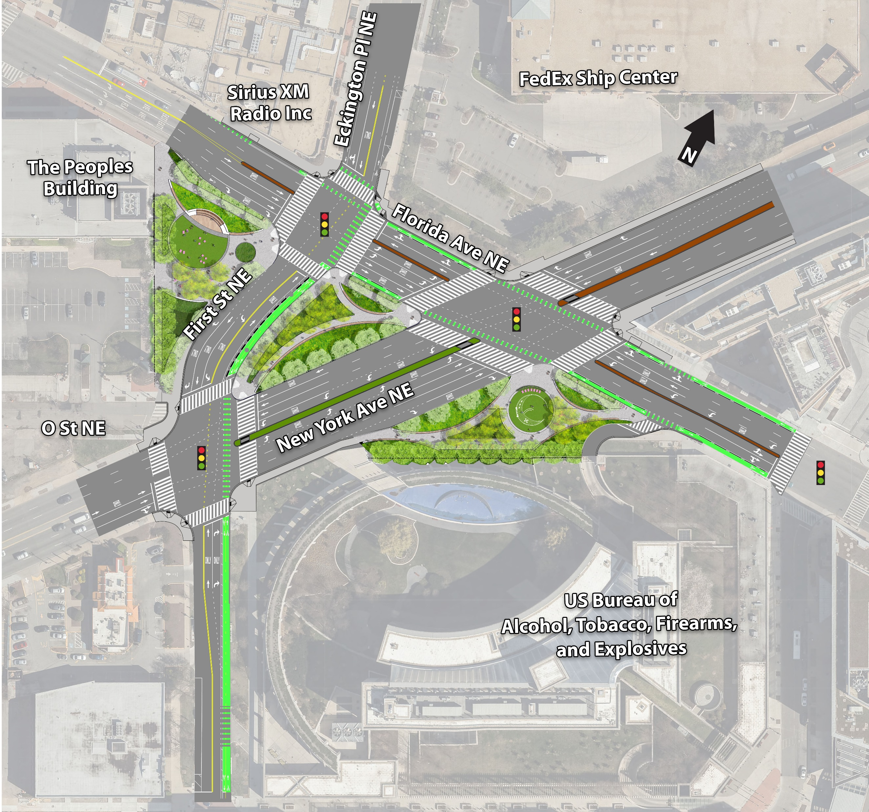
Florida Avenue-New York Avenue NE Intersection Project
Ward: 5 and 6
Performance Objective: Vehicular, Bicycle, and Pedestrian Safety and Access , Equity, Sustainability
Estimated Construction Start: FY22
Estimated Construction End: FY24
Budget Type: Federal and Local
Cost: TBD
Project Limits: Intersection of Florida Avenue NE, New York Avenue NE, First Street NE, and Eckington Place NE
Project Description: The redesigned intersection will advance DDOT's Vision Zero commitment by improving vehicular, bicycle, and pedestrian safety. This will be accomplished by improving roadway geometry to reduce confusion and improving connectivity. The project will also create three new public green spaces.
Challenges and Barriers: Relocation of Wendy's restaurant occupying property that was acquired by the District.
Opportunities to Expedite: None at this time.

Slide 30
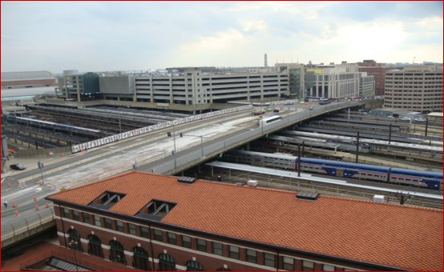
H Street Bridge Reconstruction
Ward: 5 and 6
Performance Objective: Core Infrastructure
Estimated Construction Start: FY23
Estimated Construction End: FY29
Budget Type: Federal and Local
Cost: TBD
Project Limits: North Capitol Street to 3rd Street NE
Project Description: The project will replace the structurally deficient bridge that was built in 1976. This project enables $14 billion worth of public and private investment, enhances Union Station as a transportation hub, and captures the value of one of the largest remaining developable sites in the city.
Challenges and Barriers: Ongoing coordination with railroads, utilities, and stakeholders, particularly Amtrak.
Opportunities to Expedite: None at this time.

Slide 31
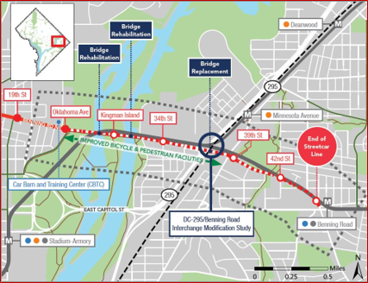
Benning Road Streetcar and Reconstruction Project
Ward: 5 and 7
Performance Objective: Vehicular, Bicycle, and Pedestrian Safety Equity, Sustainability
Estimated Construction Start: FY23
Estimated Construction End: FY26
Budget Type: Federal and Local
Cost: $111M Federal and $95M Local Capital
Project Limits: Benning Road between Oklahoma Avenue and East Capitol Street
Project Description: Replacement of the Whitlock Bridge over CSX and DC 295; safety and access improvements at Benning Road and DC 295 interchange; extension of DC Streetcar from Oklahoma to Benning Road Metro; rehabilitation and pedestrian and bicycle infrastructure enhancements on Ethel Kenney Bridge
Challenges and Barriers: Coordination with utilities. Community engagement and stakeholder buy-in.
Opportunities to Expedite: Coordination with utilities.

Slide 32
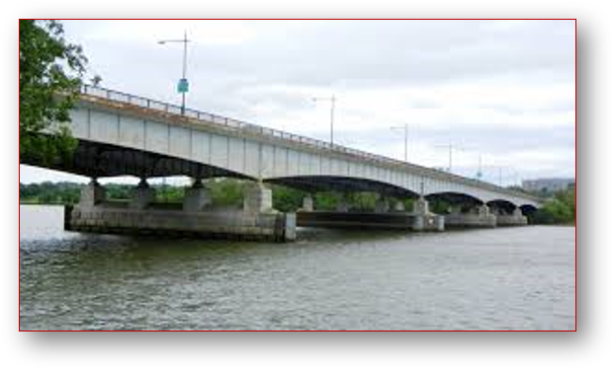
Rehabilitation of the Theodore Roosevelt Bridge
Ward: 2
Performance Objective: Core Infrastructure
Estimated Construction Start: FY23
Estimated Construction End: FY25
Budget Type: Federal
Cost: $110.5 M construction
Project Limits: Theodore Roosevelt Bridge over the Potomac River and Little River and the immediate approaches
Project Description: The project will rehabilitate the structurally deficient bridge that was built in 1964. Rehabilitation will involve upgrading and maintaining the current level of service by performing structural repairs and widening southside sidewalk to improve bicycle and pedestrian access.
Challenges and Barriers: Constant coordination with key stakeholders including National Park Service (NPS), Commonwealth of Virginia, and Arlington County; this project requires allocation of a significant portion of DDOT federal program.
Opportunities to Expedite: None at this time.

Slide 33
District of Columbia Power Line Undergrounding “DC PLUG” (Citywide)
Ward: 3, 4, 5, 7, and 8
Status: Planning / Design / Construction
Performance Objective: Core Infrastructure
Construction Start: 2019
Estimated Construction End: 2027
Budget Type: Local
Budget Estimate: $500 M = $250M (District) + $250 (Pepco)
Cost: $187.5M District Portion collected through a fee imposed on Pepco + up to $62.5M DDOT Capital Budget
Project Description: Undergrounding up to 30 electrical feeders that are most vulnerable to outages during storm conditions. DDOT will construct underground vaults and buried conduits to accommodate Pepco’s feeder lines and transformers. This project will support efforts to improve the resiliency and reliability of the District's electricity distribution system, in accordance with the recommendations of the Mayor's Power Line Undergrounding Task Force, the Electric Company Infrastructure Financing Act of 2013, and the Electric Company Infrastructure Improvement Financing Amendment Act of 2017.
Challenges and Barriers: Securing the full $62.5M of DDOT Capital Budget funds. Approximately $15.5M is unallocated.
Opportunities to Expedite: Contracted an on-call design consultant to whom design task orders can be issues, eliminating one-off procurements for design deliverables and expediting the procurement process.

