Slide 1
PROJECT DELIVERY ADMINISTRATION
FY21 4th QUARTER
CAPITAL PROJECTS UPDATE
October 2021

Slide 2
FY21 COMPLETED PROJECTS

Slide 3
G Street Cycle Track
Ward: 2
Performance Objective: Bicycle Safety, Sustainability
Construction Start: FY20
Construction End: FY21
Budget Type: Local
Cost: $310,000
Project Limits: From 17th St. NW to Virginia Ave. NW
Project Description: Two-way cycle track protected bike lane
Challenges and Barriers: Stakeholder engagement to balance multiple uses and demands, including loading and short-term parking.
Opportunities to Expedite: Project completed

Slide 4
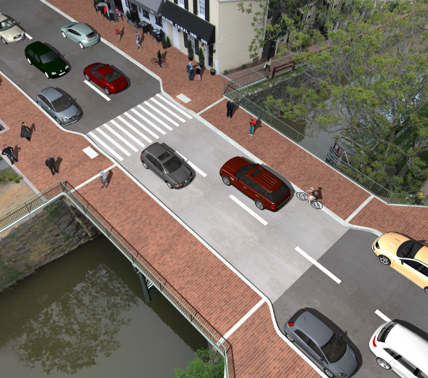
Replacement of 31st Street, NW Bridge over C&O Canal
Ward: 2
Performance Objective: Core Infrastructure
Construction Start: FY19
Construction End: FY21
Budget Type: Federal
Cost: $5M
Project Limits: From M Street NW to K Street NW
Project Description: Replacement of the structurally deficient bridge. Widening of the sidewalks to improve pedestrian access. Restore and preserve the existing historic pier as an aesthetic feature of the C&O Canal.
Challenges and Barriers: None at this time.
Opportunities to Expedite: Project completed.

Slide 5
New Jersey and New York Avenue, NW Safety Improvements
Ward: 6
Performance Objective: Improve Vehicular, Bicycle, and Pedestrian safety
Construction Start: FY19
Construction End: FY21
Budget Type: Federal
Cost: $13M
Project Limits: New Jersey Ave from H Street, NW to N Street, NW; New York Ave from 1st Street NW to 4th Street, NW
Project Description: This project advances DDOT's commitment to Vision Zero by converting New Jersey Avenue to two-way traffic operation. Addition of bicycle lanes and crosswalks including first protected intersection.
Challenges and Barriers: None at this time.
Opportunities to Expedite: Project completed.

Slide 6
Blagden Avenue Sidewalk
Ward: 4
Performance Objective: Pedestrian Safety
Construction Start: FY20
Estimated Construction End: FY21
Budget Type: Local
Cost: $935,000
Project Limits: Matthewson to Allison Streets NW
Project Description: The project provides about a quarter mile of sidewalk where there currently is none.
Challenges and Barriers: None at this time.
Opportunities to Expedite: Project completed.

Slide 7
Metropolitan Branch Trail (MBT) Eastern Avenue
Ward: 4
Performance Objective: Bicycle and Pedestrian Safety and Access, Sustainability
Construction Start: FY21
Estimated Construction End: FY21
Budget Type: Local
Cost: $1.1 million
Project Limits: Piney Branch Road to the DC/Maryland Line
Project Description: Construction of new porous asphalt trail including bioretention, new LED streetlights, and additional street trees
Challenges and Barriers: Continuing coordination with PEPCO for utility pole relocation during construction.
Opportunities to Expedite: Project was expedited for this fiscal year separate from the rest of the Metropolitan Branch Trail project to take advantage of recent PEPCO work in the project area.
Notes:
Moved from FY21 start to a FY22 start project – RS 7/14

Slide 8
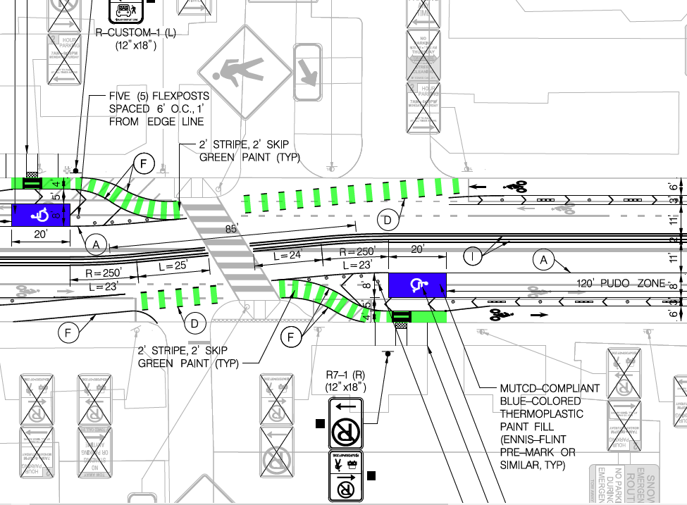
K Street NE Protected Bike Lane
Ward: 6
Performance Objective: Bicycle Safety, Equity, Sustainability
Construction Start: FY21
Estimated Construction End: FY21
Budget Type: Local
Cost: $427,000
Project Limits: From 1st St NE to 7th St NW
Project Description: Replace intermittent painted bike lanes with continuous protected bike lanes to provide a primary East/West bicycling route through downtown.
Challenges and Barriers: High demand for curbside access by competing interests, business & residential interests have varied levels of support for this project.
Opportunities to Expedite: Project completed.

Slide 9
West Virginia Avenue NE Protected Bike Lanes
Ward: 5 and 6
Performance Objective: Bicycle Safety, Equity, Sustainability
Construction Start: FY21
Estimated Construction End: FY21
Budget Type: Local
Cost: $225,000
Project Limits: From L St NE to New York Ave NE
Project Description: Install protected bike lanes along corridor to provide a safe bicycling route from K St area to Ivy City
Challenges and Barriers: Industrial uses along northern portion, residential uses along southern portion, interests not always aligned on purpose/need.
Opportunities to Expedite: Project completed.

Slide 10
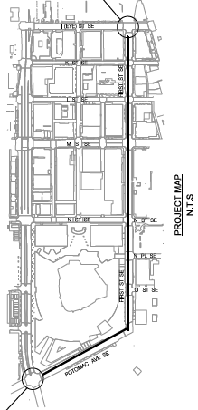
1st Street SE Protected Bike Lane
Ward: 6
Performance Objective: Bicycle Safety, Sustainability
Construction Start: FY21
Estimated Construction End: FY21
Budget Type: Local
Cost: $245,000
Project Limits: South Capitol St SE to I St SE
Project Description: Install protected bike lanes to access riverfront, Nationals Park, & growing high density residential/mixed use neighborhood
Challenges and Barriers: Stakeholder engagement
Opportunities to Expedite: Project completed.

Slide 11
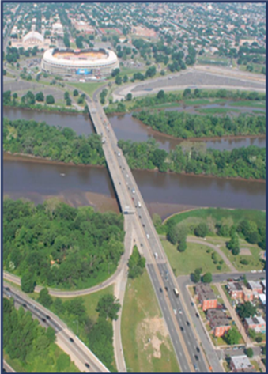
Rehabilitation of East Capitol Street Bridge over Anacostia River (Whitney Young Bridge)
Ward: 7
Performance Objective: Core Infrastructure
Construction Start: FY19
Estimated Construction End: FY21
Budget Type: Federal
Cost: $13.2M
Project Limits: Bridge and immediate approaches of Whitney Young Bridge
Project Description: Replacement of bridge bearings, widen bridge sidewalks, improve pedestrian access to the bridge through Anacostia Riverwalk Trail, rehabilitation of abutment backwalls, and deck overlay. Replace existing overhead sign support structures and panels; temporary roadway and drainage work; miscellaneous concrete and structural steel repairs.
Challenges and Barriers: Unforeseen challenges due to land use (BMX track on NPS land) and utility condition needed to be resolved prior to temporary lane closure.
Opportunities to Expedite: Project completed.

Slide 12
New Frederick Douglass Memorial Bridge / South Capitol Street Corridor
Ward: 6 and 8
Performance Objective: Core Infrastructure
Construction Start: FY17
Est. Construction End: FY21 (Bridge), FY22 (Ovals, Interchange)
Budget Type: Federal
Cost: $500M
Project Limits: South Capitol Street from N Street to Firth Sterling; I-295 from Firth Sterling to Howard Road
Project Description: In FY21 the project will complete a new six lane Frederick Douglass Memorial Bridge and deconstruct the structurally deficient South Capitol Street Bridge over Suitland Parkway built in 1964. It will also increase bicycle and pedestrian facilities and improve drainage and stormwater management across the bridge and at both FDMB abutments.
In FY22 the project will complete the construction of two new traffic ovals (one on each side of the Anacostia River) and the reconstruction of the Anacostia Freeway Bridges over Howard Road, Firth Sterling Avenue , and Suitland Parkway (another structurally deficient bridge built in 1964).
Challenges and Barriers: Delay from utility conflicts.
Opportunities to Expedite: Bridge portion of project completed.

Slide 13
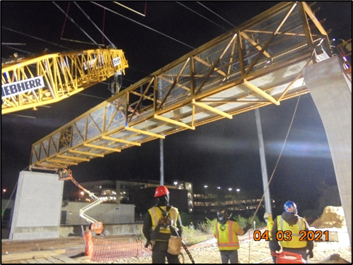
Parkside Pedestrian Bridge
Ward: 7
Performance Objective: Sustainability, Pedestrian Safety
Construction Start: FY20
Estimated Construction End: FY21
Budget Type: Local and Developer
Construction: $15M
Project Limits: From Minnesota Avenue Metro Station to Kenilworth Terrace NE
Project Description: The project will improve connections for neighborhoods on each side of DC-295, providing new access to the Minnesota Avenue Metro Station that is safe, well-lit, accessible, and available 24/7.
Challenges and Barriers: Coordination with CSX, Pepco, and WMATA.
Opportunities to Expedite: In June 2021, the Mayor released $250k in temporary funding through the District’s emergency contingency reserves to expedite the completion of this bridge to September 30, 2021 – two months earlier than planned.

Slide 14
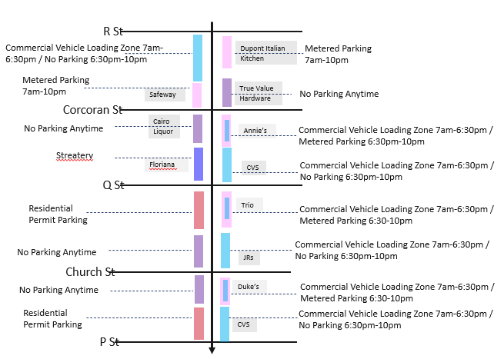
17th Street NW Protected Bike Lane
Ward: 2
Performance Objective: Bicycle and Pedestrian Safety
Construction Start: FY21
Estimated Construction End: FY21
Budget Type: Federal and local
Cost: $341,000
Project Limits: 17th Street NW between New Hampshire Avenue NW and K Street NW
Project Description: Project will add a parking protected bike lane on 17th Street, becoming a two-way protected northbound bike lane between P and R streets NW. Southbound vehicle and bicycle traffic will utilize one shared lane.
Challenges and Barriers: Accommodating the streateries added complications to the design. A solution was found by creating a parking plan with loading space during the day, and metered parking at night.
Opportunities to Expedite: Project completed.

Slide 15
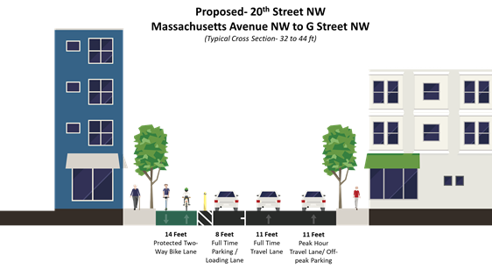
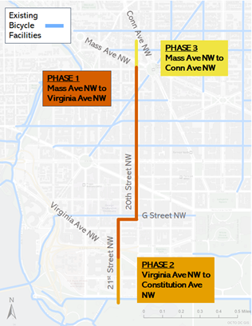
20th and 21st Street NW Protected Bike Lane
Ward: 2
Performance Objective: Bicycle Safety, Sustainability
Construction Start: FY21
Estimated Construction End: FY21
Budget Type: Federal and Local
Cost: $1.3M
Project Limits: West side of 20th Street NW between Massachusetts Avenue NW and G Street NW. East side of 21st Street NW between G Street NW and Constitution Avenue NW
Project Description: In 2018, DDOT conducted a planning study (20th/21st/22nd Protected Bike Lane Study) to identify a specific route for north- and south-running protected bike lanes between Dupont Circle, the western side of Downtown, and the National Mall that provides a safe environment for people biking of all ages and abilities.
After reviewing all public comments received, the ANC 2A and 2B resolutions, as well as the safety and operational considerations of the three alternatives, DDOT selected a recommended alternative, which advanced design in 2019. Construction began Fall 2020 and continues through Spring 2021.
Challenges and Barriers: Ongoing coordination with corridor stakeholders and need for parking/loading accommodations.
Opportunities to Expedite: Project completed.
Phase One will be designed along 20th Street NW from Massachusetts Avenue NW to Virginia Avenue NW.
Phase Two will be along 21st Street NW from Virginia Avenue NW to Constitution Avenue.
Phase Three will be along 20th Street from Massachusetts Avenue NW to Connecticut Avenue NW.
Phase One is planned to begin construction in fall 2020, with Phase Two to follow in late 2021. Phase Three does not yet have a construction date.

Slide 16
PROJECTS UNDER CONSTRUCTION DELIVERING IN FY 22

Slide 17
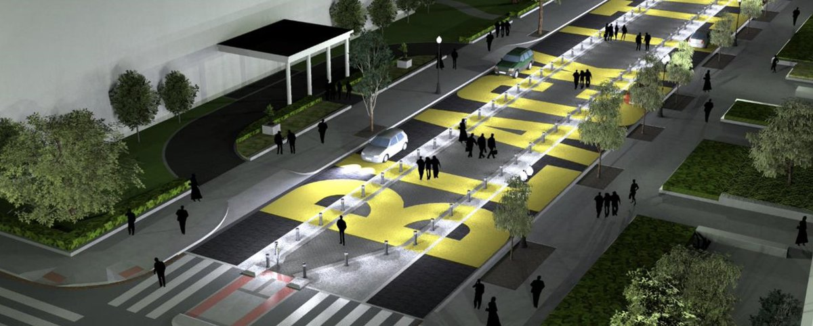
Black Lives Matter Plaza
Ward: 1
Performance Objective: Pedestrian Safety
Construction Start: FY21
Estimated Construction End: FY22
Budget Type: Local
Cost: $4M
Project Limits: 16th Street NW between H and K Streets NW
Project Description: Installation of roadway pavers, bollards, and the permanent Black Lives Matter mural. Once completed, the permanent installation will protect pedestrian safety while accommodating vehicles and keeping with the spirit of the original mural design.
Challenges and Barriers: Ongoing coordination for access with The Hay-Adams and The St. Regis Hotels.
Opportunities to Expedite: None. Project is on an expedited schedule with estimated completion in late October 2021.

Slide 18
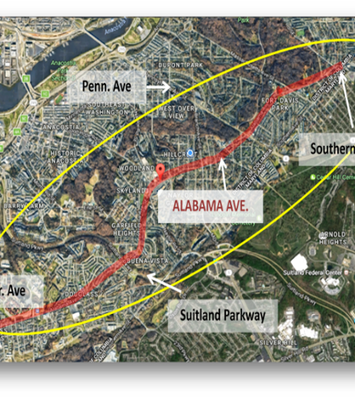
Alabama Avenue SE Corridor Safety Improvement Project
Ward: 8
Performance Objective: Vehicular and Pedestrian Safety
Construction Start: FY21
Estimated Construction End: FY22
Budget Type: Local
Cost: $600,000
Project Limits: 7th Street – 18th Street SE
Project Description: This Project is based on the findings of the 2017 Alabama Avenue SE Corridor Safety Study. To advance Vision Zero, the project will reduce travel lanes in some sections while maintaining parking along the corridor. Curb bump outs, refuge islands, and a HAWK signal at 15th Place SE improve pedestrian safety, a critical component of DDOT's Vision Zero program.
Challenges and Barriers: None at this time.
Opportunities to Expedite: None at this time.

Slide 19
Oregon Avenue NW Reconstruction
Ward: 4
Performance Objective: Core Infrastructure
Construction Start: FY20
Estimated Construction End: FY22
Budget Type: Federal
Cost: $29.2M
Project Limits: From Military Road to Western Avenue NW.
Project Description: This project aims to improve the overall roadway and storm management infrastructure. The project, which went through an Environmental Assessment (EA) process, includes construction of new sidewalk, stormwater Low-Impact Development (LIDs), and streetlights, as well as replacement of a deteriorated large box culvert with a new bridge over Pinehurst Run.
Challenges and Barriers: None at this time.
Opportunities to Expedite: None at this time

Slide 20
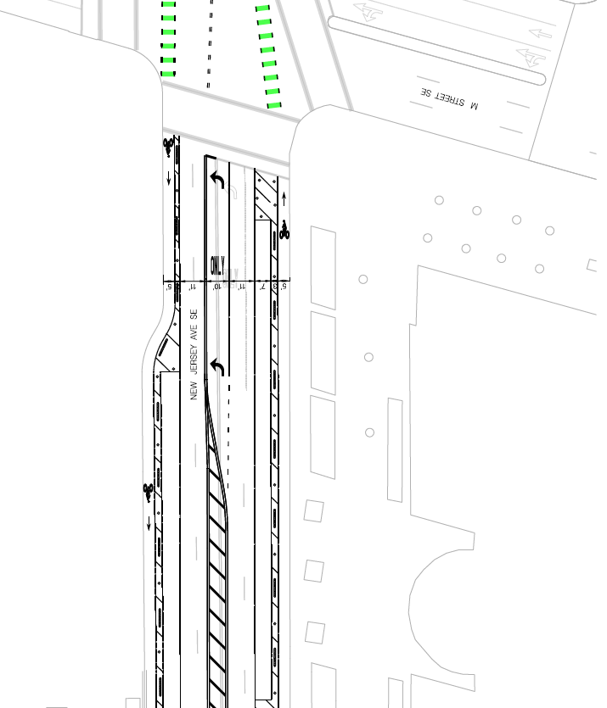
New Jersey Avenue SE Protected Bike Lanes
Ward: 6
Performance Objective: Bicycle Safety, Sustainability
Construction Start: FY22
Estimated Construction End: FY22
Budget Type: Local
Cost: $165,000
Project Limits: H Street SE to Tingey Square SE (Navy Yard)
Project Description: Extend existing protected bike lanes south to meet bike lanes at Tingey Square, crosses in front of USDOT Headquarters.
Challenges and Barriers: Stakeholder concern over relocation of loading / PUDO zones.
Opportunities to Expedite: EOM support and outreach to Secretary of USDOT for public support/publicity.

Slide 21
Revitalization of Martin Luther King Jr., Avenue SE Phase 1
Ward: 8
Performance Objective: Vehicular and Pedestrian Safety
Construction Start: FY20
Estimated Construction End: FY22
Budget Type: Local
Cost: $8M
Project Limits: From Milwaukee Place SE to 4th Street SE
Project Description: In support of DDOT's commitment to Vision Zero, this project improves pedestrian and vehicular safety in the MLK corridor. The project includes street and sidewalk enhancements and will improve the aesthetics of the corridor.
Challenges and Barriers: None at this time.
Opportunities to Expedite: None at this time.

Slide 22
Maryland Avenue NE Multi-Modal Improvements
Ward: 6
Performance Objective: Vision Zero, Multimobility
Construction Start: FY19
Estimated Construction End: FY22
Budget Type: Federal and Local
Cost: $22M
Project Limits: From 2nd Street, NE to 14th Street, NE
Project Description: The project provides multi-modal improvements to the Maryland Avenue NE corridor to improve pedestrian and overall corridor safety, add bicycle lanes, and incorporate a “road diet” to slow traffic by reducing lanes. The project aims to improve bus operations, traffic signal operations, lighting, and drainage.
Challenges and Barriers: Coordination with Washington Gas capital project working concurrently.
Opportunities to Expedite: None at this time.

Slide 23
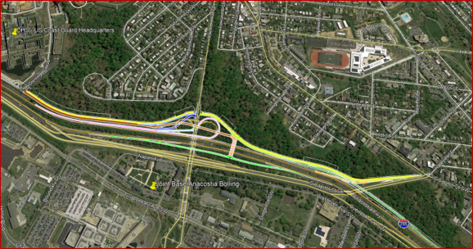
I-295/Malcolm X Avenue Interchange Improvement
Ward: 8
Performance Objective: Core infrastructure
Construction Start: FY18
Estimated Construction End: FY22
Budget Type: Federal
Cost: $ 105 M
Project Limits: From Firth Sterling Ave SE to MLK Jr. Ave SE.
Project Description: Project will build access roads from I-295 to St. Elizabeth’s West Campus, site of Department of Homeland Security. The construction project includes 3.45 lane miles of roadway, 6 new overpass bridges, one overpass bridge widening, 240,000 sf of walls with aesthetic finish, and improved streetlights, traffic signals, and landscaping. The project has a requirement for new hires and trainees to be at least 51% DC residents. The project also has a requirement of 29 trainees for On the Job Training (OJT). In addition, the Construction Management consultant team will train four local trainees to become inspectors.
Challenges and Barriers: Unforeseen conditions and utility conflicts. Stakeholder management is also a challenge.
Opportunities to Expedite: None at this time.

Slide 24
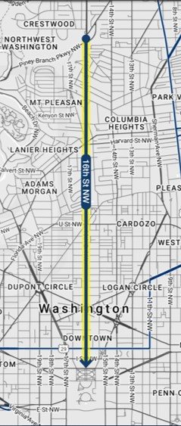
16th Street NW Transit Priority Project
Ward: 1, 2, and 6
Performance Objective: Bus Priority, Equity, Sustainability
Construction Start: FY21
Estimated Construction End: FY22
Budget Type: Federal and local
Cost: $12M
Project Limits: 16th Street from Arkansas Ave NW to H St NW
Project Description: ​This bus priority project will improve transit performance and reliability of a 2.7 mile segment of 16th St NW. Design includes peak period red bus lanes, bus stop enhancements, pedestrian improvements, transit signal priority, and queue jumps. Project will have automated traffic enforcement to ensure performance.
Challenges and Barriers: None at this time.
Opportunities to Expedite: None at this time.

Slide 25
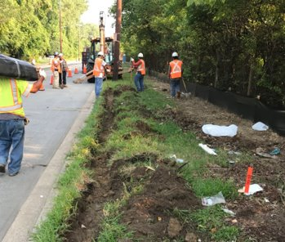
Metropolitan Branch Trail (MBT) Brookland to Fort Totten
Ward: 4 and 5
Performance Objective: Bicycle and Pedestrian Safety and Access; Sustainability
Construction Start: FY19
Estimated Construction End: FY22
Budget Type: Federal and Local
Cost: $8.5M
Project Limits: From John McCormack Drive to First Place NE
Project Description: Design-Build construction extending the MBT from Brookland to the Fort Totten Metro, along the Red Line tracks over the Green Line tunnel.
Challenges and Barriers: Ongoing coordination with WMATA, National Park Service (NPS), and District Department of Energy and Environment (DOEE) for construction activity along Red Line.
Opportunities to Expedite: None at this time.

Slide 26
Virginia Avenue NW Protected Bike Lanes
Ward: 2
Performance Objective: Bicycle Safety, Sustainability
Construction Start: FY21
Estimated Construction End: FY22
Budget Type: Federal and Local
Cost: $1.3M
Project Limits: Rock Creek Parkway NW to 18th/Constitution NW
Project Description: Adding protected bike lanes that connect Georgetown, Theodore Roosevelt Bridge path, G St protected bike lanes, Foggy Bottom, and the Mall.
Challenges and Barriers: Federal stakeholders with changing needs, residential stakeholders with differing views on goals.
Opportunities to Expedite: None at this time.

Slide 27
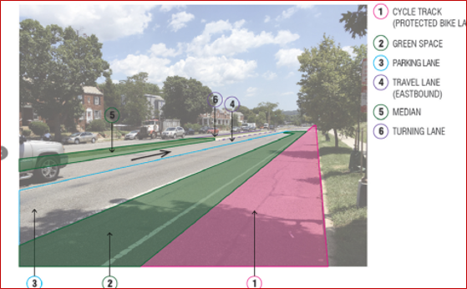
C Street NE Safety Improvements
Ward: 6
Performance Objective: Multimobility, Vision Zero
Construction Start: FY21
Estimated Construction End: FY22
Budget Type: Federal
Cost: $17M
Project Limits: C Street from 14th Street to 21st Street NE and North Carolina Avenue from 14th Street to 16th Street NE
Project Description: This project involves a road diet to reduce the number of vehicle travel lanes, as well as adding protected bicycle lanes and curb extensions to improve safety for pedestrians and bicyclists. The project will add green infrastructure and improve circulation by adding left turn lanes.
Challenges and Barriers: None at this time
Opportunities to Expedite: None at this time

Slide 28
PROJECTS UNDER CONSTRUCTION DELIVERING IN FY 22
Chestnut Street NW Sidewalk (Ward 4)
Reconstruction of Florida Avenue/9th Street NW (Ward 1)
Southern Avenue Phase 2 (Barnaby Road to UMC Campus) (Ward 8)

Slide 29
PROJECTS UNDER CONSTRUCTION DELIVERING IN FY 23

Slide 30
Massachusetts Avenue NW Reconstruction
Ward: 2
Performance Objective: Core Infrastructure
Construction Start: FY21
Estimated Construction End: FY23
Budget Type: Federal
Cost: $25M
Project Limits: 20th Street to Waterside Drive NW
Project Description: Reconstruction of 0.86 mile roadway section in which the subgrade has deteriorated to poor condition. Improvement of streetscape elements to improve safety including sidewalks, ADA ramps, traffic signals, streetlight, and Low-Impact Development (LID).
Challenges and Barriers: Coordination with various stakeholders including 34 foreign embassies. Contractor overlap due to major Washington Gas upgrade within the same project footprint.
Opportunities to Expedite: None at this time.

Slide 31
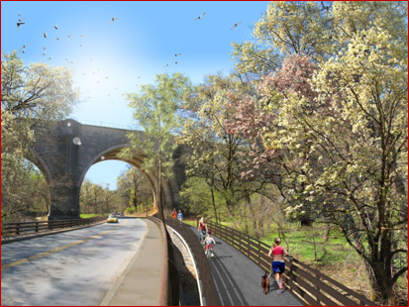
Rock Creek Park Multi-Use Trail and Pedestrian Bridge
Ward: 1, 2, 3, and 4
Performance Objective: Bicycle and Pedestrian Safety and Access, Sustainability
Construction Start: FY21
Estimated Construction End: FY23
Budget Type: Federal
Cost: $18.9 M
Project Limits: M Street to Broad Branch Road NW; Piney Branch Parkway; Beach Drive to Arkansas Avenue NW
Project Description: This project includes 3.7 miles of trail and the construction of a new pedestrian bridge entirely on National Park Service (NPS) land.
Challenges and Barriers: None at this time.
Opportunities to Expedite: None at this time.

Slide 32
Pennsylvania Avenue SE Streetlights (2nd – 13th Street SE)
Ward: 6
Performance Objective: Core infrastructure
Construction Start: FY21
Estimated Construction End: FY23
Budget Type: Federal
Cost: $15.3 M
Project Limits: Pennsylvania Ave SE from 2nd-13th Street SE
Project Description: This project will convert streetlights to LED luminaries, upgrade traffic signals at intersections, repair sidewalks and ADA ramps to improve pedestrian mobility, and repave the road.
Challenges and Barriers: None at this time
Opportunities to Expedite: None at this time

Slide 33
PROJECT PREVIEW

Slide 34
CONSTRUCTION SCHEDULED TO BEGIN IN FY22
Cleveland Park NW Streetscape and Drainage Project (Phase 1) (Ward 3)
16th Street Bridge over Piney Branch Parkway Reconstruction (Wards 1 and 4)
Florida Avenue (2nd Street to H Street) NE Multimodal Safety and Streetscape (Wards 5 and 6)
Douglas Street NE Pedestrian Bridge (Ward 7)
Kenilworth Avenue SE Reconstruction (south of Nannie Helen Burroughs to CSX Railroad Ramp) (Ward 7)
Pennsylvania Avenue & Minnesota Avenue SE Intersection Safety Project (Ward 7)
Revitalization of Martin Luther King, Jr, Avenue SE Phase 2 (4th Street SE to South Capitol Street) (Ward 8)
Florida Avenue-New York Avenue NE Intersection Project (Wards 5 and 6)
Metropolitan Branch Trail (MBT) Fort Totten to Takoma (Wards 4 and 5)

Slide 35
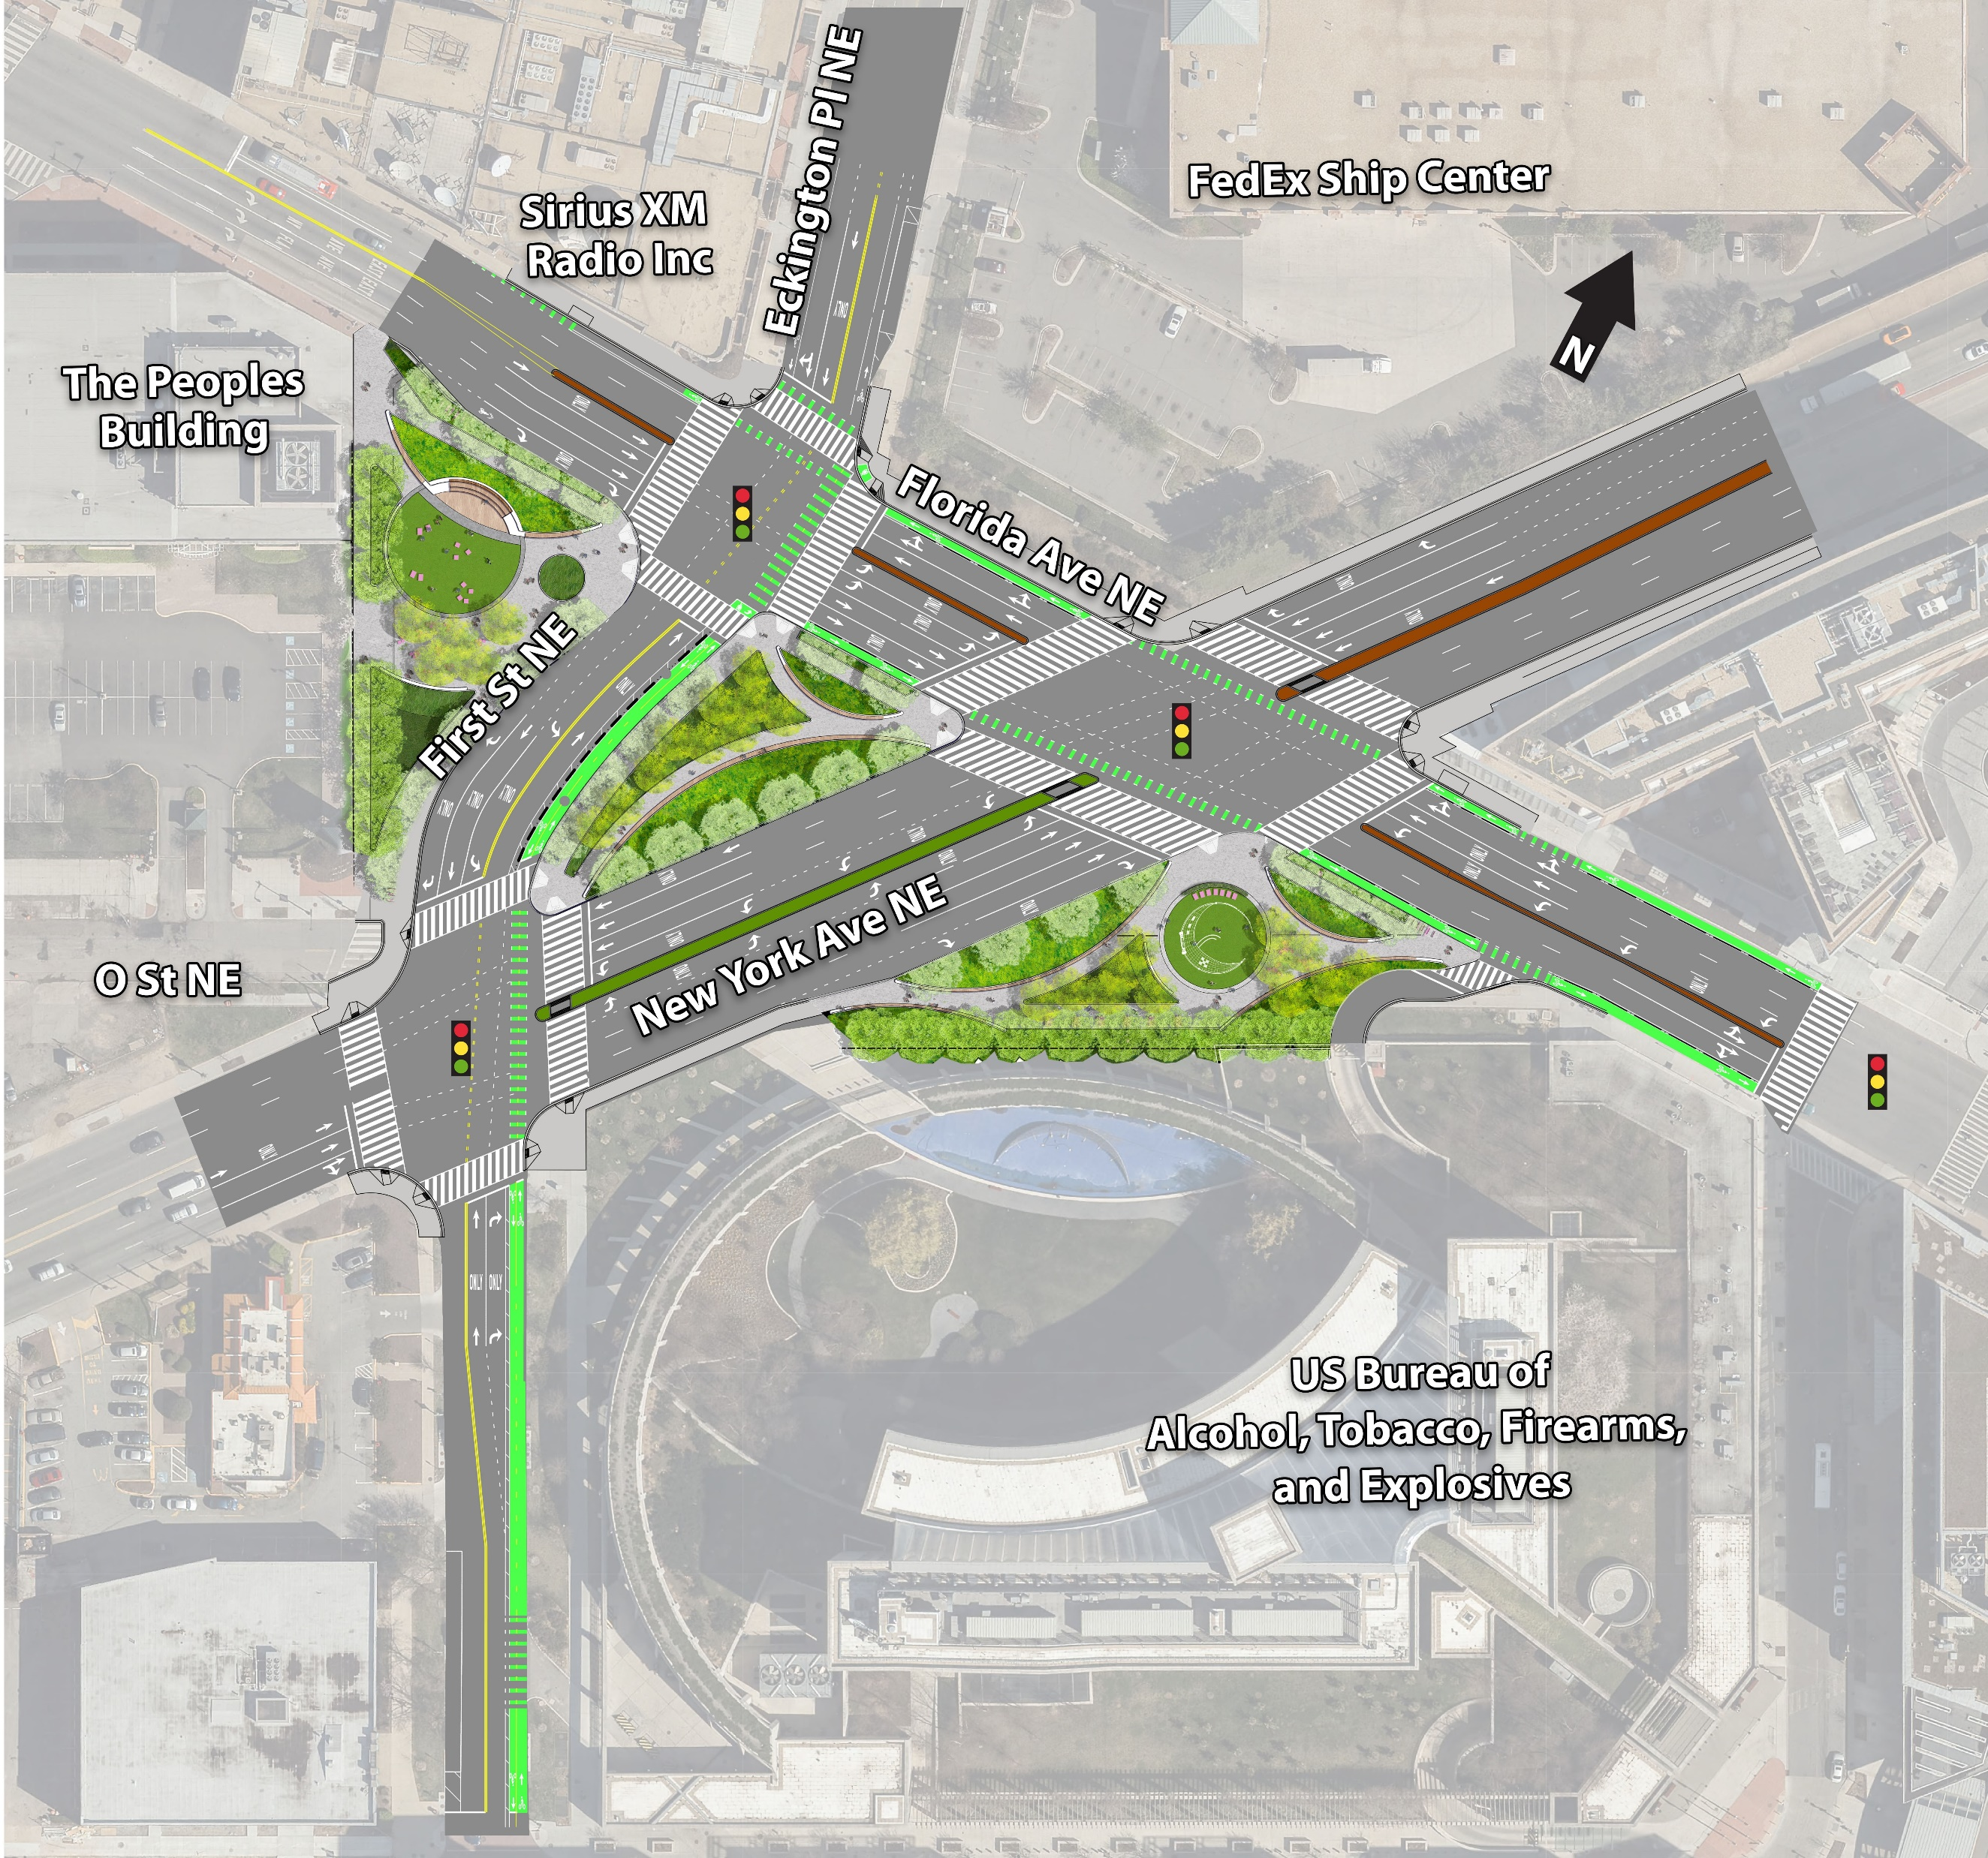
Florida Avenue-New York Avenue NE Intersection Project
Ward: 5 and 6
Performance Objective: Vehicular, Bicycle, and Pedestrian Safety and Access , Equity, Sustainability
Estimated Construction Start: FY22
Estimated Construction End: FY24
Budget Type: Federal and Local
Cost: TBD
Project Limits: Intersection of Florida Avenue NE, New York Avenue NE, First Street NE, and Eckington Place NE
Project Description: The redesigned intersection will advance DDOT's Vision Zero commitment by improving vehicular, bicycle, and pedestrian safety. This will be accomplished by improving roadway geometry to reduce confusion and improving connectivity. The project will also create three new public green spaces.
Challenges and Barriers: Relocation of Wendy's restaurant occupying property that was acquired by the District.
Opportunities to Expedite: None at this time.

Slide 36
Metropolitan Branch Trail (MBT): Ft Totten to Takoma
Ward: 5 & 4
Performance Objective: Bicycle and Pedestrian Safety and Access, Sustainability
Estimated Construction Start: FY22
Estimated Construction End: FY24
Budget Type: Federal
Cost: $18.7M
Project Limits: From First Place NW to Sandy Spring Street NW.
Project Description: Metropolitan Branch Trail is a key transportation route facilitating access to many residential areas and business as well as convenient access to Metro stations. This project will provide a connection for bicyclists and pedestrians to the surrounding neighborhoods, Metrorail stations, and the regional trail network.
Challenges and Barriers: Stakeholders coordination.
Opportunities to Expedite: None at this time.

Slide 37
CONSTRUCTION SCHEDULED TO BEGIN IN FY23
K Street Transitway (Ward 2)
Benning Road Reconstruction and Streetcar Project (Ward 7)
H Street Bridge Reconstruction (Ward 6)
I-395 HOV Bridge over Potomac River (Ward 2)
Theodore Roosevelt Bridge Rehabilitation Project (Ward 2)
Lane Place Pedestrian Bridge (Ward 7)
Aspen Street NW Rehabilitation (Ward 4)
Kennedy Street NW Reconstruction (Ward 4)
Southern Avenue Phase 1 (South Capitol Street to Barnaby Road) (Ward 8)

Slide 38
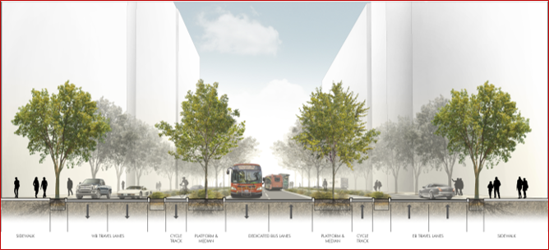
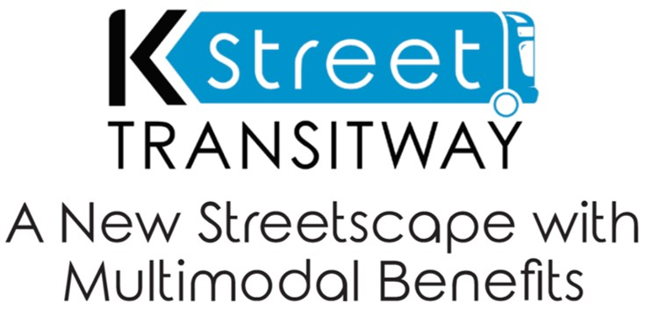
K Street Transitway
Ward: 2
Performance Objective: Bus Priority, Bicycle Safety and Access
Estimated Construction Start:FY23
Estimated Construction End: FY24
Budget Type: Local
Construction: $124.7M
Project Limits: K Street from 12th Street to 21st Street NW
Project Description: K Street Transitway will improve on-time bus performance and reliability of east-west bus routes across the District. It will feature a 2-way dedicated bus stops, lighting, landscaping, pedestrian amenities and protected bicycle lanes.
Challenges and Barriers: Utility relocation, curbside management (operations and policy to complement new street design), construction impacts to businesses and traffic.
Opportunities to Expedite: MOU with utilities

Slide 39
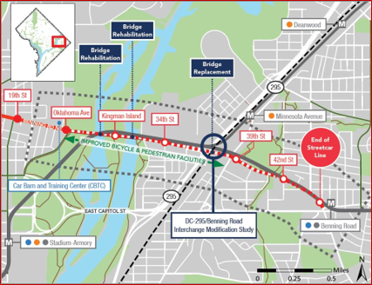
Benning Road Streetcar and Reconstruction Project
Ward: 5 and 7
Performance Objective: Vehicular, Bicycle, and Pedestrian Safety Equity, Sustainability
Estimated Construction Start: FY23
Estimated Construction End: FY26
Budget Type: Federal and Local
Cost: $111M Federal and $95M Local Capital
Project Limits: Benning Road between Oklahoma Avenue and East Capitol Street
Project Description: Replacement of the Whitlock Bridge over CSX and DC 295; safety and access improvements at Benning Road and DC 295 interchange; extension of DC Streetcar from Oklahoma to Benning Road Metro; rehabilitation and pedestrian and bicycle infrastructure enhancements on Ethel Kenney Bridge
Challenges and Barriers: Coordination with utilities. Community engagement and stakeholder buy-in.
Opportunities to Expedite: Coordination with utilities.

Slide 40
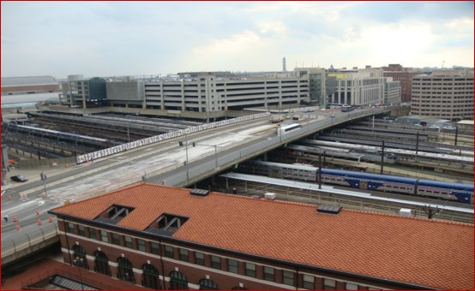
H Street Bridge Reconstruction
Ward: 5 and 6
Performance Objective: Core Infrastructure
Estimated Construction Start: FY23
Estimated Construction End: FY29
Budget Type: Federal and Local
Cost: TBD
Project Limits: North Capitol Street to 3rd Street NE
Project Description: The project will replace the structurally deficient bridge that was built in 1976. This project enables $14 billion worth of public and private investment, enhances Union Station as a transportation hub, and captures the value of one of the largest remaining developable sites in the city.
Challenges and Barriers: Ongoing coordination with railroads, utilities, and stakeholders, particularly Amtrak.
Opportunities to Expedite: None at this time.

Slide 41
I-395 HOV Bridge over Potomac River
Ward: 2
Performance Objective: Core Infrastructure
Estimated Construction Start: FY23
Estimated Construction End: FY26
Budget Type: Federal
Budget Estimate: $26 M
Project Limit: Over Potomac River and immediate approaches
Project Description: Rehabilitation of existing bridge to upgrade and maintain current level of service for 40 years by performing structural repairs. Pier crack repairs, deck overlay, steel bridge coating restoration and bridge lighting upgrade.
Challenges and Barriers: Securing staging and laydown areas for construction. Coordination with other stakeholders including Commonwealth of Virginia, National Park Service (NPS), U.S. Coast Guard, and U.S. Army Corps of Engineers.
Opportunities to Expedite: None at this time

Slide 42
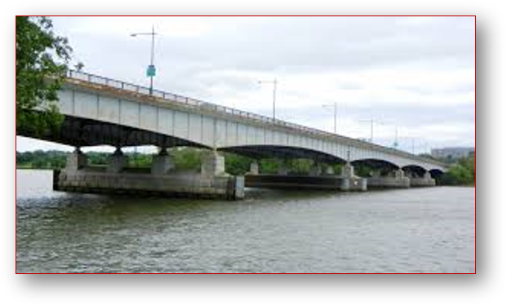
Rehabilitation of the Theodore Roosevelt Bridge
Ward: 2
Performance Objective: Core Infrastructure
Estimated Construction Start: FY23
Estimated Construction End: FY25
Budget Type: Federal
Cost: $110.5 M construction
Project Limits: Theodore Roosevelt Bridge over the Potomac River and Little River and the immediate approaches
Project Description: The project will rehabilitate the structurally deficient bridge that was built in 1964. Rehabilitation will involve upgrading and maintaining the current level of service by performing structural repairs and widening southside sidewalk to improve bicycle and pedestrian access.
Challenges and Barriers: Constant coordination with key stakeholders including National Park Service (NPS), Commonwealth of Virginia, and Arlington County; this project requires allocation of a significant portion of DDOT federal program.
Opportunities to Expedite: None at this time.

Slide 43
District of Columbia Power Line Undergrounding “DC PLUG” (Citywide)
Ward: 3, 4, 5, 7, and 8
Status: Planning / Design / Construction
Performance Objective: Core Infrastructure
Construction Start: 2019
Estimated Construction End: 2027
Budget Type: Local
Budget Estimate: $500 M = $250M (District) + $250 (Pepco)
Cost: $187.5M District Portion collected through a fee imposed on Pepco + up to $62.5M DDOT Capital Budget
Project Description: Undergrounding up to 30 electrical feeders that are most vulnerable to outages during storm conditions. DDOT will construct underground vaults and buried conduits to accommodate Pepco’s feeder lines and transformers. This project will support efforts to improve the resiliency and reliability of the District's electricity distribution system, in accordance with the recommendations of the Mayor's Power Line Undergrounding Task Force, the Electric Company Infrastructure Financing Act of 2013, and the Electric Company Infrastructure Improvement Financing Amendment Act of 2017.
Challenges and Barriers: Securing the full $62.5M of DDOT Capital Budget funds. Approximately $15.5M is unallocated.
Opportunities to Expedite: Contracted an on-call design consultant to whom design task orders can be issues, eliminating one-off procurements for design deliverables and expediting the procurement process.

