Slide 1
District Department of Transportation
Discussion of the District’s Mobility Vision
2/18/2021 (updated 3/5/21)

Slide 2
District Department of Transportation (DDOT)
DDOT's mission is to equitably deliver a safe, sustainable and reliable multimodal transportation network for all residents and visitors of the District of Columbia.
DDOT is committed to elevating and advancing transportation equity to ensure public investments in transportation justly benefit all residents, visitors and commuters.
DDOT is committed to implementing its goals outlined in moveDC:
DDOT's investments in pedestrian, bicycle and transit meet many of DDOT's goals: especially mobility and sustainability while advancing equity.
Safety
Mobility
Management & Operations
Project Delivery
Sustainability
Enjoyable Spaces
Notes:
moveDC is DDOT’s plan that sets the 25-year vision for the transportation system. It is a federal requirement.
moveDC is used to guide and prioritize investment and development
moveDC is updated regularly to reflect the evolving needs of the District. It was completed in 2014, and the update we are undertaking now will be released this year.

Slide 3
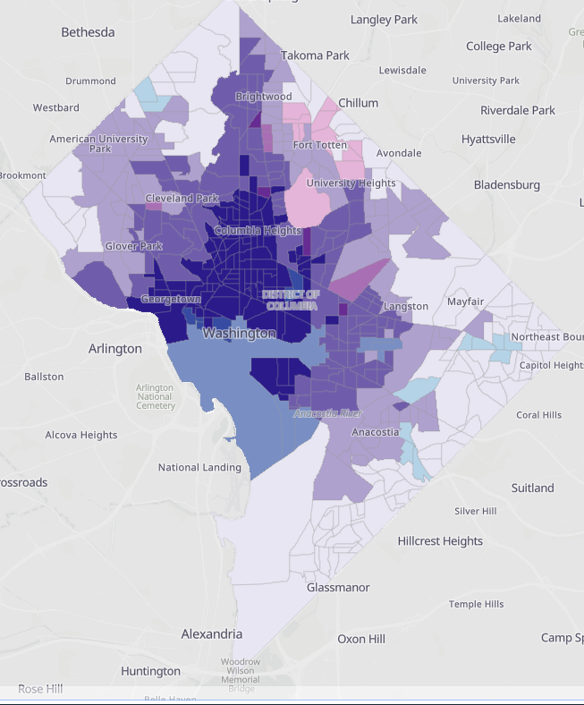
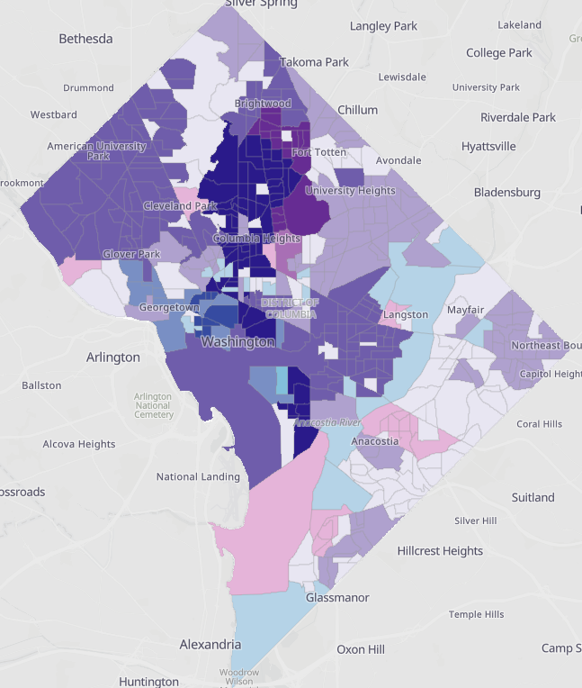
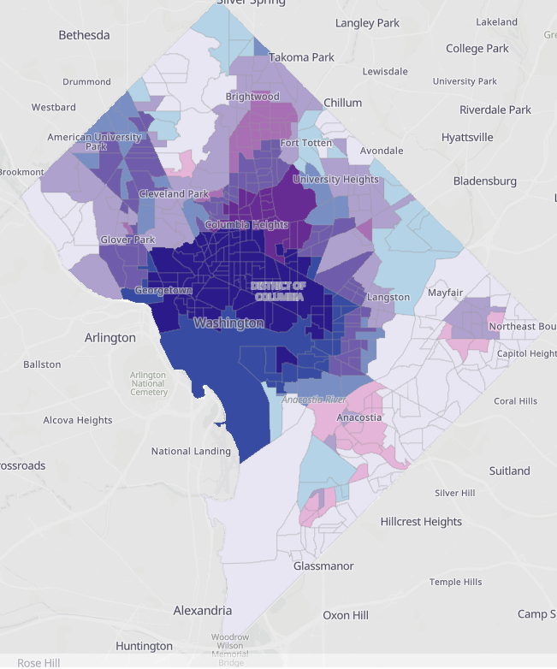
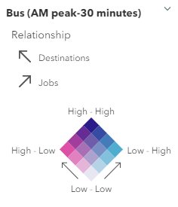
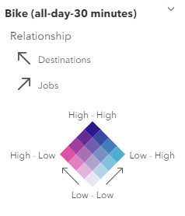
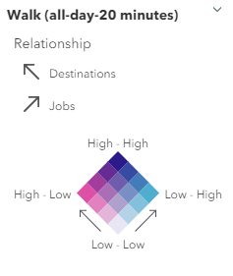
Investing in transit, bicycle, and pedestrian facilities will improve equity in accessibility of where residents need to go
30-minute bus ride
30-minute bike ride
20-minute walk
moveDC 2021 Update Snapshot
Notes:
Jobs are concentrated in the core while historically under-resourced communities are often in the areas outside of the core. Investing in our transit, bicycle and pedestrian facilities will improve resident's ability to get to where they need to go within 30 minutes.
The maps above show the access to various transit types and how that access is currently inequitable. Areas of dark purple indicate more transit options, more bicycling facility availability and available sidewalk networks, making it easier to efficiently and safely get around in those areas. Lighter colored areas represent less availability of buses, bike facilities and sidewalks.
Jobs data source: 2018 Longitudinal Employer-Household Dynamics (LEHD), adjusted to account for federal jobs.
Destinations include the following locations: Grocery stores, supermarkets, big box stores, hospitals, health clinics, high schools, colleges and universities, senior centers, recreation centers, community centers, social security offices, libraries, city halls, post offices and pharmacies.

Slide 4
DDOT is focused on improved mobility in all 8 wards
This transportation needs map shows proximity to high frequency transit, access to jobs and destinations, and safety risks. DDOT recognizes the opportunity to improve access and safety for historically under-resourced communities.
Transportation Needs Index
Least Need
Greatest Need
moveDC 2021 Update
Notes:
The map reflects an index: the darker the shade of purple is where the we have the greatest transportation needs as defined by proximity to high frequency transit, access to jobs and safety. The graph shows how the populations of historically under-resourced communities are distributed in the areas of greatest and least transportation need.
The areas with the greatest transportation needs contain higher concentrations of historically marginalized residents.
More details: The index blends the information from the previous screen (access to jobs and destinations) with proximity to high frequency transit and safety issues and creates an index on transportation needs. Disadvantaged people are over-represented in areas with the greatest transportation needs. This will require DDOT to be intentional and inclusive as we advance our projects and programs.
More on the index
Proximity to Frequent Transit
This index measures areas of the District that have access to transit stations and stops with high service frequency (pre-COVID levels) as follows:
Access to Rail – areas within ½-mile walking distance of rail stations with train frequencies of 5 minutes or better during peak and midday
Access to Bus – areas within ¼-mile walking distance of bus stops with bus frequencies of 10 minutes or better during peak and midday
Areas with lower access to frequent transit have a greater transportation need.
Access to Jobs and Destinations
This index measures areas of the District that have access to jobs and key destinations as follows:
Access to Jobs1 – jobs in the region that can be reached:
Access to Destinations2 – destinations in the region that can be reached:
Within a 20-minute walk
Within a 30-minute bike ride on low-stress streets
Within a 30-minute bus ride
Within a 30-minute train ride
Within a 45-minute train and bus ride (that involves a transfer from one to the other)
Within a 45-minute drive
Areas with lower access to jobs and destinations have a greater transportation need.
Safety Risks
This index measures areas of the District based on proximity to safety risks as follows:
High-stress/low-comfort cycling routes
Sidewalk gaps
Vision Zero high-crash corridors
Areas that are closer to safety risks have a greater transportation need.

Slide 5
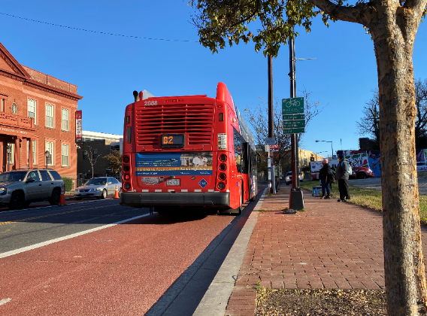
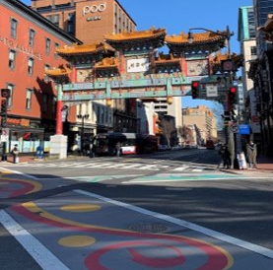
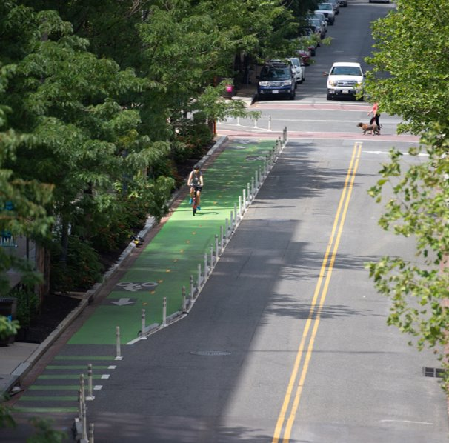
The District will achieve 75% of all commute trips by non-auto modes by 2032
BUS
WALK
& BIKE
DDOT is committed to improving bus speeds and reliability
DDOT is committed to integrating and expanding the bicycle and pedestrian network
DDOT is committed improving economic equity and accessibility through safe, efficient, integrated transit options
Notes:
This is very achievable and continuing to invest in our transit, bike and pedestrian infrastructure we will get there. Currently 58.5% of commute trips are made by non-auto modes ( transit, walking, biking or teleworking); we need to help 16.5% more commuters make a different decision). (this does not account for covid; it is based on the most recent Census – 2018)
(covid: The Transportation Planning Board (TPB) found that traffic levels were recorded well below 2019 levels beginning in March 2020 (-21.9 percent), reached their lowest point in April 2020 (-50.5 percent), and began to rebound in May 2020. In the summer months of 2020, traffic levels were nearly 20 percent lower than the same period in 2019. Of the three jurisdictional groupings, the region’s core—or District of Columbia, Arlington, and Alexandria—experienced the biggest drop in traffic, and has been the slowest to rebound. TPB also conducted an employer telework survey also asked about post-pandemic plans. Fifty-seven percent of work sites expected to see a long-term increase in teleworking, even when the pandemic is over.)
moveDC policies (have gone out for public feedback in Fall 2020 receiving general agreement to all of them; have been approved internally)
Policy 17: Promote partnerships and programs such as travel demand management to achieve 75% of all commute trips in the District by non-auto modes by 2032 (this is also in DOEE Sustainable DC and the Comprehensive Plan)
Policy 14: Improve economic equity and accessibility through safe, efficient, integrated and affordable transit options.
Policy 15: Improve bus speeds and reliability through strategic transit priority treatments.
Policy 10: Integrate and expand the bicycle and pedestrian network to ensure safe, connected and more equitable infrastructure for all users.

Slide 6
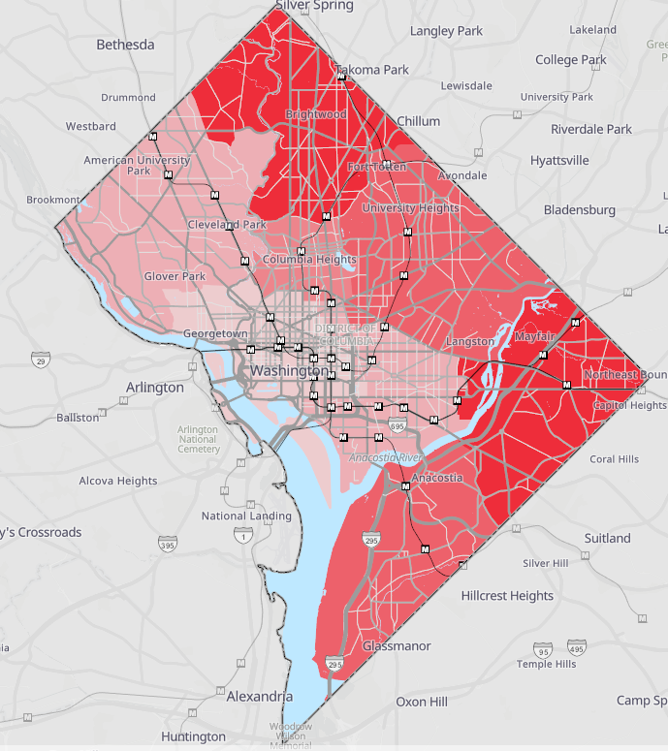
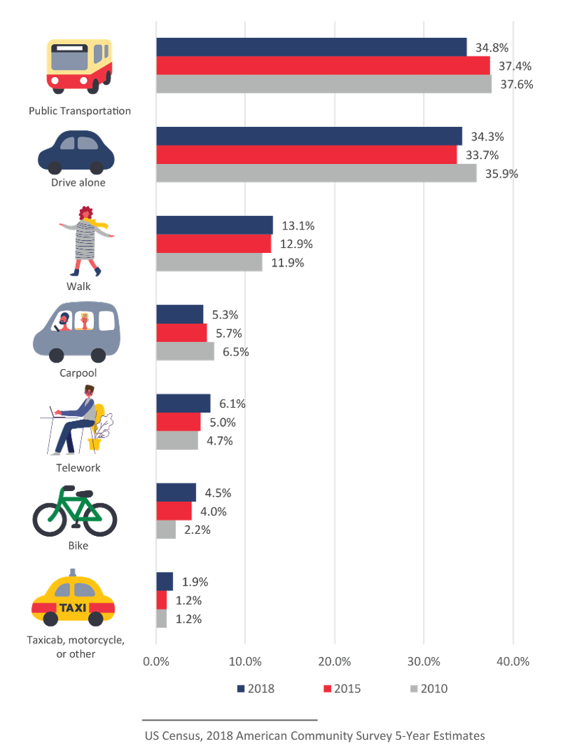
Opportunities for mobility improvements
46% of DDOT’s 6-year CIP request is directly related to bicycle, pedestrian, and transit improvements
Comprehensive transit network improvements will help improve the time it takes residents to get to work
Comprehensive, safe bike and pedestrian networks will help accelerate growth in walking and biking
Average Commute Time for all Modes by Ward
moveDC 2021 Update Snapshot
Notes:
The map shows that where you live influences the time it takes for you to get to work. DDOT values all residents' time and wants to improve the equitable access to high frequency transit and reduce commute times. The average commute time for the District is 32 minutes but varies by location. (Nationwide the average commute is 27 minutes (2018 American community survey 5-year estimate))
More residents are walking or biking to work for a total of 17.6% in 2018. DDOT has the opportunity to accelerate that growth by making that choice easier for residents to make by ensuring our sidewalk and bicycle networks are safe, integrated and accessible. (Nationwide and in the District, transit ridership is in decline as it competes with ride-hailing services, car share, scooter share, and increased urban congestion. Teleworking is also on the rise (an increase of 1.3 percent since 2010), reducing the need for traditional commuting. Transit mode share has decreased over the last decade by three percent while walking, biking, teleworking, and taxi and taxi-like service has increased in mode share. Despite these trends, bus transit remains a critical piece of the mobility fabric, with nearly as many people in the region riding the bus every day as ride rail.)
FY 22 Proposed vs. FY 21 Approved: Our request is focused on achieving 75% of all commute trips by non-auto modes.
For Bike, Ped, and Transit categories DDOT’s request is a $60M increase compared to Year 1 of the current CIP; and $302M increase over the 6-years.
Year 1: In year 1 of the current CIP DDOT’s budget is 44% focused on bike, ped, and transit compared to 51% in proposed request.
6-Year Plan: For the full six-year period in the current CIP DDOT’s 40% focused on bike, ped, and transit compared to 46% in the proposed request.
Current vs. Proposed:
Transit: $62M increase in Year 1 and $181M increase over 6-year CIP
Bicycle: $9M increase in Year 1 and $118M increase over 6-year CIP
Walking: $10 decrease in Year 1 and $3M increase over 6-year CIP

Slide 7
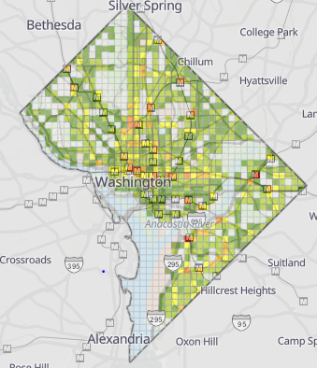
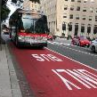
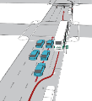
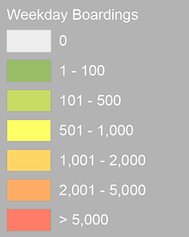
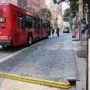
Taking transit in the District
The District has many tools to improve and encourage transit ridership including:
Bus Priority Program
Bus Lanes
Queue Jumps
Transit Priority Signals
DC Circulator
Expansion of program and conversion of the buses to electric
DC Streetcar
Completion of Benning Extension
DDOT requests $117M in FY 2022 and $462M across 6-year CIP for transit improvements
Metrobus Transit Ridership
moveDC 2021 Update Snapshot
Notes:
FY 22 (Year 1): $117M some of the bigger projects include:
K Street Transitway - $58M
Circulator Bus Procurement - $12M
Circulator Bus Garage (S. Cap) - $11.7M
Streetcar Vehicle Procurement – $10M
Circulator Bus Garage (Claybrick) - $5.3M
Benning Extension (Streetcar): $5M
FY 22- 27 (6 Yr): $462M
Circulator Bus Garage (Claybrick): $135M
K Street Transitway: $116M
Benning Extension (Streetcar): $88M
Streetcar Vehicles: $33M
Bus Priority: $24M
FY 2022
Bus priority $3.9M
Bus efficiency & enhancements $933K
Benning Road $5.2M
K Street Transitway $60M
- vehicle expansion
Streetcar procurement $10.9M
Streetcar overhaul $3.9M
Circulator procurement $12.1M
Circulator rehab $3M
- bus garage
Claybrick $5.3M
South Cap $11.8M
Streetcar project management $1.7M

Slide 8
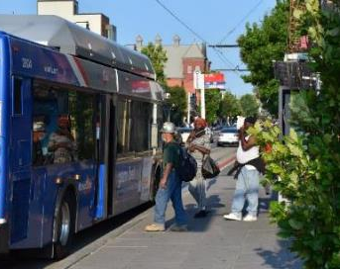
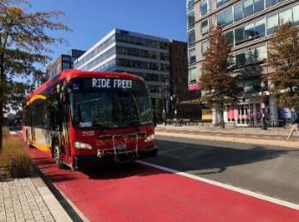
Bus Priority Vision
Faster and more reliable transit provides better access to more jobs and opportunity, helping to address transportation needs identified in moveDC’s analysis and support an equitable recovery
During the COVID-19 pandemic, Metrobus ridership has consistently been two to three times higher than Metrorail ridership
Almost half of District Metrobus riders make under $30,000 per year and two thirds live in zero-car households**
Improve the entire rider experience, including:
Pedestrian improvements to ensure bus stop accessibility
Bus lanes to reduce congestion delay
Transit signal priority and queue jumps to address signal delay
*https://www.wmata.com/service/covid19/Covid-19-Public-Information.cfm
**2018 WMATA Metrobus rider survey
Notes:
An investment in bus priority represents an investment in transformative mobility for District residents, with targeted improvements for historically under-resourced communities.
Providing faster and more reliable transit is key to expanding access to jobs and opportunity, which has become even more critical due to the COVID-19 pandemic.
Our bus system is a lifeline for our most under-resourced communities: almost half of District Metrobus riders make under $30,000 per year and two thirds live in zero-car households (based on WMATA’s 2018 rider survey).
Bus priority seeks to improve the entire rider experience, including bus stop accessibility, bus lanes to reduce congestion delay, and transit signal priority to address delay at intersections.

Slide 9
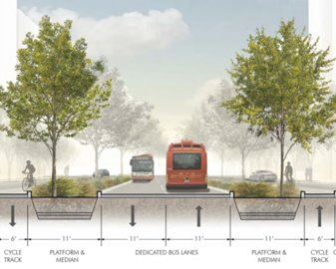
Taking transit in the District
DDOT requests $58M in FY 2022 and $116M across 6-year CIP for K Street Transitway
K Street Transitway
Corridor serves 20,000 daily bus passengers that travel to/from across all Wards of the District
Project will feature a two-way dedicated transitway from 12th Street to 21st Street, NW
Improvements include new bus stops, lighting, landscaping, pedestrian amenities, and a protected bicycle lane
Is compatible with future streetcar needs
The transitway will serve 50-60 buses per hour and improve bus travel times by 30-40%
Notes:
DDOT is requesting $58.0 million in FY 2022 and $116.0 million over the CIP to align the funding with the expected project timetable
Design completion estimate: Nov. 30, 2021
Construction completion estimate: Aug. 30, 2024
Project is currently at 30% design and advancing to final design (vendor to be selected by end of February 2021)

Slide 10
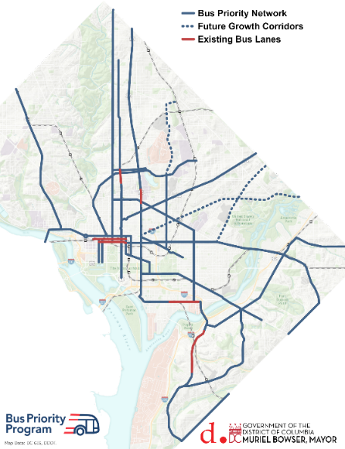
Bus Priority Network
DDOT and WMATA identified a bus priority network, consisting of corridors spanning 70 miles across all eight wards of the District.*
The network identifies where future improvements are needed to make transit faster and more reliable along the District’s busiest bus routes.
The network serves 122 Metrobus and 5 Circulator routes for at least a portion of their route.
63% of District residents will live within ¼ mile of a bus priority corridor. The network serves approximately 60% of the District’s bus riders and 79% of jobs.
Historically under-resourced communities (per DDOT’s Equity Statement) are within ¼ mile of the network:
67% of low-income households
65% of persons with disabilities
64% of People of Color
*Mileage does not include future growth corridors (areas where demand for transit is expected to grow over the next 20 years based on projected land use changes)
Notes:
DDOT and WMATA jointly identified a bus priority network: where improvements are needed to make transit faster and more reliable along our busiest bus routes.
The network serves 122 Metrobus and 5 Circulator routes for at least a portion of their route and approximately 60% of District bus riders.
The network is also within walking distance of approximately two-thirds of low-income households, persons with disabilities, and People of Color and almost 80% of low-income jobs.

Slide 11
Process to Identify and Prioritize Projects
Bus Priority Corridor Identification
Corridors identified jointly with WMATA and Circulator
Based on moveDC, WMATA’s Priority Corridor Network and Circulator's Transit Development Plan
Data-driven corridor analysis
Transit*
Equity*
Safety
Land Use
Bus priority projects in 6-year CIP will be periodically adjusted based on updated data and coordination with future projects initiated by other DDOT teams.
Corridor Analysis
Consideration of Other DDOT Projects
6-Year Capital Improvement Program
​*The transit and equity metrics were weighted more heavily to reflect the importance of addressing slow and unreliable bus service in historically under-resourced communities.
Notes:
As part of the establishment of the Bus Priority Program, DDOT is instituting a data-driven process to identify and prioritize projects to focus on areas with the greatest need and opportunity.
Transit performance and equity indicators were weighted most heavily to reflect the importance of addressing slow and unreliable bus service in historically under-resourced communities.
Also part of the prioritization process is consideration of alignment with other DDOT projects in order to leverage work led by other teams in the agency.
DDOT anticipates updating the bus priority projects in the 6-year CIP periodically based on updated data and coordination with other agency projects.

Slide 12
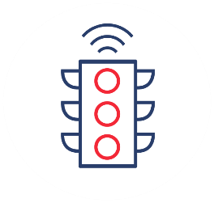
Flexible and Context-Sensitive Planning
DDOT will identify the tools to improve bus speeds and reliability within the neighborhood context and specific project needs
DDOT’s Bus Priority Program Toolbox includes over 20 treatments to improve bus operations including:
Bus lanes to reduce congestion delay
Queue jumps to allow buses to get to the front of the line
Bulb-outs to allow buses to board from the travel lane and provide more space for passengers to wait
Transit signal priority to give buses more green time
Notes:
Bus priority is not one-size-fits-all. For each project, DDOT will identify the tools to improve bus performance within the given neighborhood context and project needs.
DDOT developed a toolbox of over 20 bus priority improvements to target specific causes of delay, including:
Bus lanes
Queue jumps
Bulb-outs
Transit signal priority
Bus priority improvements yield travel time savings of 10-20% based on peer cities and DDOT experience. The pilot bus lanes on H and I Street NW improved travel times overall by 10% and further benefits are expected as DDOT upgrades the design this fiscal year.

Slide 13
Benefits of Bus Priority Improvements
When several bus priority improvements are implemented in a corridor, travel time savings of 10-20% are anticipated based on peer cities and DDOT experience
The pilot bus lanes on H and I Street NW improved travel times overall by 10%
16th Street NW is expected to yield 2-3 minutes of travel time savings in the peak direction (about 15%)*
Improvements made in one location benefit passengers along the entire route with greater reliability because of more on-time departures
Peer cities have seen ridership increase by as much as 10% along bus priority corridors (pre-COVID data)
Treatment | Anticipated Benefit
Bus lanes | Up to 1 minute/mile or 10% travel time savings Bus lanes reduced travel time variability 1- 57% percent in Los Angeles and New York.
Transit signal priority (TSP) | 5-15 seconds/intersection travel time savings. 5-15% travel savings in TSP corridors
Stop rebalancing | 10-15 seconds/stop in travel time savings In Portland, increasing stop spacing by 6–8% resulted in a 5.7% reduction in travel time
Queue jumps | 6 seconds/intersection travel time savings; 1 minute of savings with 10 queue jumps WMATA is currently performing analysis of queue jumps
Bus bulbs (allows bus to board from the travel lane) | 1 to 12 seconds/stop travel time savings; 7% travel time savings corridor wide In San Francisco, bus bulbs increased bus speeds by 0.2-2.2 mph, as well as non-bus vehicle speeds by 4.5-8.5 mph by improving predictability of bus operations
Source: NACTO and DDOT project experience.
*See here for more info about 16th Street NW projected benefits
Notes:
Bus priority is not one-size-fits-all. For each project, DDOT will identify the tools to improve bus performance within the given neighborhood context and project needs.
DDOT developed a toolbox of over 20 bus priority improvements to target specific causes of delay, including:
Bus lanes
Queue jumps
Bulb-outs
Transit signal priority
Bus priority improvements yield travel time savings of 10-20% based on peer cities and DDOT experience. The pilot bus lanes on H and I Street NW improved travel times overall by 10% and further benefits are expected as DDOT upgrades the design this fiscal year.

Slide 14
DDOT’s FY22-27 Bus Priority Request ($24.5M)
Construction for approx. 17 bus priority projects over the next six years, with 2-3 projects delivered each year*​
Green lines on map are funded as part of FY21-26 CIP​
Yellow lines on map represent additional proposed projects that would be funded as part of FY22-27 request​
Planning and design of 3 additional projects, which would deliver after FY27
Notes:
DDOT’s FY22-27 request would fund approximately 17 projects over the next six years, or two to three projects per year.
Projects represent 1-2 mile segments of the bus priority network.
The proposed projects are displayed by the yellow lines on the map.

Slide 15
DDOT’s FY22-27 Bus Priority Request Plus ($49M)
Construction for approx. 34 bus priority projects over the next six years, with 4-6 projects delivered each year*​
Green lines on map are funded as part of FY21-26 CIP
Yellow lines on map represent additional proposed projects that would be funded as part of FY22-27 request​
Purple lines on map represent additional proposed projects that would be funded as part of FY22-27 request plus​
Planning and design of 5 additional projects, which would deliver after FY27​
Additional FTEs requested​
Two engineers and two planners
Notes:
With additional funding, DDOT could deliver approximately 34 projects over the next six years, with four to six projects delivered per year.
The additional proposed projects are shown as the purple lines on the map and were selected in order to primarily target improvements that benefit riders in Wards 7 and 8.
Although not located East of the River, M Street NW in Georgetown helps to provide a reliable connection to the concentration of low wage jobs in that neighborhood.

Slide 16
Bus Priority for H Street / Benning Road NE Part of DDOT’s FY22-27 Request Plus if Benning Streetcar isn’t funded
Supports improved operation of existing Streetcar
Could provide alternative to extending Streetcar to Benning Road Metro
High-level concept includes:
Curbside-running dedicated bus lanes in each direction between Union Station and Benning Road Metro Station
May require turn restrictions to keep through traffic moving
Conversion of metered parking on H Street NE to loading/pick-up drop-off zones or sidewalk extensions
Transit signal priority to give extra green time to buses
Upgraded bus stops and stop relocation to improve pedestrian / ADA access
Bus bulb-outs to allow buses to board from the travel lane and provide more space for passengers to wait
Removal of closely spaced stops to keep buses moving
Notes:
DDOT has outlined a high-level concept for what bus priority on the H Street / Benning Road NE corridor could look like, with a cost estimate of approximately $5-6 million.
The concept could support or replace existing streetcar operations
The concept includes:
Curbside bus lanes
Reprograming of the parking lane along H Street NE to loading / pick-up drop-off zones or sidewalk extensions
Transit signal priority to give extra green time to buses and vehicles travelling in the same direction
Upgraded bus stops, bulb-outs, and improved accessibility
The anticipated timeline for delivery is as follows:
The eastern section (Oklahoma Ave to Benning Road Metro) would keep the same delivery timeline as the current streetcar extension/bridge project: completion anticipated 2025/2026
This section would be completed as part of the bridge project
The western section (Union Station to Oklahoma Ave) could be delivered as soon as 2024 (planning in FY22, design in FY23, construction in FY24)

Slide 17
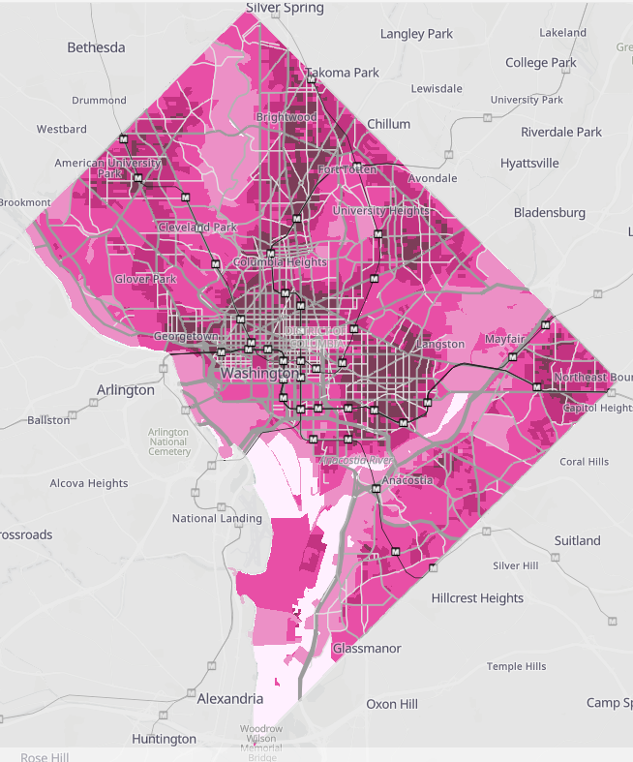
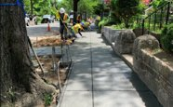
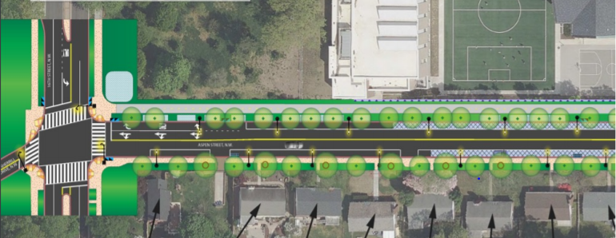
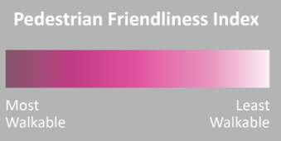
Walking in the District
Focusing on Sidewalk State of Good Repairs
Sidewalk Rehabilitation
Sidewalk Maintenance
DDOT requests $57M in FY 2022 and $331M across the 6-year CIP to improve and expand the walkability of the District
Pedestrian Friendliness Index
And Key Projects
MLK Phase III​
Aspen Street NW Safety Improvements​
Southern Avenue SE Traffic Calming
moveDC 2021 Update Snapshot
Notes:
Map: the entire District should be fuchia on future updates to this map to reflect a connected street grid with sidewalks and safe intersections!
(Pedestrian Friendliness In)
•Pedestrian safety stimulates more walking trips. DDOT is using new technology and designs to increase pedestrian safety over the past 3 years:
600 intersections with Leading Pedestrian Intervals
21 HAWK pedestrian signals
20 pedestrian activated crosswalk beacons
Pedestrian crossing islands
Curb extensions to shorten crossing distances and reduce conflicts with vehicles.
In FY 2022 DDOT will implement moveDC beyond mobility and sustainability. Management and Operations is one of our goals and sidewalk rehabilitation and maintenance helps meet that goal. The implementation of safety improvements and traffic calming to improve the pedestrian Facilities with projects such as Ward 8 Streetscapes, Aspen Street NW and Southern Avenue SE as well as the 11th Street Bridge SE Park partnership helps meet our Project Delivery Goal
FY 22 Proposed vs. FY 21 Approved:
For the ‘Walking’ Category DDOT’s request is a $10.6M decrease compared to Year 1 of the current CIP; and $3.0M increase over the 6-years.
Year 1: In year 1 of the current CIP DDOT’s budget is 23% focused on walking compared to 15% in proposed request.
The big variances in comparison is due to one-time project 11th Street Bridge Park receiving budget authority in FY21 and DDOT requesting less in Streetscapes in the first year.
6-Year Plan: For the full six-year period in the current CIP DDOT’s 20% focused on walking compared to 16% in proposed CIP.
Current vs. Proposed:
Walking: $10 decrease in Year 1 and $3M increase over 6-year CIP
Why does the investment look like it is dropping?
Sidewalk – Asset Mgmt. – reduction of ~$6M across the CIP due to the condition of the sidewalks – our asset says things are in pretty good shape.
11th Street Bridge Park: One-Time Funding was received in FY21 ($49M reduction compared to FY21 CIP)
Streetscapes: Increase in FY22 CIP of more than $50 across CIP.

Slide 18
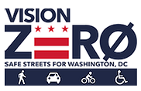
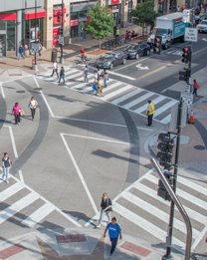
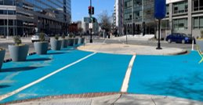
Walking & Biking in the District: Vision Zero
DDOT requests $5.3M in FY 2022 and $24.4M across the 6-year CIP to advance the Vision Zero program
Safety
DDOT is committed to designing infrastructure to improve safety for all - especially the most vulnerable users
Examples include:
Florida Avenue, NE interim safety project
dual-turn lane mitigations
left-turn traffic calming
no turn on red restrictions
signalization of pedestrian crossing
Notes:
Safety is a moveDC goal
Policy 7 from moveDC: Design infrastructure to improve safety for all, focusing especially on our most vulnerable roadway users.
Safety is the Department’s top priority. The Safety & Mobility Project (which houses the VZ capital project) is the top project and priority for the Department in our FY22 submission.
Although all projects are developed and executed using a safety lens – this program focuses specifically on expediting safety improvements.
A second construction traffic safety construction contract was advertised last week by OCP – once awarded this will give DDOT two (2) construction contracts w/ $7M ceilings… to deliver these safety improvements. We need resources to reach the ceiling and deliver on safety commitments to the residents of the District.
Proposed request is a $14.3M increase over the 6-year plan
We will have contractual capacity to deliver
We have unfortunately have the safety improvements backlog

Slide 19
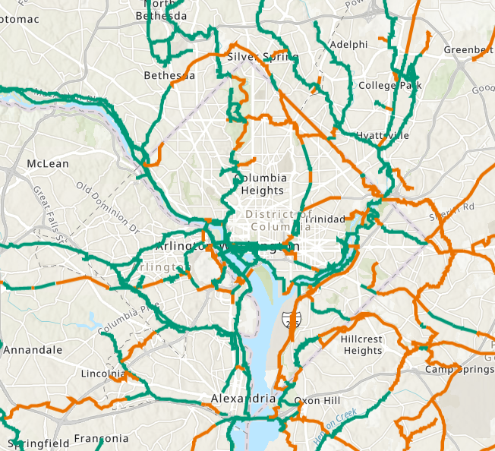
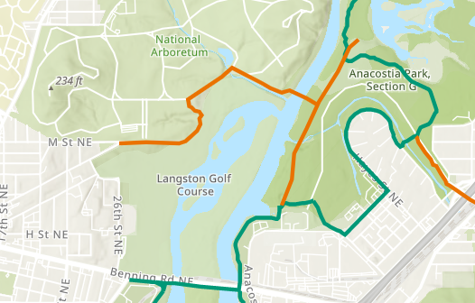
Walking & Biking in the District: Trails
Existing
DDOT requests $6.1M in FY 2022 and $37.7M across the 6-year CIP to expand and improve the trails network
Planned
2
Met Branch Trail to Piney Branch
Arizona Ave to Capital Crescent Trail
5
4
Anacostia Riverwalk Trail
4b. Arboretum Bridge & Trail
6
4c
4b
Fort Davis Dr. and Texas Ave. SE Trail
4c. Arboretum Bridge – Maryland Ave. Connection
3
1
4a
South Capitol Street Trail
Suitland Parkway Trail
4a. Kenilworth Park Section
Notes:
Trails, which are completely separated from roadways, are safer for people of all ages to bike and walk. The District has 60 miles of off-street paved trails.
Key: green in existing; orange is planned
DDOT is working to build out the network of trails and connect them regionally as part of the Capital Trails Network. DDOT's capital proposal takes a balanced approach to ensure trail access across the District.
Trails:
provide a safe space for people to walk and bike completely separated from traffic
serve as the backbone of the regional network of biking and walking facilities
DDOT’s FY 22 CIP request would build another 10.3 miles for trails.

Slide 20
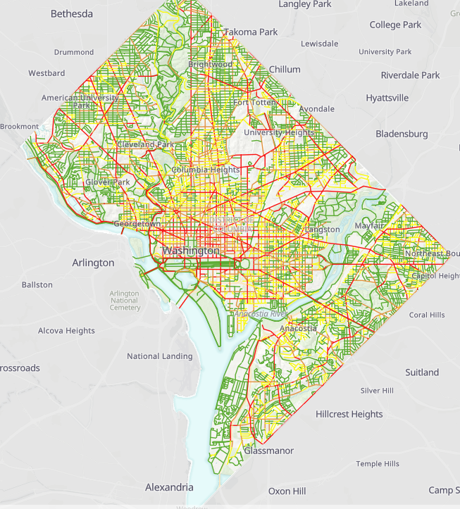
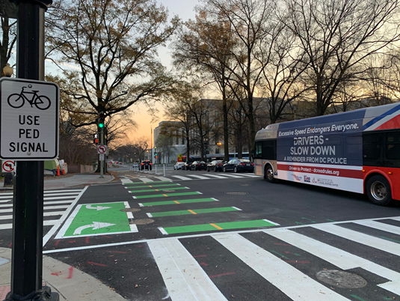
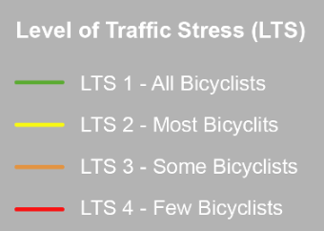
Biking in the District: 20x2022
DDOT is focused on the completion of the 20x2022 bicycle plan and DDOT's continued commitment to expand the bicycle network, which will encourage more people to travel by bike.
Protected bike lanes are safer than riding in the roadway. DDOT has installed 16.6 miles of protected bike lanes.
DDOT requests $7.0M in FY 2022 and $94.1M across the 6-year CIP improve the bicycle network
Bicycle Level of Stress
moveDC 2021 Update Snapshot
Notes:
Bicycle Level of Stress – evaluates impact of traffic, street configuration and includes factors such as bicyclist's comfort level.
•Protected bike lanes (PBLs) have helped encourage more people in the District to bicycle because PBLs are safer than riding in the roadway, exposed to high-speed vehicles. The District now has 16.6 miles of PBLs.
DDOT’s request will deliver about 5 miles of PBL/year which would deliver nearly twice the existing amount 16.6 miles vs. 30 miles (5 miles/yr. = 6 yrs.).
Notable Inclusions:
NEW – Long Bridge Pedestrian and Bicycle Connection: $52M in out years for construction
NEW -DPW Fleet Transfer ($2M Year 1 and $12M across 6-yr plan): DDOT proposes to get funding to assist with DPW purchasing custom streetsweepers for bike lanes

