Slide 1
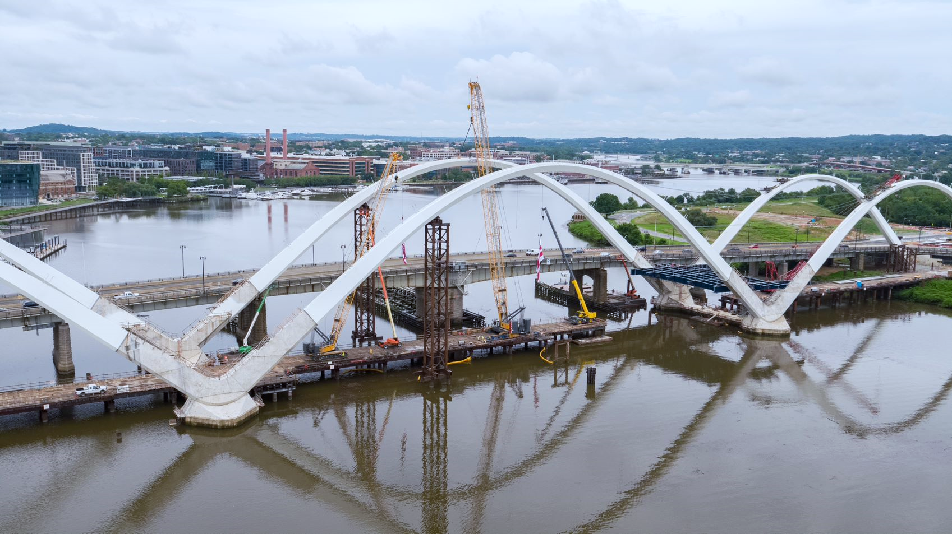
Mayor Bowser’s Fiscal Year 2022 Budget for DDOT
District Department of Transportation FY 2022 Budget Hearing
June 10, 2021

Slide 2
Overview
Contents
Overview​
Recovery
Equity
moveDC​
Operating budget ​
Capital budget ​
Safety​
Mobility
Sustainability​
Enjoyable Spaces​ / Reimagining public spaces
Project Delivery
Management and Operations
District Department of Transportation FY 2022 Budget Hearing
June 10, 2021
2

Slide 3
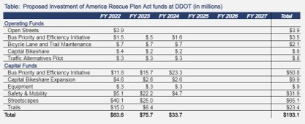
Overview
Recovery
Three Congressional acts have passed to support the country's recovery from the coronavirus pandemic: the Coronavirus Aid, Relief, and Economic Security Act, the Coronavirus Response and Relief Supplemental Act, and the most recent and most impactful for the District, the American Rescue Plan Act, shown in the table below.
Congress also introduced an opportunity to submit locally supported, impactful projects for funding, and DDOT submitted nine projects for possible funding to the Community Project Funds that were supported by Mayor Bowser.
District Department of Transportation FY 2022 Budget Hearing
June 10, 2021
3

Slide 4
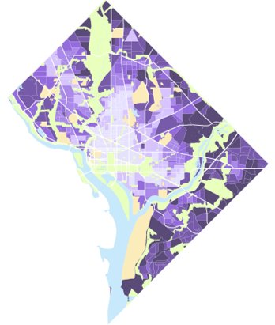
Overview
Equity Statement
DDOT recognizes that there are inequities in transportation policy, planning and project delivery. Deep-rooted structural injustices and inequities have contributed to disparate access to safe, affordable, and efficient transportation that provides access to economic opportunities, housing and services for communities across the District. DDOT also acknowledges these inequities have disproportionately and negatively impacted environmental and health outcomes in our underserved communities.
DDOT is committed to elevating and advancing transportation equity by evaluating our policies, planning, community engagement and project delivery to ensure public investments in transportation justly benefit all residents, visitors and commuters.
Transportation Needs Map
Areas with greatest needs are darker
Areas with least needs are lighter
District Department of Transportation FY 2022 Budget Hearing
June 10, 2021
4

Slide 5
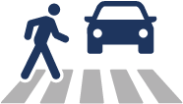
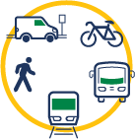
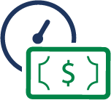
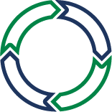
Overview
moveDC Goals
Equity
Safety
Enjoyable Spaces
Mobility
Project Delivery
Sustainability
Management & Operations
District Department of Transportation FY 2022 Budget Hearing
June 10, 2021
5

Slide 6
Overview
FY 2022 Operating Budget
DDOT’s Operating Budget, FY 2020 – FY 2022 (in millions)
Highlights for FY 2022:
Free Circulator - $1.4M provided to implement Free Circulator service for the District.
Reimagining Safe and Open Spaces– Enhancements of $4.1M and 3 FTE for Open Streets and $255K for Vision Zero programming, including $55K for Arts in the Right of Way (AROW).
ATE Program - Enhancements of $5.7M and 6 FTE for ATE equipment refresh, $5.5M and 23 FTE to transfer ATE program to DDOT, and $1.2M and 3 FTE for Bus Priority ATE enforcement pilot.
Curbside Management - $1.5M enhancement to ensure capacity of Operations and Maintenance
$169.2M
685.4 FTE
$146.9M
625.4 FTE
$132.6M
593.9 FTE
District Department of Transportation FY 2022 Budget Hearing
June 10, 2021
6

Slide 7
Overview
FY 2022 Operating Budget
Changes made to FY22 Operating Budget (in thousands)
District Department of Transportation FY 2022 Budget Hearing
June 10, 2021
7

Slide 8
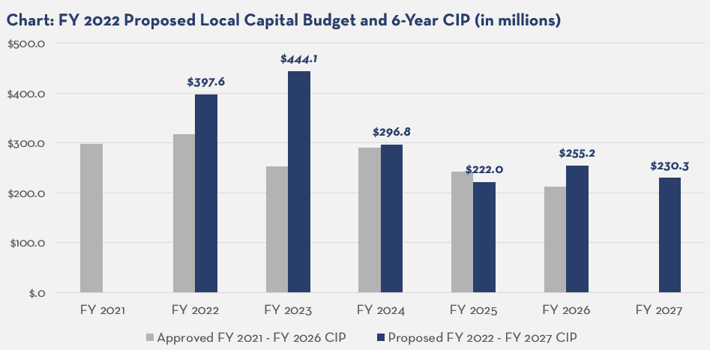
Overview
FY 2022 Local Capital Budget and 6-Year Plan
District Department of Transportation FY 2022 Budget Hearing
June 10, 2021
8

Slide 9
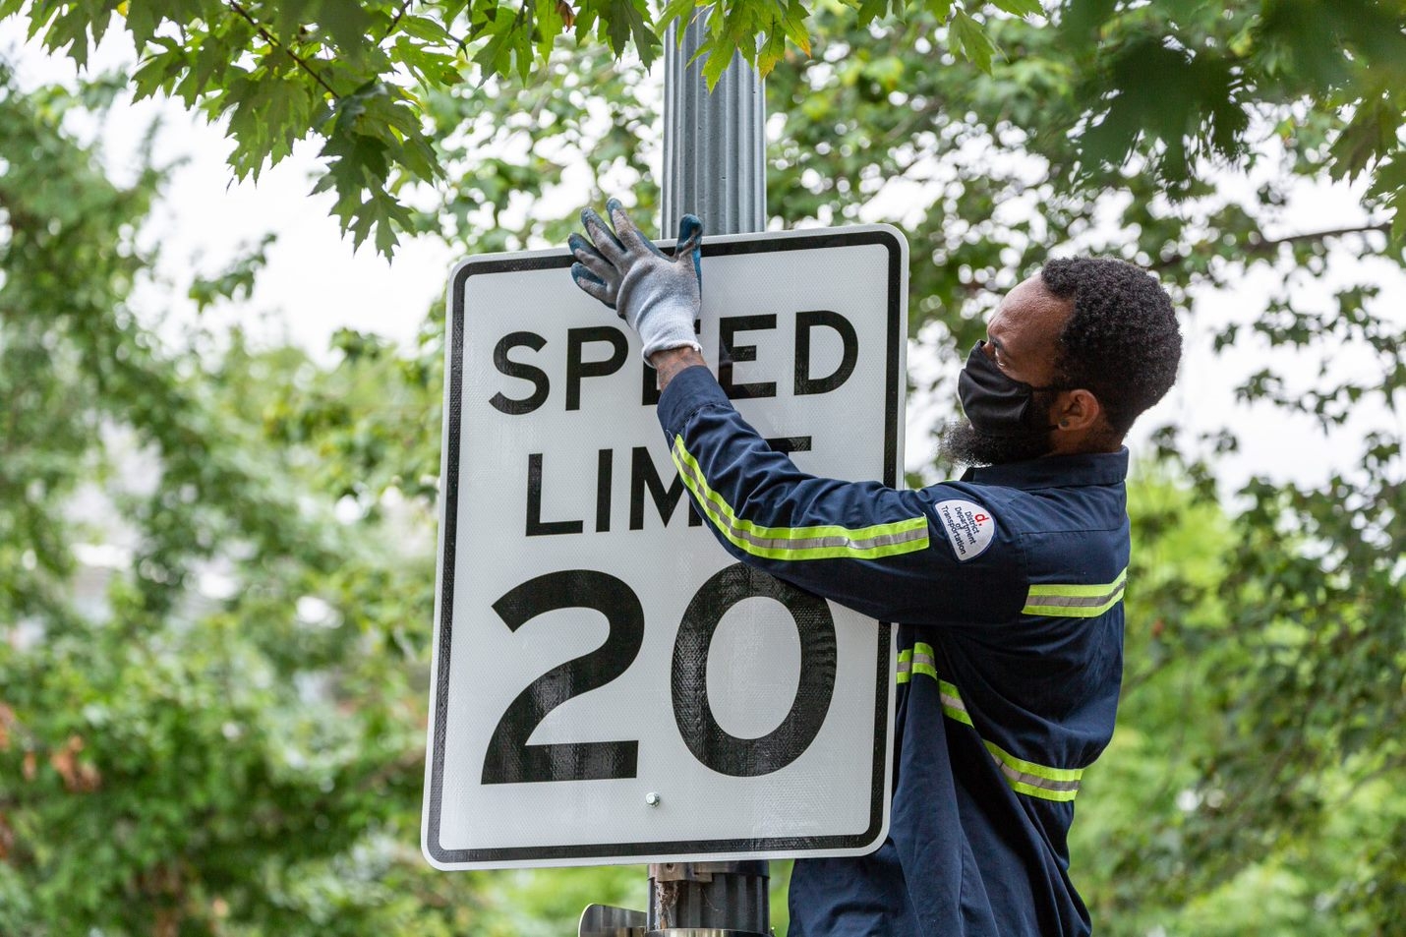
chapter two
safety

Slide 10
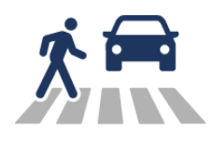
Safety
Vision Zero Summer Safety Initiative
Prior to releasing the FY 2022 Budget, Mayor Bowser demonstrated her commitment to reaching zero fatalities and serious injuries to travelers of our transportation system by announcing a Summer Safety Initiative with a $10M commitment.
Rapid Response Plan
Internal Realignment of Safety Functions within DDOT.
DDOT has begun implementation of the Post Fatal Crash Site 24 Hour Response team.
Immediate implementation of flashing pedestrian signals and driver feedback signs.
Summer Safety Implementation Plan
Construct 14 shovel-ready Livability Improvements projects across DC.
Implement 15 intersection safety projects across DC’s Critical Emphasis Areas.
Implement pedestrian and traffic calming improvements on high-priority streets in our current-year paving plan.
District Department of Transportation FY 2022 Budget Hearing
June 10, 2021
10

Slide 11
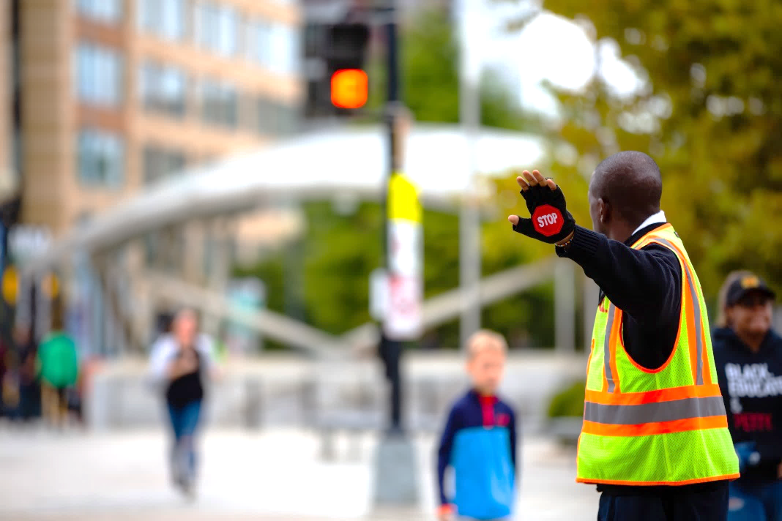
Safety
Vision Zero Operating Improvements: Traffic Safety
The Mayor's budget makes historic investments in an expansion of critical safety infrastructure.
Provides resources for an asset refresh and expansion of bus lanes, red light, and speed cameras ($6.9M), as well as transferring the Automated Traffic Enforcement (ATE) program to DDOT ($5.5M).
The Mayor’s $1.0M investment to convert 20 Safety Technicians from part-time to full-time status creates career pathways for full-time staff who will be able to cover rapid deployment needs ($821K), as well as hire two additional supervisors to ensure adequate manager coverage. ($197K).
District Department of Transportation FY 2022 Budget Hearing
June 10, 2021
11

Slide 12
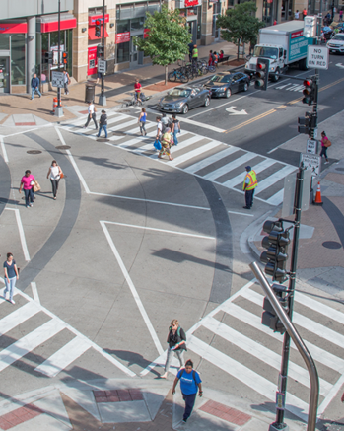
Safety
Vision Zero
Mayor Bowser is doubling down on investments in safety and mobility projects in FY 2022 - 2024; investing $64.4M in the first three years of the CIP.
The Vision Zero Safety Improvements sub-project is DDOT’s primary project for addressing small and medium-scale safety improvements at high-risk intersections and corridors across the District.
Examples include dual-turn lane mitigations, left-turn traffic calming, no turn on red restrictions, signalization of pedestrian crossing and bicycle and bus priority lane expansions.
The new Vision Zero Asset Preservation sub-project ensures that newly installed assets are maintained or replaced when damaged.
$200K will be provided for the creation of an expanded public communication campaign on Vision Zero practices and behaviors.
District Department of Transportation FY 2022 Budget Hearing
June 10, 2021
12

Slide 13
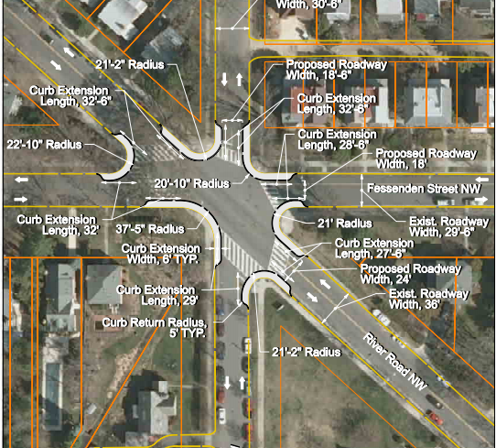
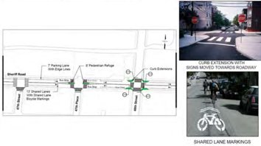
Safety
Vision Zero Livability Implementation
The Mayor’s budget provides $4.9M across the 6-year plan for the implementation of Livability Study recommendations.
Livability is about making a neighborhood safer and healthier for residents.
DDOT has completed 9 livability studies which include 555 recommendations.
The Mayor’s budget will allow DDOT to continue to deliver on recommendations developed by the residents of the District.
Recommendation types include:
Safer pedestrian crossings.
More accessible bus stops.
Geometric adjustments that support intersection safety.
Traffic signal modification.
Enhanced green spaces, signage for better driver information
Speed controls in sensitive areas.
District Department of Transportation FY 2022 Budget Hearing
June 10, 2021
13

Slide 14
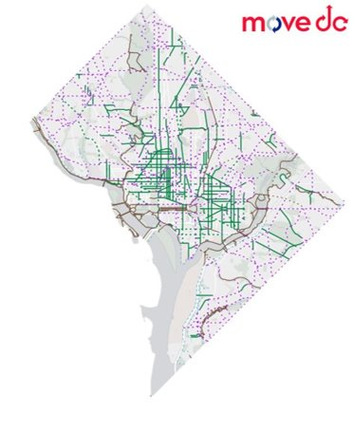
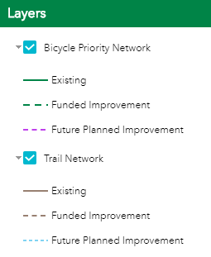
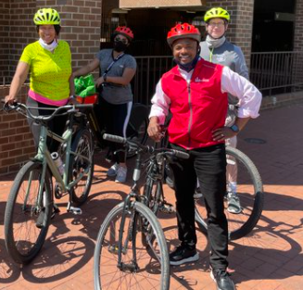
Safety
Protected Bicycle Lanes
Mayor Bowser's FY 2022 local capital budget and 6-year CIP continues the momentum in accelerating the construction of bicycle lanes across the District.
The PBL plan grows the network 10 miles per year, including the $2.7M for the 9th Street Protected Bike Lane, from Florida Ave to Pennsylvania Ave.
District Department of Transportation FY 2022 Budget Hearing
June 10, 2021
14

Slide 15
Safety
Streetscapes
Black Lives Matter Plaza
Ward 2
Phase I – Plaza - Curb to Curb
Project will maintain a sense of place for the plaza, a destination for visitors and gathering place for residents and visitors. It will emphasize pedestrian safety while accommodating vehicular traffic.
Status: Construction
FY 2022 CIP: Funded in FY 2021
Black Lives Matter Plaza
Ward 2
Phase II: Plaza - Sidewalk
Project will be for sidewalk work to complement to Phase I
Status: Planning
FY 2022 CIP: $3M for design/construction
District Department of Transportation FY 2022 Budget Hearing
June 10, 2021
15

Slide 16
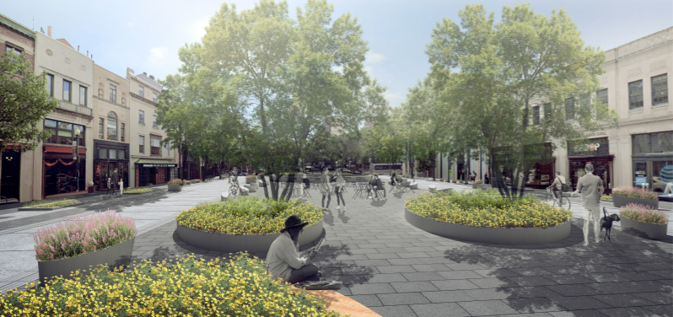
Safety
Streetscapes
Connecticut Avenue Streetscape & Deckover (‘Dupont Crown Park’)
Ward 2
DDOT will provide a new, multi-modal streetscape along Connecticut Avenue, starting on the north side of Dupont Circle and continuing north to California Street NW that will help enhance mobility, safety and repurpose unused existing spaces through innovative design solutions. New street design will include:
Bicycle and pedestrian amenities.
Pedestrian-friendly traffic.
Green infrastructure elements.
Deck-over plaza over the Connecticut Avenue underpass.
Status: Final Design
Funding: $27M in local
District Department of Transportation FY 2022 Budget Hearing
June 10, 2021
16

Slide 17
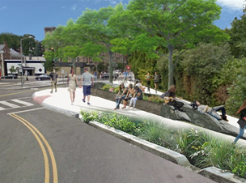
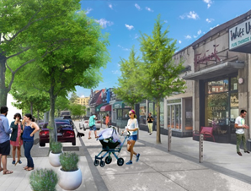
Safety
Streetscapes
Cleveland Park Streetscapes
Ward 3
Phase 1: Streetscape and Drainage
(Connecticut Ave NW from Macomb Street NW to Porter St NW)
Install permeable pavers and other measures to address flooding at Cleveland Park Metro Station entrance. Add curb extensions, improve crosswalks, add street furnishings, and raise the service lane to improve pedestrian safety.
Status: In procurement for construction
FY 2022 CIP: Funded in FY 2021 leverages local and federal
Phase 2: Drainage & Watershed Improvements
Address stormwater management needs upstream on Connecticut Avenue and drainage improvement work.
Status:
Status: Final Design
FY 2022 CIP: Funded in FY 2024 for construction
District Department of Transportation FY 2022 Budget Hearing
June 10, 2021
17

Slide 18
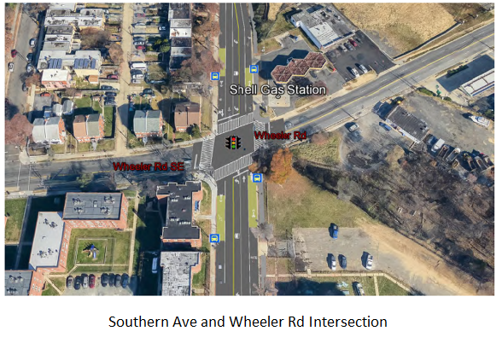
Safety
Streetscapes
Southern Avenue
Ward 8
Phase 1: South Capitol Street to Barnaby Road
Roadway and pedestrian safety improvements, including widening sidewalks for ADA compliance. Bridge rehabilitation, new retaining wall and traffic lane reconfiguration at South Capitol Street intersection.
Status: Final Design
FY 2022 CIP: $9M for Construction
Phase 2: Barnaby Road to 13th St SE (funded)
Install traffic calming features, upgrade traffic signals, and improve safety for pedestrians and vehicles along the corridor and at intersections.
Status: Construction contract has been awarded.
District Department of Transportation FY 2022 Budget Hearing
June 10, 2021
18

Slide 19
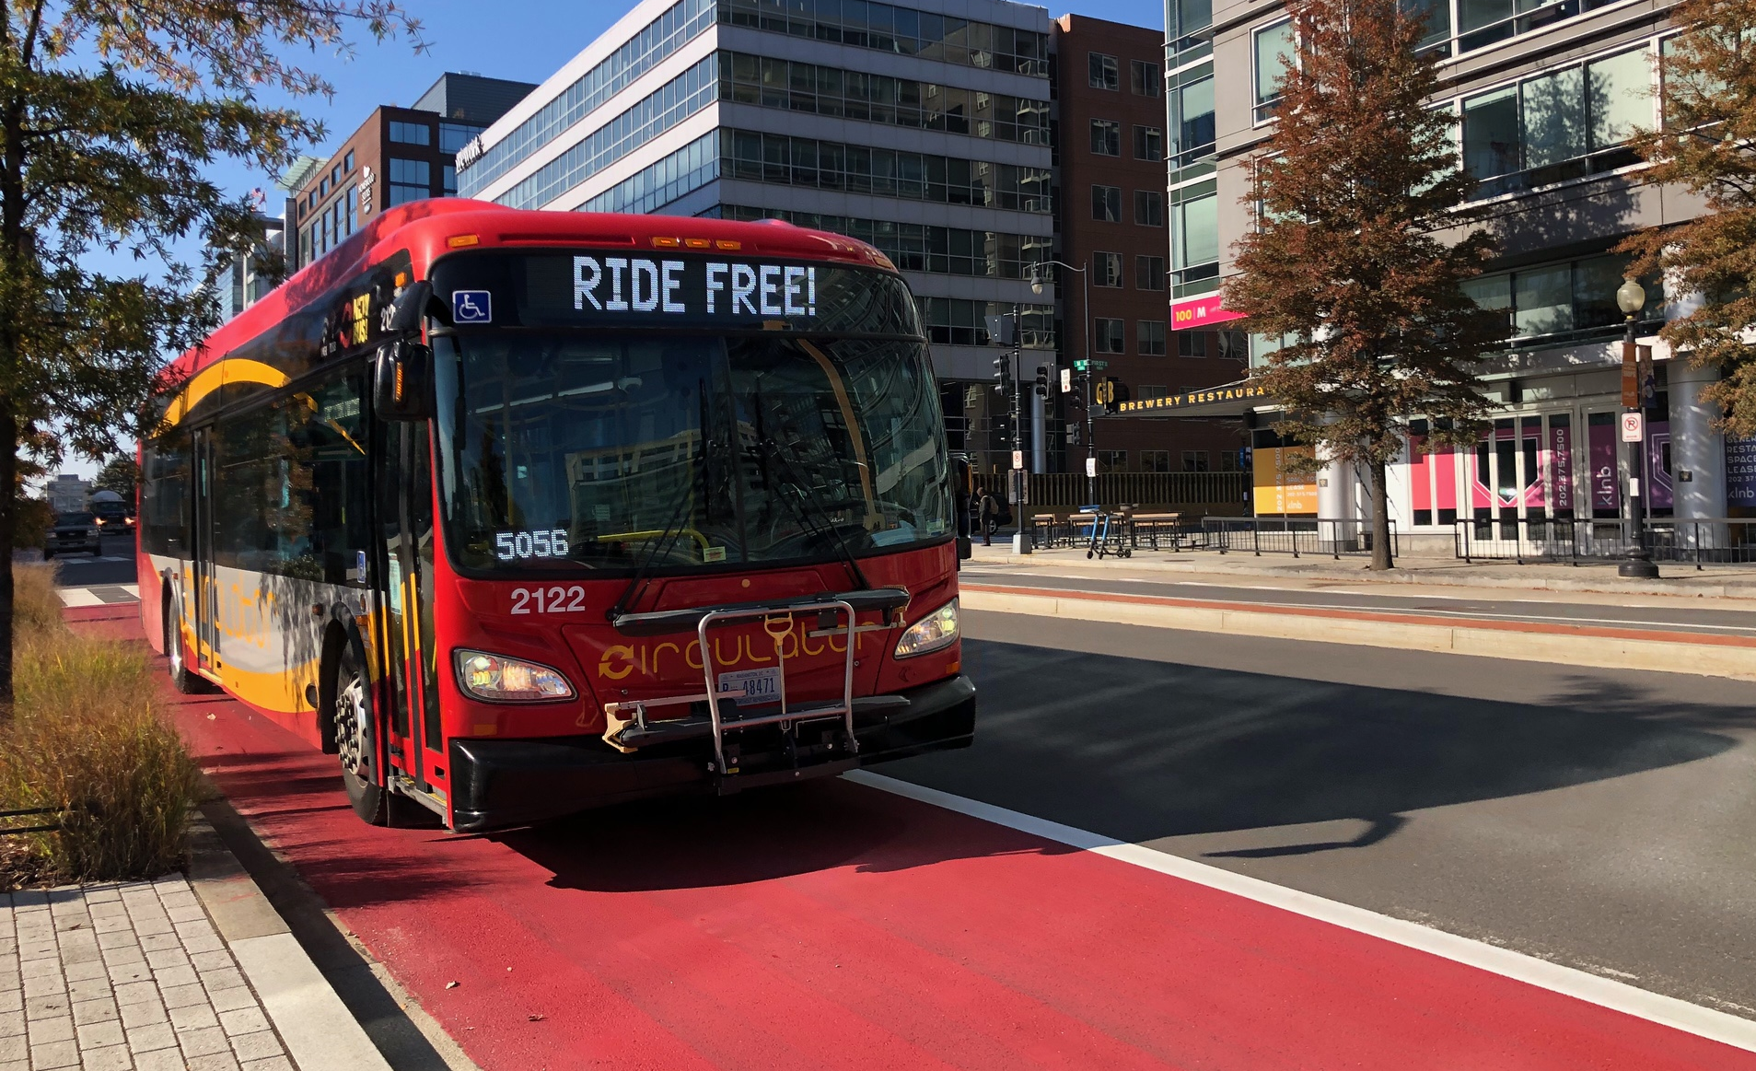
chapter three
mobility

Slide 20
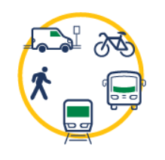
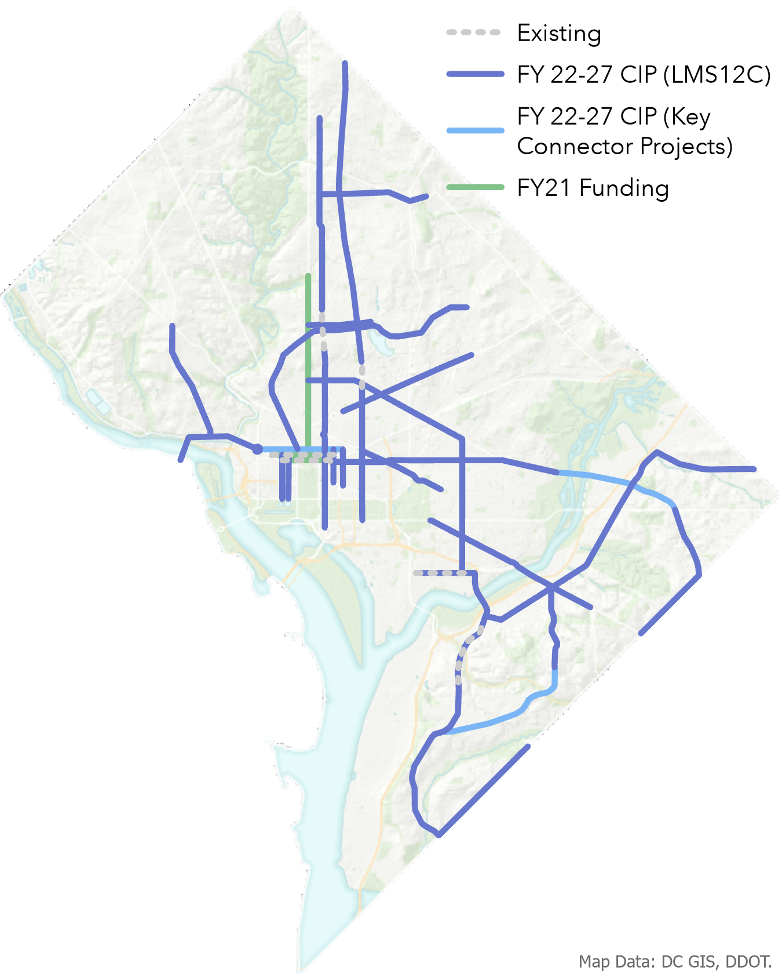
Mobility
Bus Priority Program
The Mayor’s budget focuses on the implementation of the Bus Priority Program and improving bus service for residents in all eight wards.
The $63.6M six-year budget (2.5 times larger than the current FY21 CIP) will enable DDOT to build bus priority lanes and projects.
Capital improvement projects that include bus priority: 16th Street, K Street Transitway, and Alabama Ave.
The funding will also implement bus efficiency measures such as queue jumps and transit signal priority ($5.4M).
DDOT will also conduct a feasibility study for transit hubs ($350K).
District Department of Transportation FY 2022 Budget Hearing
June 10, 2021
20

Slide 21
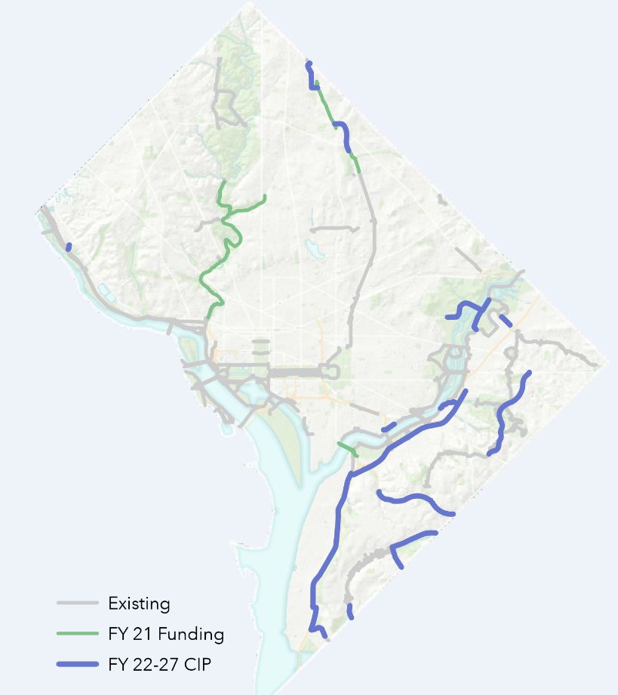
Mobility
Trails
Mayor Bowser's budget makes a record investment in trails – expanding the network by over 17 miles (see map).
Capital investment - $113.1M over the 6-year CIP, which is a $102.3 million increase over the current CIP, to design construct 12 trails across the District. Highlights include:
New South Capitol Street, Shepherd Branch, Fort Davis, and Oxon Run trails.
Completing the Metropolitan Branch Trail.
Connections to Anacostia Riverwalk and Arboretum.
Operating investment – $346K to operate and maintain the growing network.
Figure: Trails projects proposed for FY 2022 - 2027
District Department of Transportation FY 2022 Budget Hearing
June 10, 2021
21

Slide 22
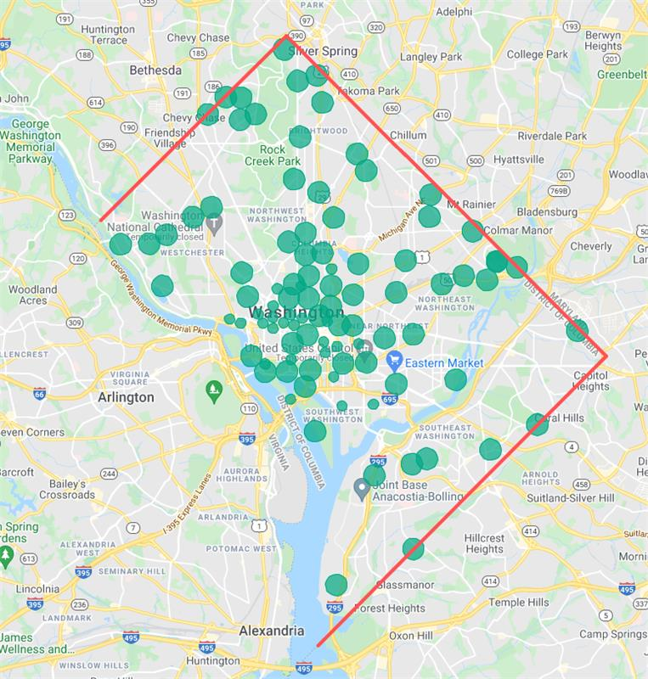
Mobility
Capital Bikeshare
The Mayor’s budget will expand the Capital Bikeshare network to be accessible for all users in the District.
Provides $19.4M over the 6-year CIP to install 80 additional docking stations throughout all eight wards to ensure that every resident has access to Capital Bikeshare within 1/4 mile from their home; $250K to create a new Adaptive Bikeshare hub at Union Station; and $100K to launch e-bikes into the CaBi fleet.
District Department of Transportation FY 2022 Budget Hearing
June 10, 2021
22

Slide 23
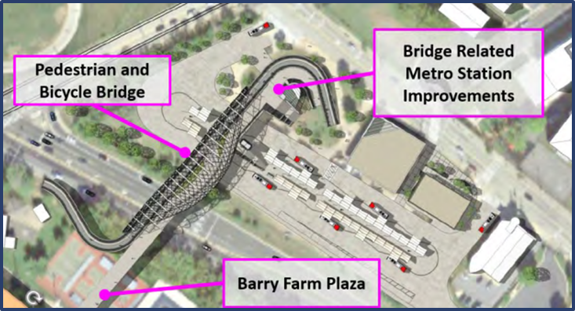
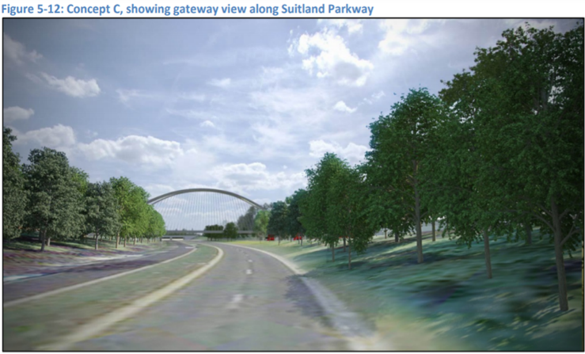
Mobility
Connecting Communities to Transit: Anacostia Metro Bicycle and Pedestrian Bridge
This project provides a key connection for the neighborhoods south of Suitland Parkway to the Anacostia Metro Station.
The bridge will provide a safe and efficient pedestrian and bicycle bridge, allowing residents and visitors access to this regional transit hub which houses not only the green line rail stop but also a local/regional connection for over 15 bus routes.
Status: Planning
Funding: $20.5M
($2.5M for Design & $18.0M for Construction)
District Department of Transportation FY 2022 Budget Hearing
June 10, 2021
23

Slide 24
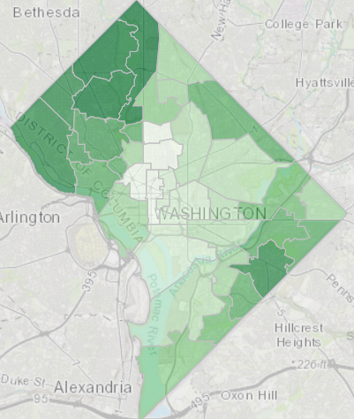
Sustainability
Urban Forestry
Mayor Bowser's budget makes a sustained investment in maintaining and growing the District's urban forest.
$12.8M investment in FY22, and $50.8M over the 6-year CIP:
$8.0M in Greenspace Management to ensure that the District's 175,000 street, park & school trees are healthy.
$4.5M in Tree Planting to keep the District on track to achieve a 40% tree canopy by 2032.
98% of all street tree boxes are currently planted, DDOT needs to maintain these assets and expand into public spaces at schools/parks.
Figure: District's Tree Canopy
Legend: Darker green = greater canopy
District Department of Transportation FY 2022 Budget Hearing
June 10, 2021
24

Slide 25
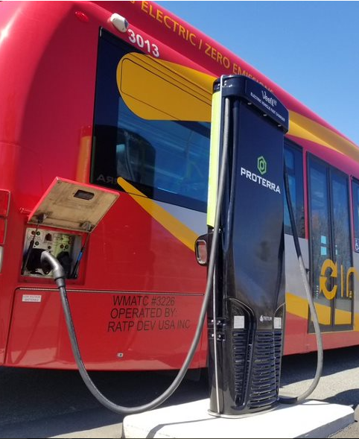
Sustainability
DC Circulator
Mayor Bowser's budget makes a sustained investment in Circulator – more than twice the FY 2021 levels.
$11.8M will be used to build-out the existing facility at South Capitol Street to house, maintain, and charge the growing electric fleet.
$7.6M will come from the Federal Transit Administration and the VW settlement and will allow DDOT to procure 17 electric buses (14 new, 3 replacement).
District Department of Transportation FY 2022 Budget Hearing
June 10, 2021
25

Slide 26
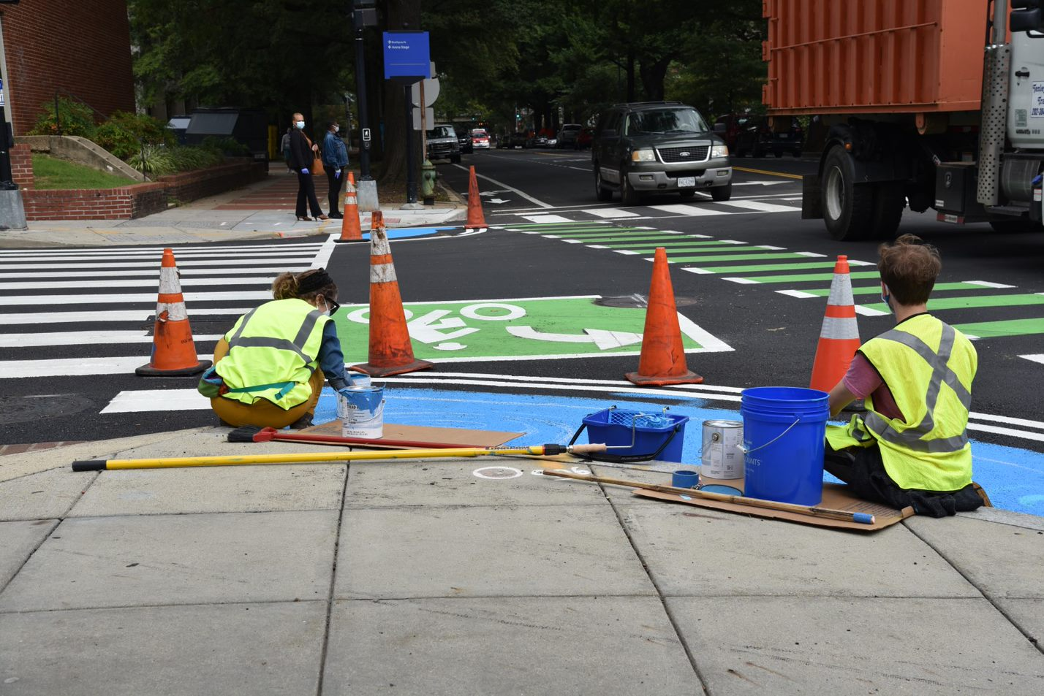
chapter five
enjoyable spaces

Slide 27
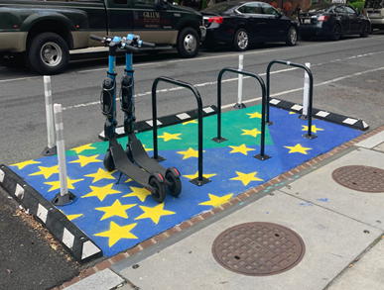
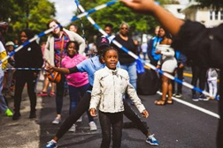
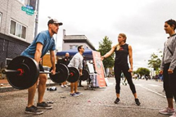
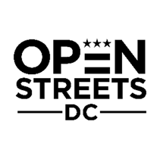
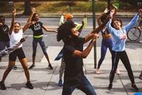
Enjoyable Spaces
Reimagining Public Spaces
Open Streets events are a key catalyst for reengaging residents and visitors with businesses and the transportation network in downtown and across all eight wards. Arts-in-the-ROW (AROW) is a new program within DDOT that facilitates art installations in the public realm to emphasize safety and engagement through placemaking.
The Mayor's budget makes investments in economic and public space recovery and achieves moveDC goals by implementing innovative open space infrastructure and placemaking in the District, with $55K provided for AROW installations and $3.9M for DDOT to coordinate and plan a suite of Open Streets events in every ward- including a signature event on 7th Street NW from U Street to the Wharf.
District Department of Transportation FY 2022 Budget Hearing
June 10, 2021
27

Slide 28
chapter six
project delivery

Slide 29
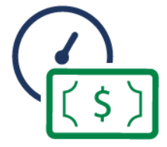
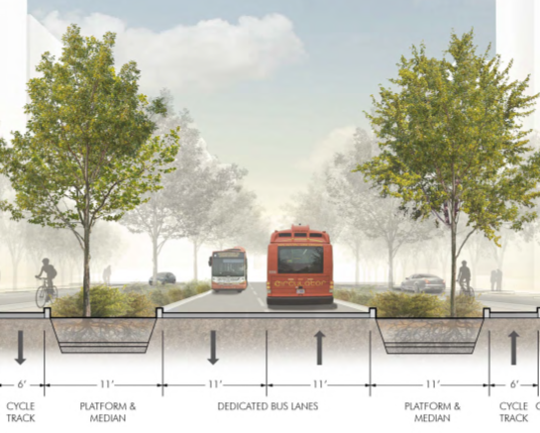
Project Delivery
K Street Transitway
The K Street Transitway is one of DDOT’s most important capital projects to improve transit mobility along one of the busiest corridors in the District.
Corridor serves 20,000 daily bus passengers that travel to/from across all Wards of the District.
Project will feature a two-way dedicated transitway from 12th Street to 21st Street, NW plus new bus stops, lighting, landscaping, pedestrian amenities, and a protected bicycle lane.
The transitway will serve 50-60 buses per hour and improve bus travel times by 30-40%.
The Mayor’s budget provides $58M in FY 2022 and $116M over the CIP to align the funding with the expected project timetable.
Design completion estimate: Fall 2022
Construction start estimate: Early 2023
District Department of Transportation FY 2022 Budget Hearing
June 10, 2021
29

Slide 30
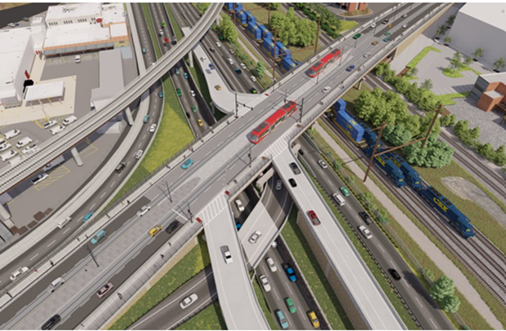
Project Delivery
DC Streetcar
Benning Road Reconstruction & Streetcar Expansion
Project aims to improve transportation infrastructure conditions and enhance safety and operations along Benning Road. Key elements of this project include pedestrian and bicyclist infrastructure enhancements, replacement of the Whitlock Bridge over CSX and DC 295, safety and access improvements at Benning Road and DC 295 interchange.
Construction to begin in FY 2023
Provides a key transit link to residents and businesses in Wards 5 & 7.
Project will leverage both local ($88M) and federal ($96M) resources.
The project has advanced to final design and the resources provided in the Mayor’s budget will complete the project within the 6-year plan.
Streetcar Master Project: The Mayor has provided $136M over the 6-year local capital plan to support the preservation and expansion of the DC Streetcar Program.
Resources will be used for Benning Road Reconstruction & Streetcar ($88M) program management ($13.1M), vehicle rehabilitation ($8.4M), and vehicle replacement ($26.1M)
District Department of Transportation FY 2022 Budget Hearing
June 10, 2021
30

Slide 31
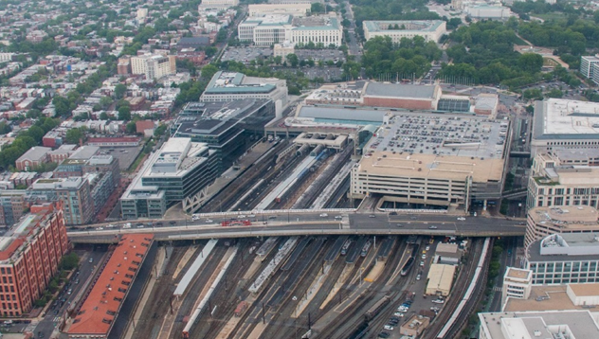
Project Delivery
H Street Bridge NE
This project replaces the bridge that was built in 1976 and is structurally deficient. Planning studies for the new bridge feature designs for streetcar expansion, including a new station for a vital link to transfer to Metro and Amtrak rail.
Preparing a design-build procurement package that will be solicited in FY 2021.
Leverages both local and federal funds.
Status:
Environmental Assessment under FHWA review
Draft RFQ has been released for comments
RFP anticipated in the next few months for Design/Build contract
Funding:
Local: $215.6M over 6-year CIP
Federal: $25M
District Department of Transportation FY 2022 Budget Hearing
June 10, 2021
31

Slide 32
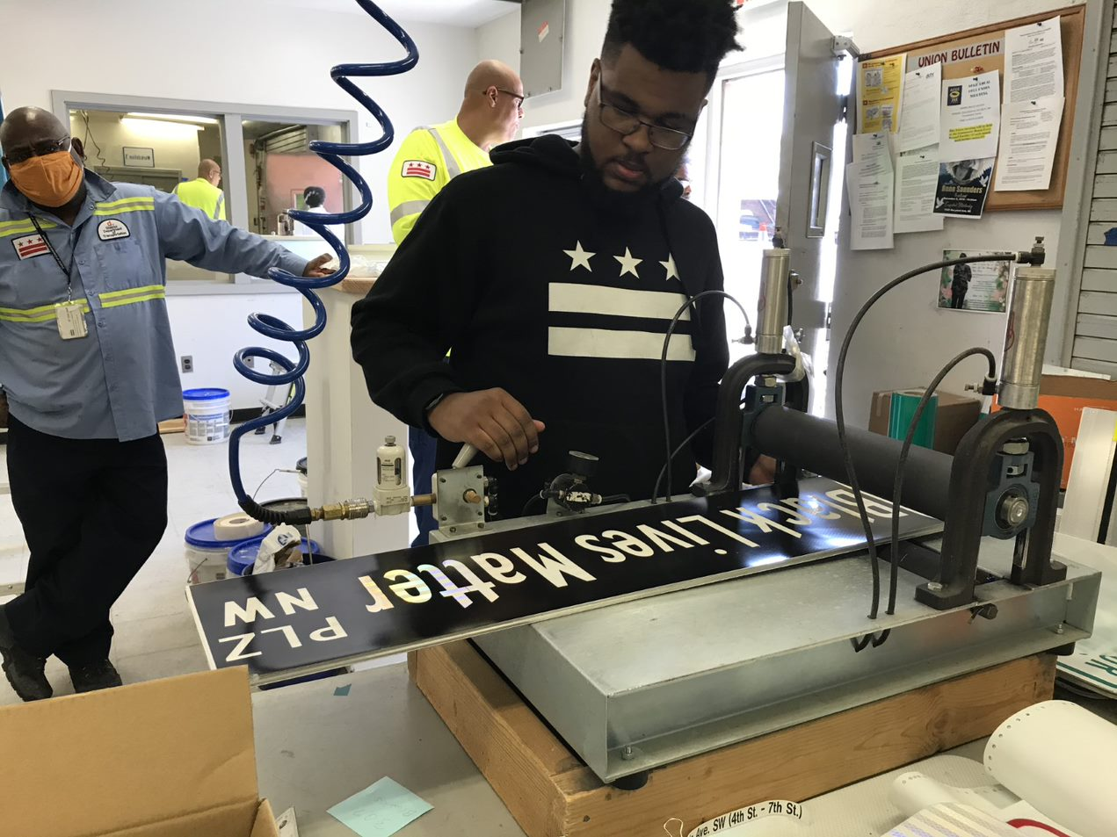
chapter seven
management & operations

Slide 33
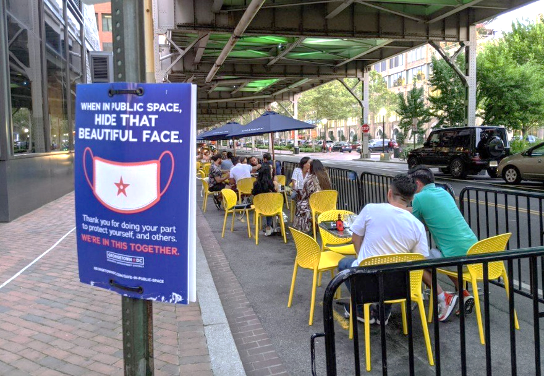
Management & Operations
Permitting
DDOT’s Public Space Regulation Division processes all permit applications for use of the District’s public spaces in the Right of Way. Application volume has steadily increased for the past several years, and is anticipated to continue to grow substantially, especially with respect to Streateries and 5G Small cell implementation in the District.
Mayor Bowser's investment of $491K will support permit and inspections capacity for DDOT; ($236K of which will be dedicated for Streateries).
District Department of Transportation FY 2022 Budget Hearing
June 10, 2021
33

Slide 34
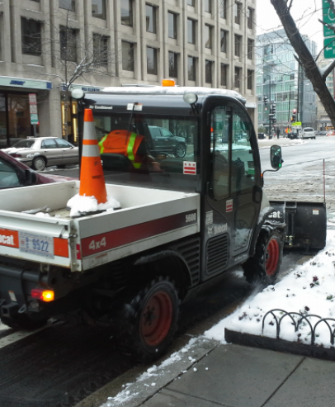
Management & Operations
Fleet & Equipment
Mayor Bowser's budget proposes a $32.6M investment in fleet and equipment over the 6-year CIP.
Investment level aligns with needs defined by OCFO's Capital Asset Replacement Scheduling System (CARSS).
New for FY 2022: $2M for Bicycle Lane maintenance equipment such as plows and sweepers.
District Department of Transportation FY 2022 Budget Hearing
June 10, 2021
34

Slide 35
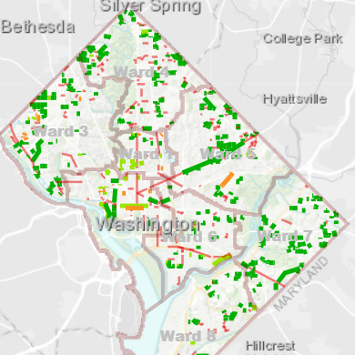
Management & Operations
Streets
Mayor Bowser's budget continues record state of good repair investments in streets.
For FY 2021, DDOT plans to repave 162 miles of streets, with 51 miles completed (see figure).
Mayor Bowser's FY 2022 budget makes a $200M investment in local streets over the 6-year CIP with a goal toward eliminating streets in poor condition by FY 2025.
Figure: Status of street resurfacing projects, as of May 30, 2021
District Department of Transportation FY 2022 Budget Hearing
June 10, 2021
35

Slide 36
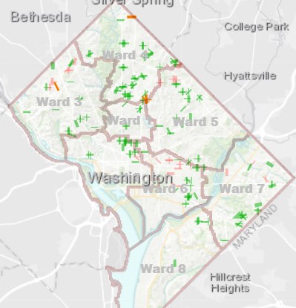
Management & Operations
Alleys
Mayor Bowser's budget continues record state of good repair investments in alleys.
For FY 2021, DDOT plans to repave 120 miles of local streets, with 86 miles completed (see figure).
Mayor Bowser's FY 2022 budget makes a $110M investment in alleys over the 6-year CIP, with a goal of eliminating alleys in poor condition by FY 2023.
New for FY 2022: $500K for a "Paper Alley" program—a community-driven initiative to construct unbuilt alleys.
Figure: Status of alley resurfacing projects, as of May 30, 2021
District Department of Transportation FY 2022 Budget Hearing
June 10, 2021
36

Slide 37
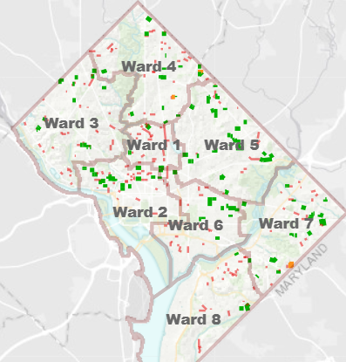
Management & Operations
Sidewalks
Mayor Bowser's budget continues record state of good repair investments in sidewalks.
For FY 2021, DDOT plans to rehabilitate 65 miles of sidewalks, with 15 miles completed (see figure).
Mayor Bowser's FY 2022 budget makes a $111M investment in sidewalks over the 6-year CIP.
New for FY 2022: $2M for a "Sidewalk network expansion" program to provide for more sidewalks in targeted areas.
Figure: Status of sidewalk resurfacing projects, as of May 30, 2021
District Department of Transportation FY 2022 Budget Hearing
June 10, 2021
37

Slide 38
Thank you, and please be safe

